Slide 1
STREAMS & STRING

Slide 2
STREAMS

Slide 3
Streams
Streams
Sequences of characters organized into lines
Each line consists of zero or more characters and ends with newline character
ANSI C must support lines of at least 254 characters
Performs all input and output
Can often be redirected
Standard input – keyboard
Standard output – screen
Standard error – screen

Slide 4
Formatting Output with printf
Precise output formatting
Conversion specifications: flags, field widths, precisions, and literal characters.
Can perform rounding, aligning columns, right/left justification, inserting literal characters, exponential format, hexadecimal format, and fixed width and precision
Format:
printf( format-control-string, other-arguments );
Format control string: describes output format
Other-arguments: correspond to each conversion specification in format-control-string
Each specification begins with a percent sign(%), ends with conversion specifier

Slide 5
Formatting capabilities of printf:
Rounding floating-point values to an indicated number of decimal places.
Aligning a column of numbers with decimal points appearing one above the other.
Right justification and left justification of outputs.
Inserting literal characters at precise locations in a line of output.
Representing floating-point numbers in exponential format.
Representing unsigned integers in octal and hexadecimal format.
Displaying all types of data with fixed-size field widths and precisions.

Slide 6
Integer Conversion Specifiers

Slide 7
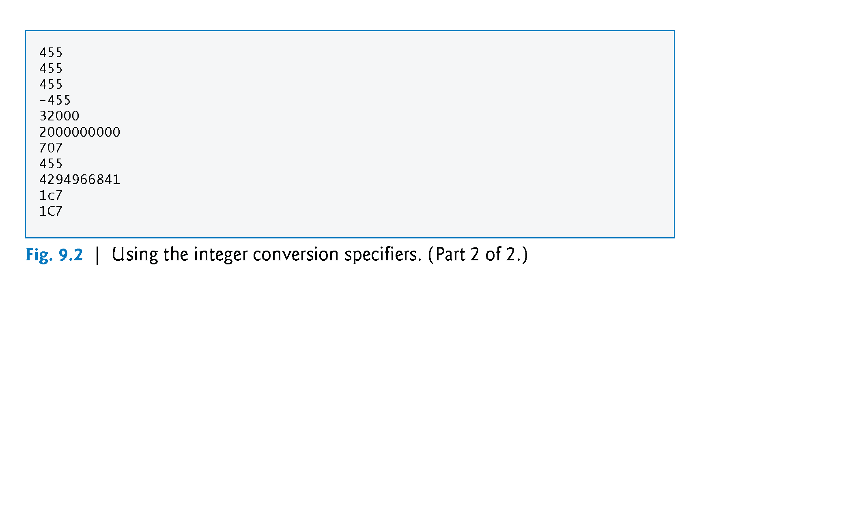
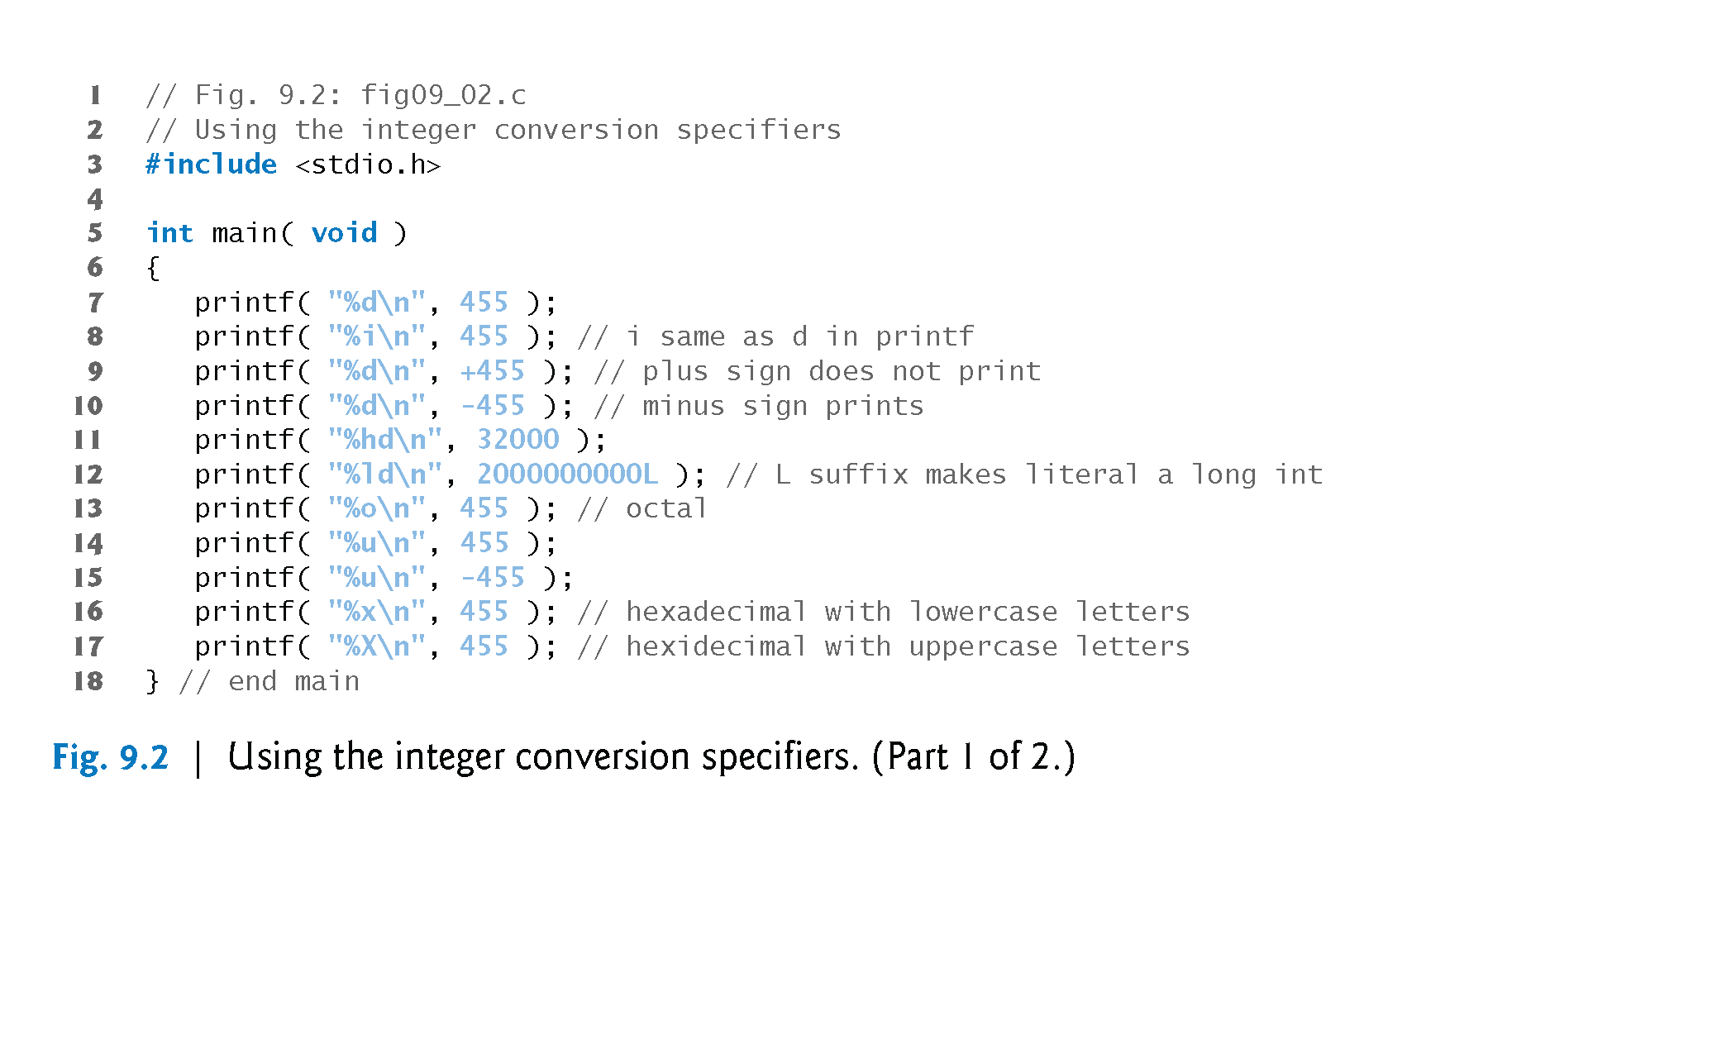

Slide 8
Printing Integers
Integer
Whole number (no decimal point): 25, 0, -9
Positive, negative, or zero
Only minus sign prints by default (later we shall change this)

Slide 9
Printing Floating-Point Numbers
Floating Point Numbers
Have a decimal point (33.5)
Exponential notation (computer's version of scientific notation)
150.3 is 1.503 x 10² in scientific
150.3 is 1.503E+02 in exponential (E stands for exponent)
use e or E
f – print floating point with at least one digit to left of decimal
g (or G) - prints in f or e with no trailing zeros (1.2300 becomes 1.23)
Use exponential if exponent less than -4, or greater than or equal to precision (6 digits by default)

Slide 10
Printing Floating-Point Numbers

Slide 11
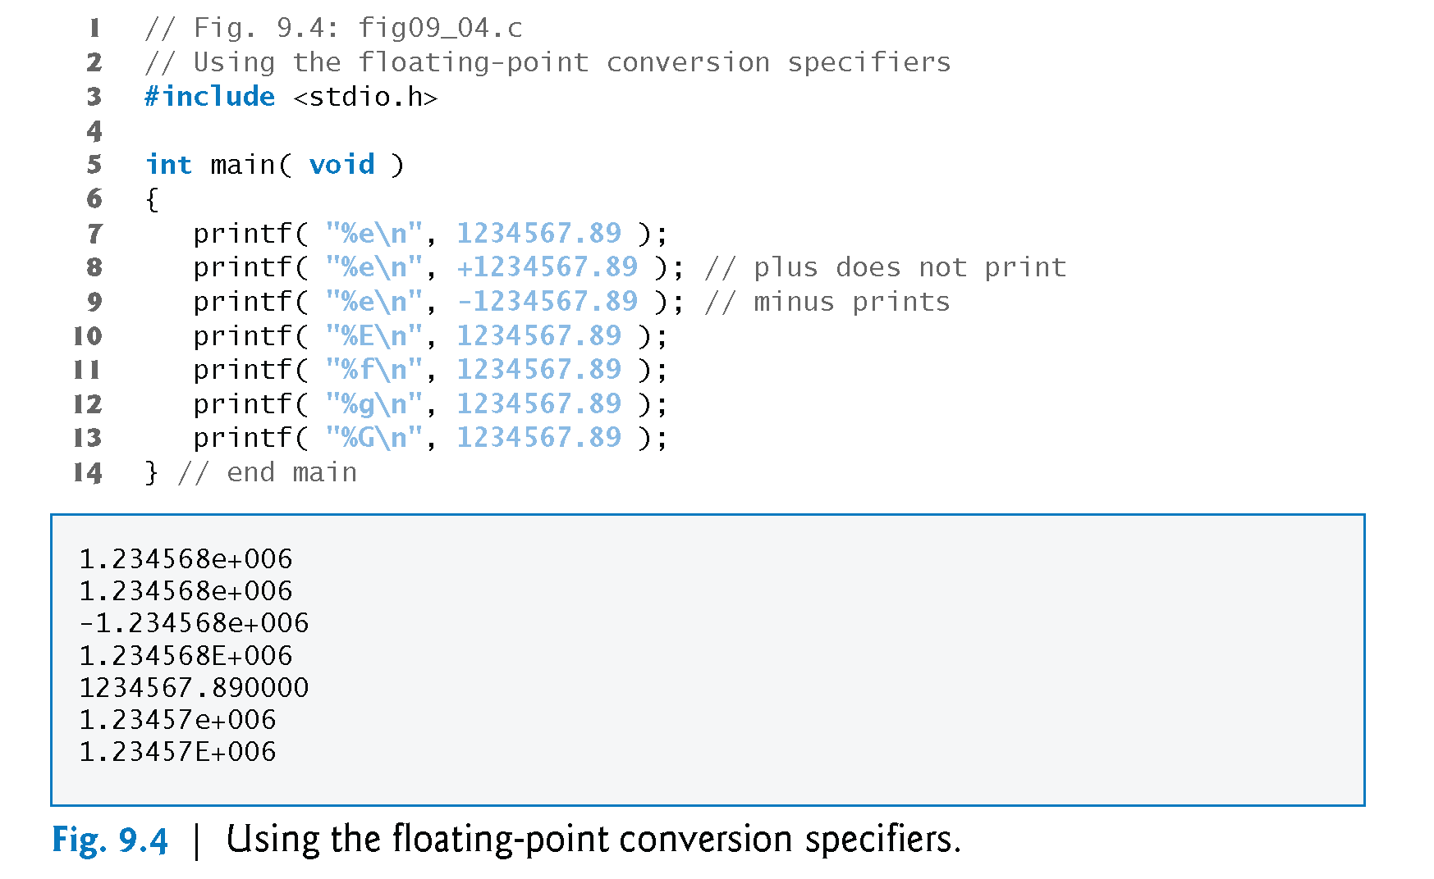

Slide 12
Printing Strings and Characters
c
Prints char argument
Cannot be used to print the first character of a string
s
Requires a pointer to char as an argument
Prints characters until NULL ('\0') encountered
Cannot print a char argument
Remember
Single quotes for character constants ('z')
Double quotes for strings "z" (which actually contains two characters, 'z' and '\0')

Slide 13
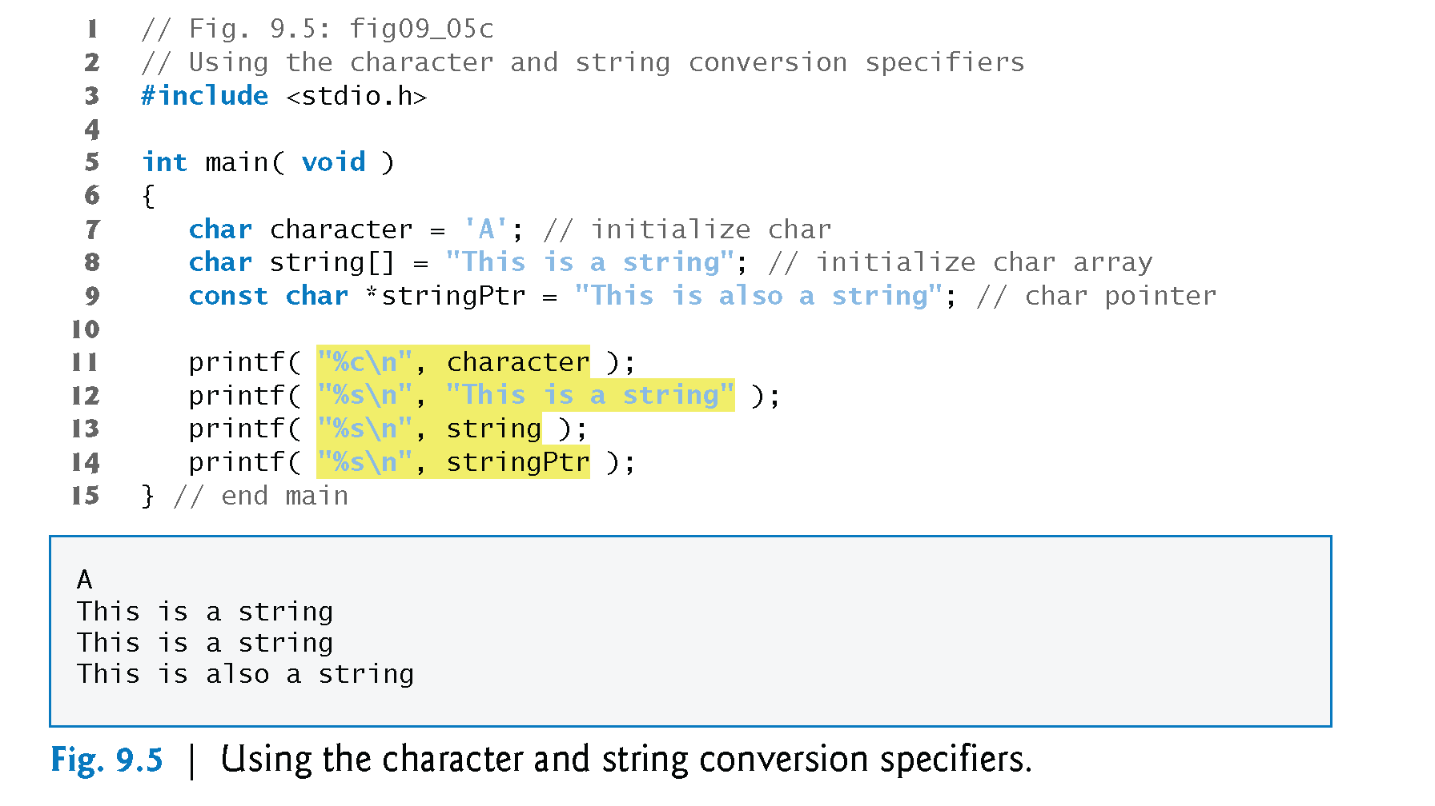

Slide 14
Other Conversion Specifiers
p
Displays pointer value (address)
%
Prints a percent sign
%%

Slide 15
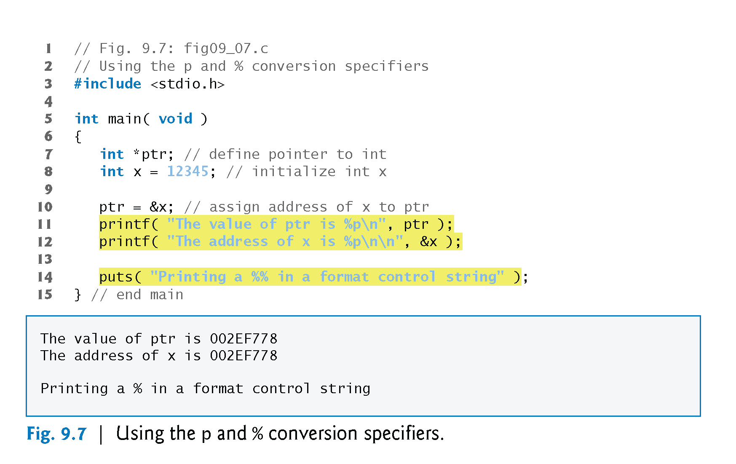

Slide 16
Printing with Field Widths and Precisions
Field width
Size of field in which data is printed
If width larger than data, default right justified
If field width too small, increases to fit data
Minus sign uses one character position in field
Integer width inserted between % and conversion specifier
%4d – field width of 4

Slide 17
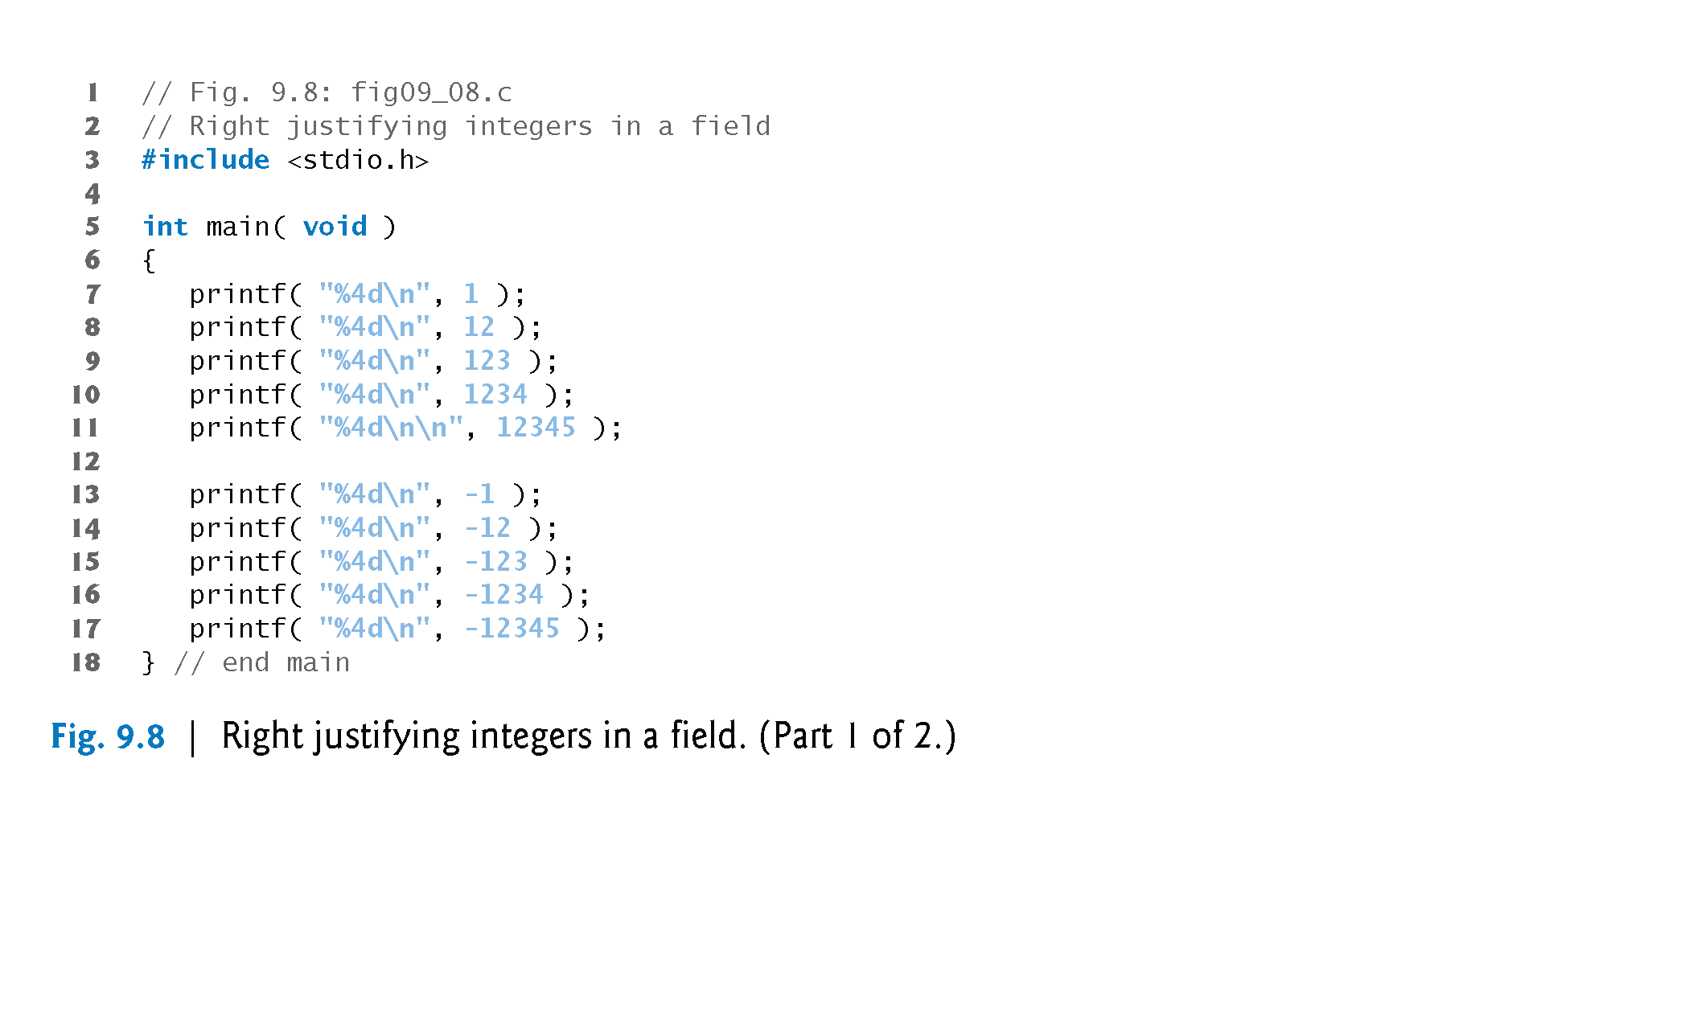
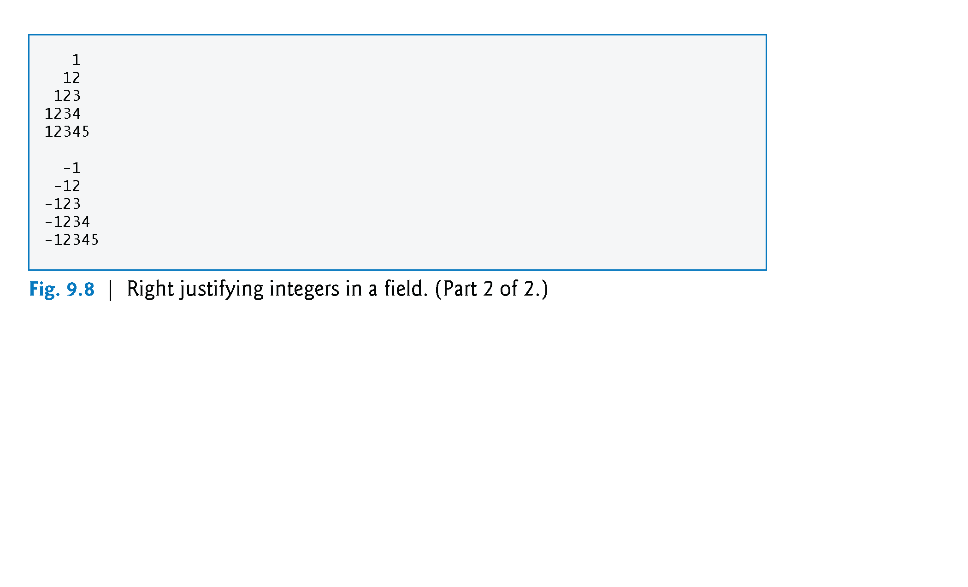

Slide 18
Printing with Field Widths and Precisions
Precision
Meaning varies depending on data type
Integers (default 1)
Minimum number of digits to print
If data too small, prefixed with zeros
Floating point
Number of digits to appear after decimal (e and f)
For g – maximum number of significant digits
Strings
Maximum number of characters to be written from string
Format
Use a dot (.) then precision number after %
%.3f

Slide 19
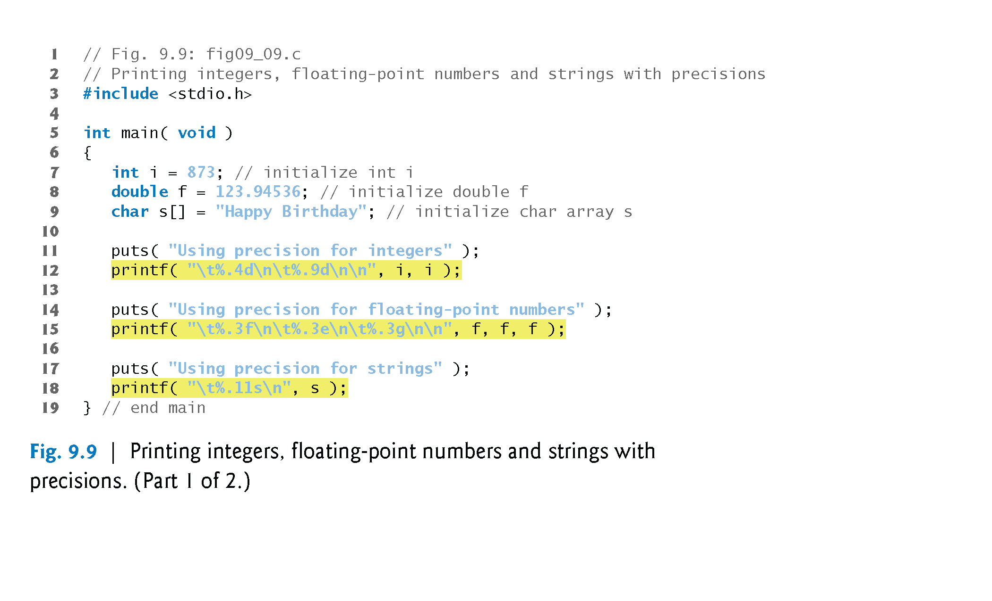
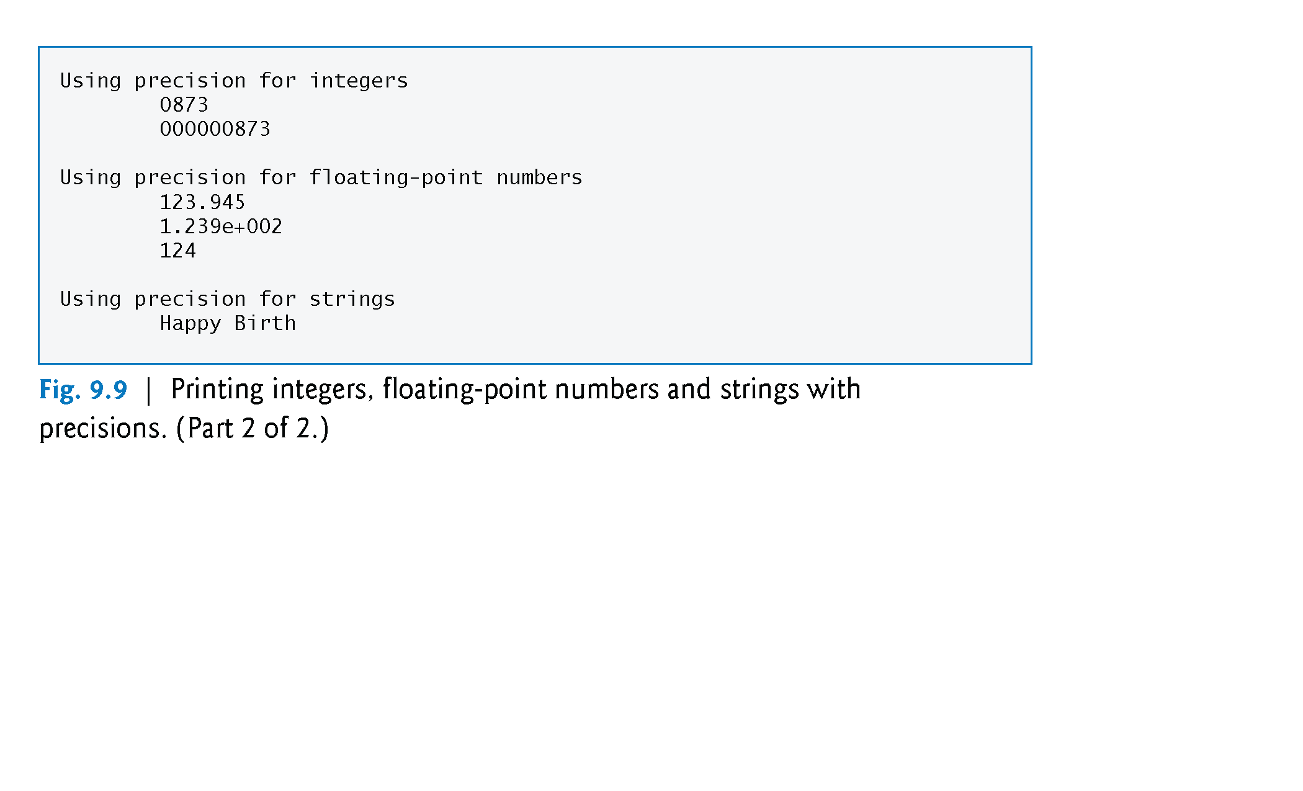

Slide 20
Printing with Field Widths and Precisions
Field width and precision
Can both be specified
%width.precision
Example:
printf( "%9.3f", 123.456789 ); //displaying 123.457
Negative field width – left justified
Positive field width – right justified
Precision must be positive
Can use integer expressions to determine field width and precision values
Place an asterisk (*) in place of the field width or precision
Matched to an int argument in argument list
Example:
printf( "%*.*f", 7, 2, 98.736 ); //displaying 98.74

Slide 21
Using Flags in the printf Format-Control String
Flags
Supplement formatting capabilities
Place flag immediately to the right of percent sign
Several flags may be combined

Slide 22
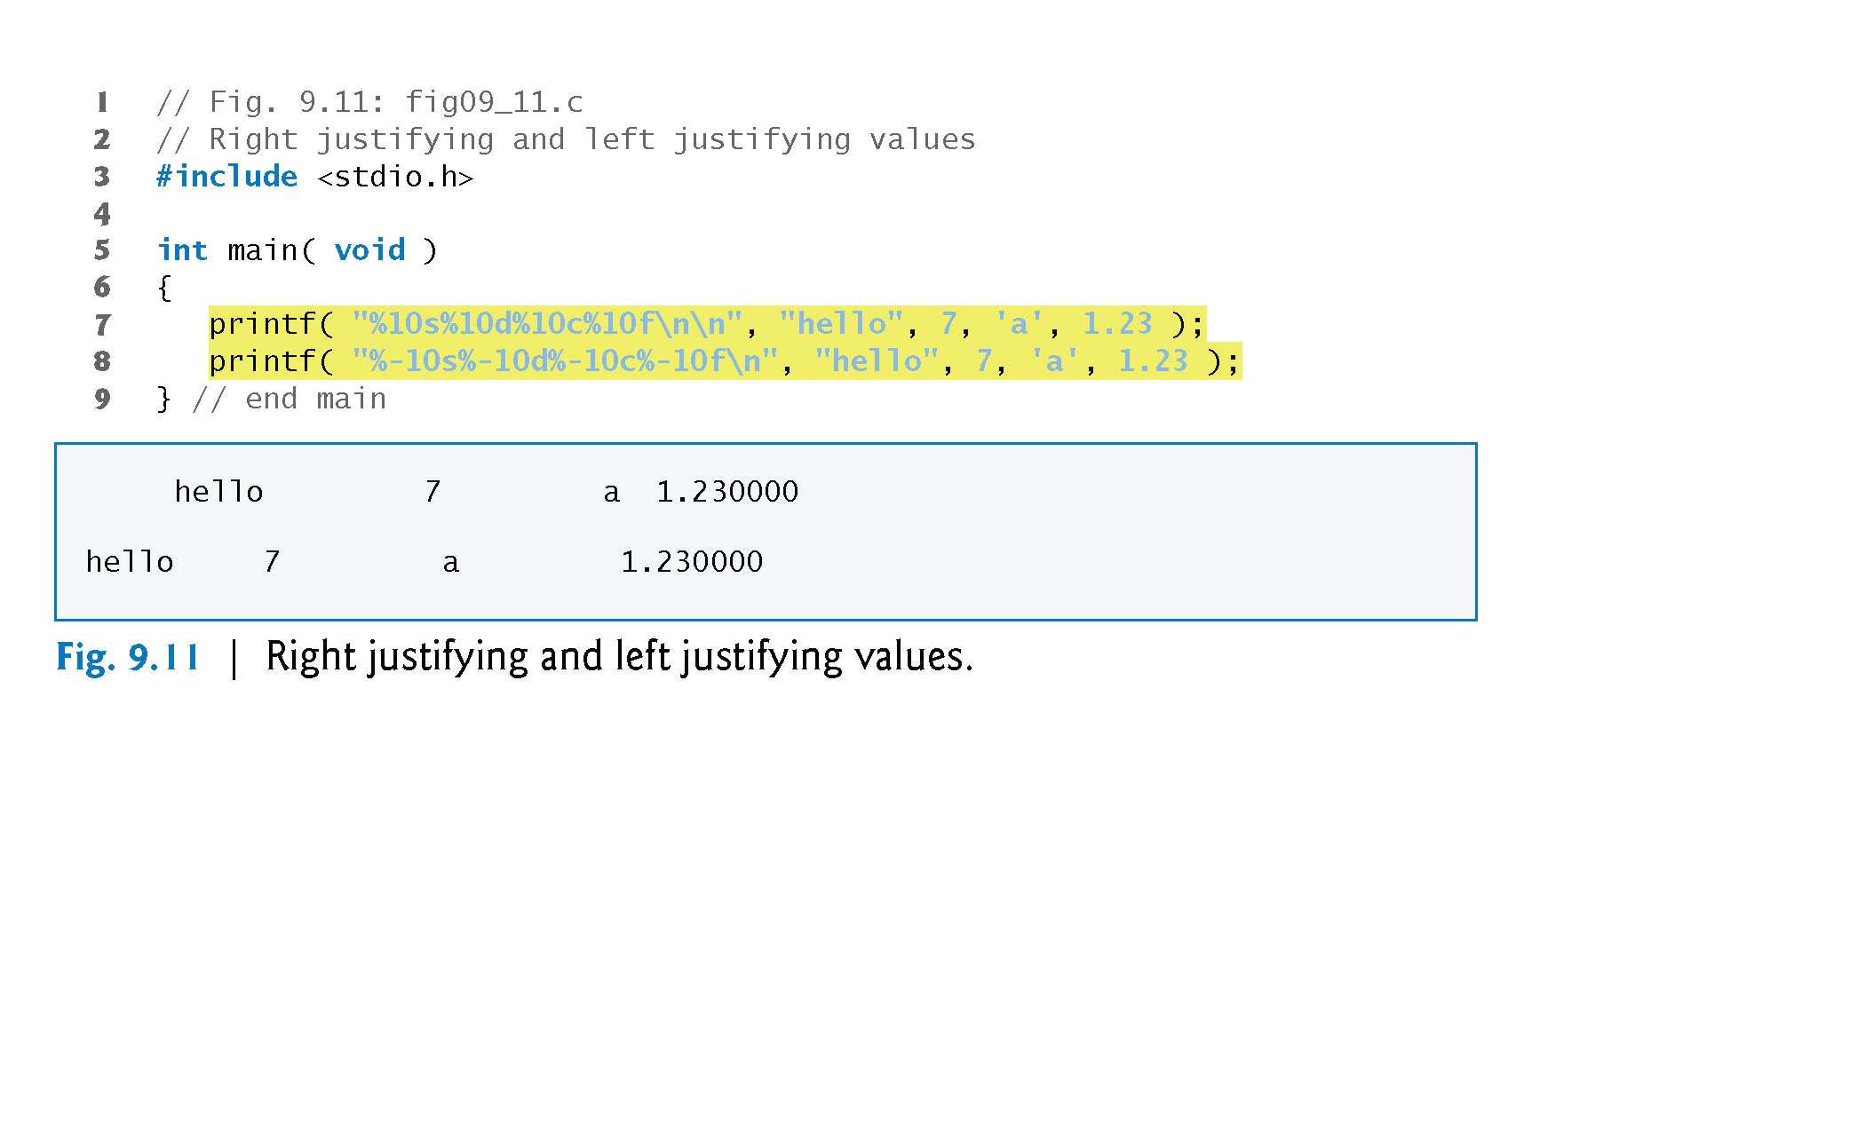

Slide 23
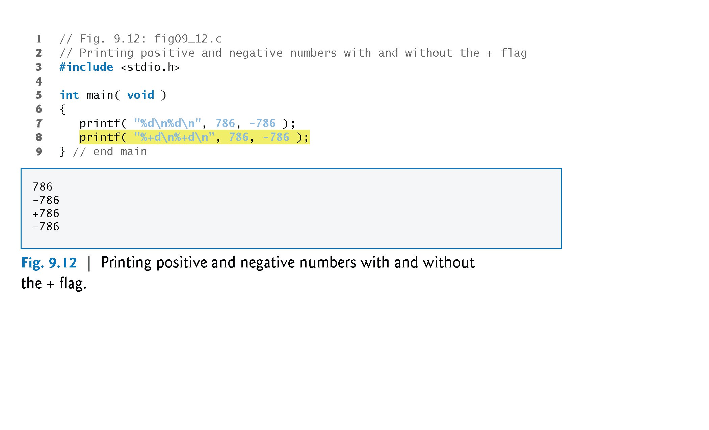

Slide 24
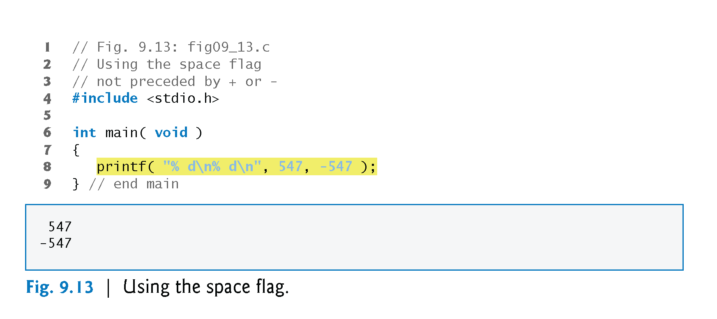

Slide 25
Printing Literals and Escape Sequences
Printing Literals
Most characters can be printed
Certain "problem" characters, such as the quotation mark "
Must be represented by escape sequences
Represented by a backslash \ followed by an escape character

Slide 26
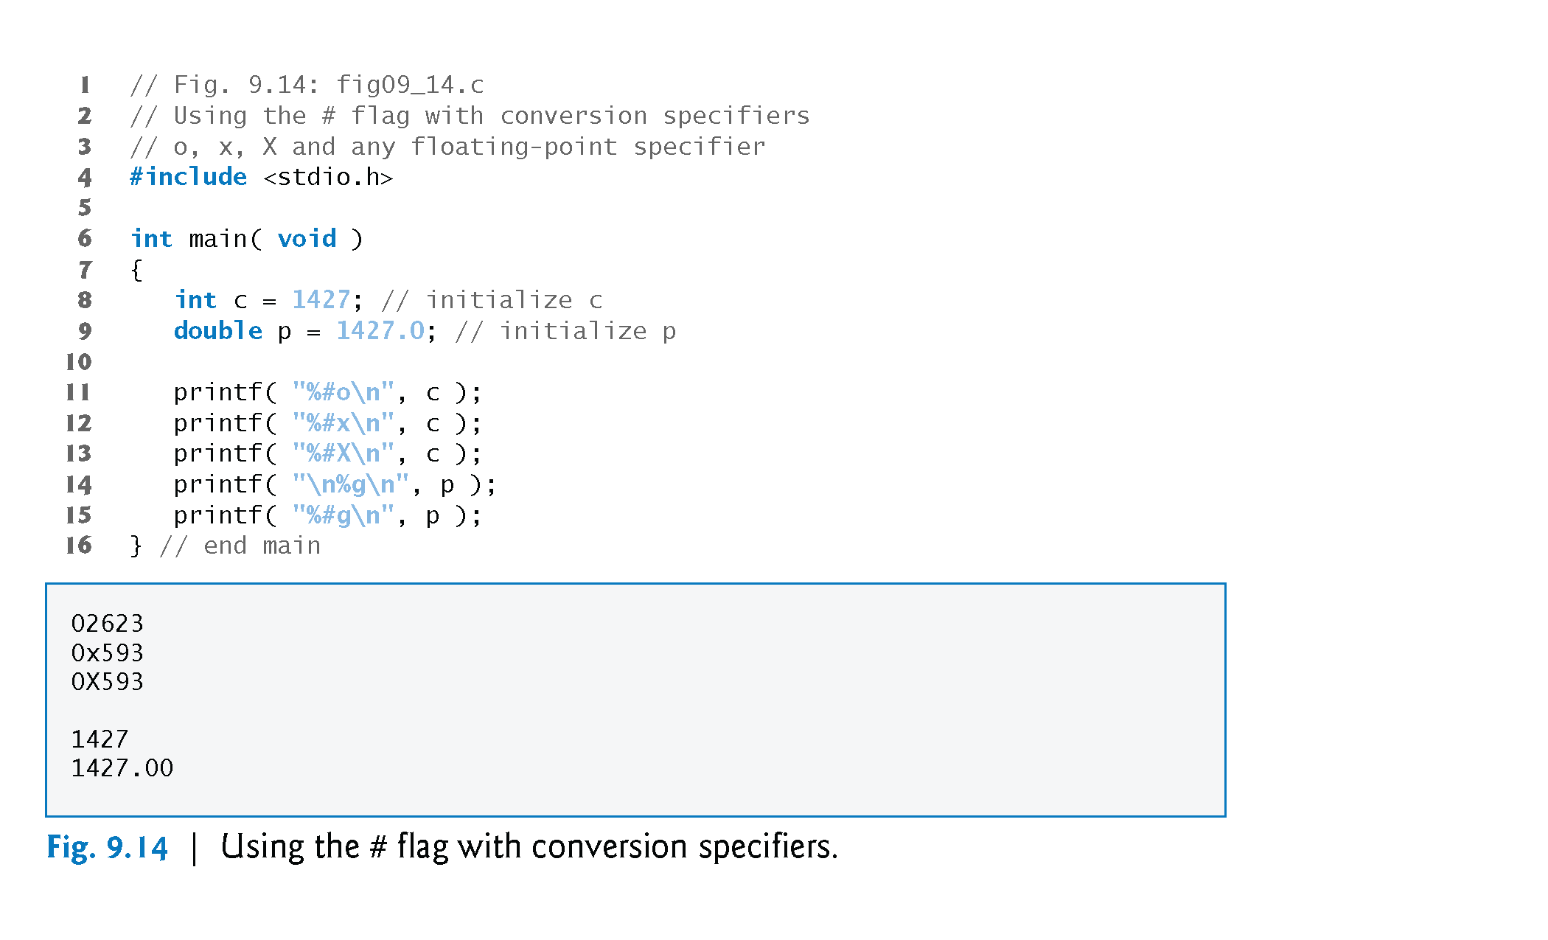

Slide 27
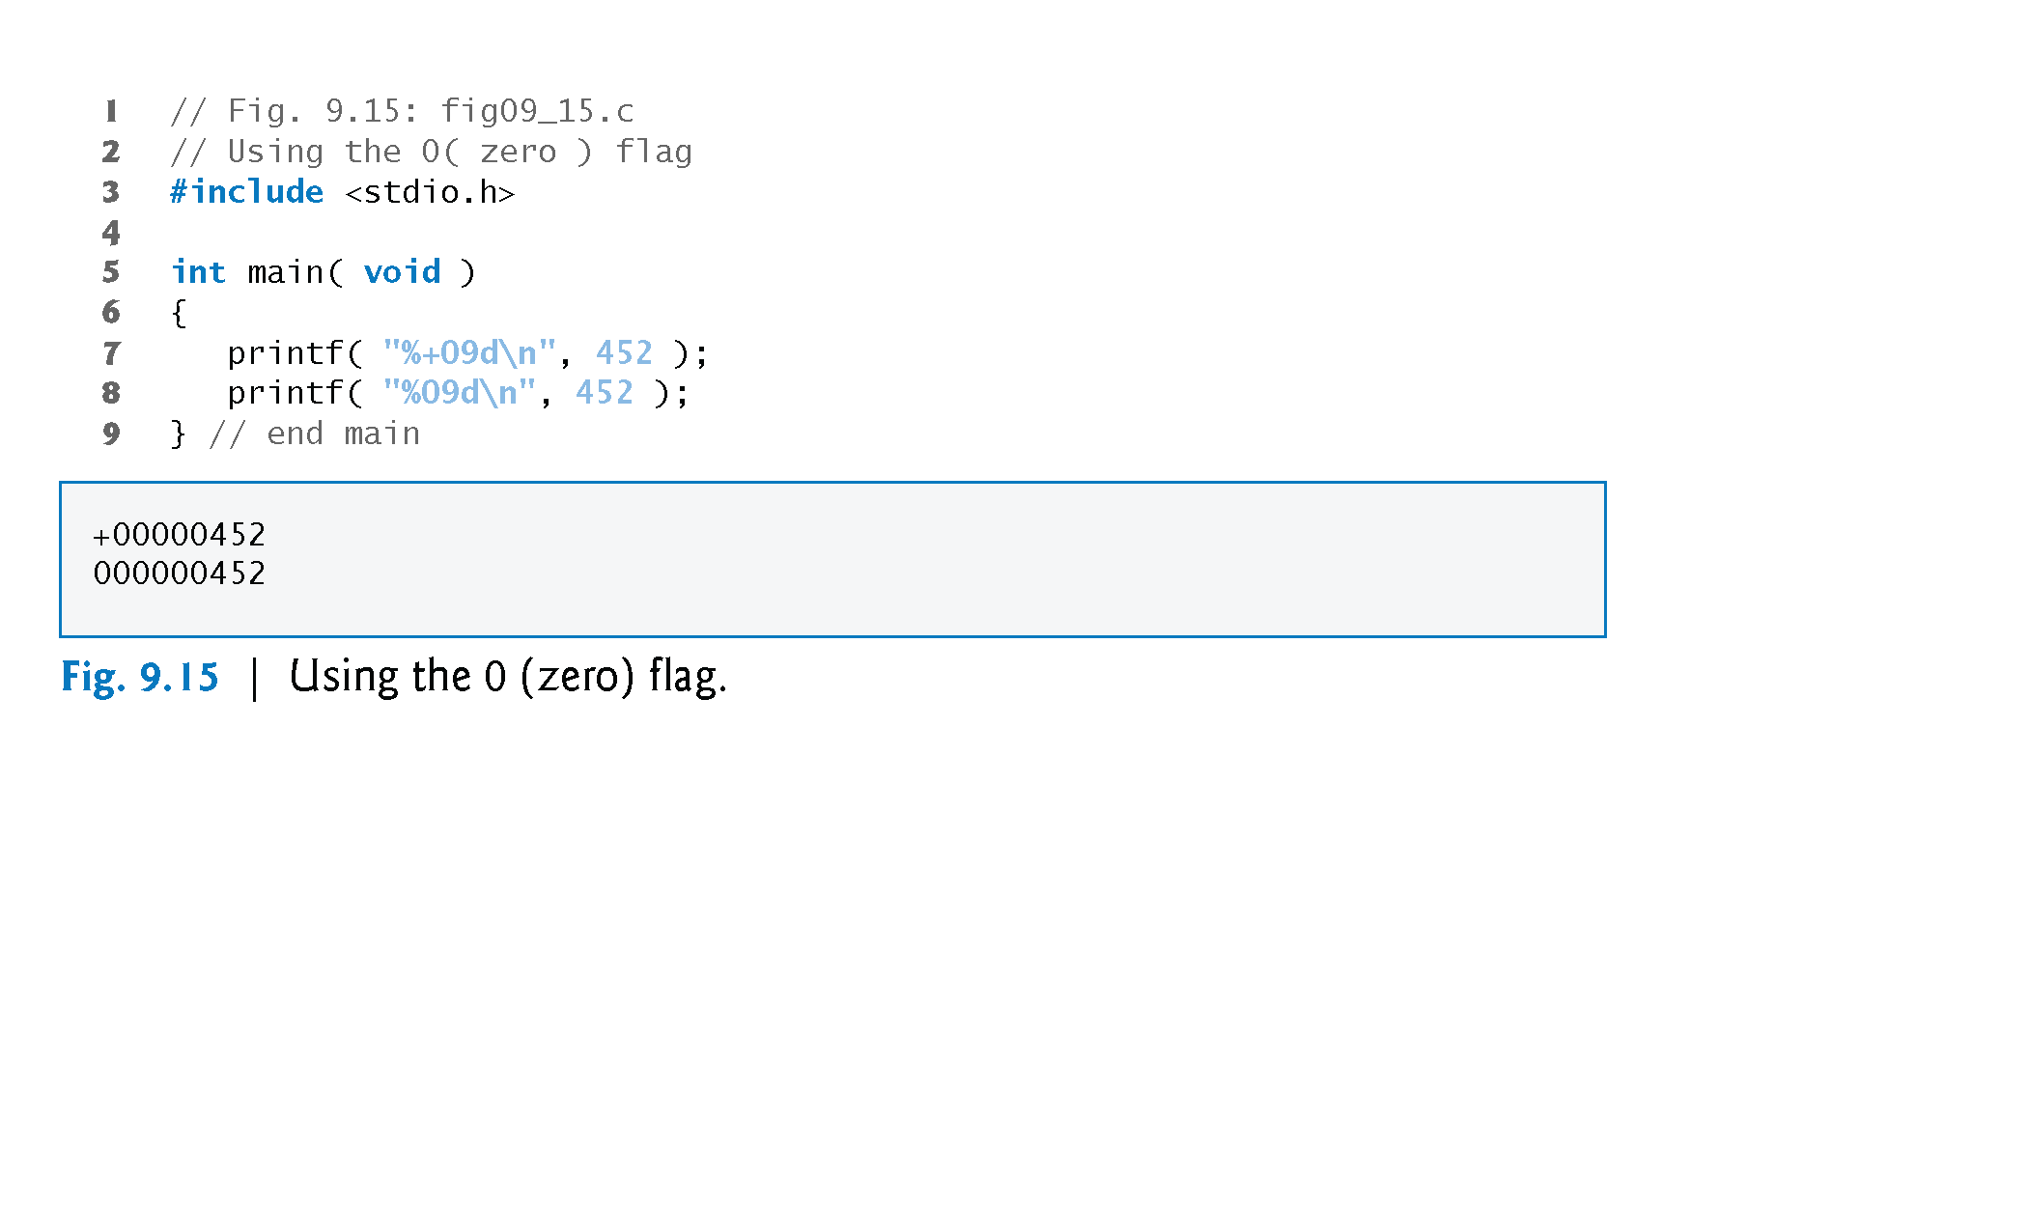

Slide 28
Printing Literals and Escape Sequences

Slide 29
9.11 Reading Formatted Input with scanf
Precise input formatting can be accomplished with scanf.
Every scanf statement contains a format control string that describes the format of the data to be input.
The format control string consists of conversion specifiers and literal characters.
Function scanf has the following input formatting capabilities:
Inputting all types of data.
Inputting specific characters from an input stream.
Skipping specific characters in the input stream.

Slide 30
Formatting Input with scanf

Slide 31
Formatting Input with scanf

Slide 32
Formatting Input with scanf
Scan sets
Set of characters enclosed in square brackets []
Preceded by % sign
Scans input stream, looking only for characters in scan set
Whenever a match occurs, stores character in specified array
Stops scanning once a character not in the scan set is found
Inverted scan sets
Use a caret ^: [^aeiou]
Causes characters not in the scan set to be stored
Skipping characters
Include character to skip in format control
Or, use * (assignment suppression character)
Skips any type of character without storing it

Slide 33
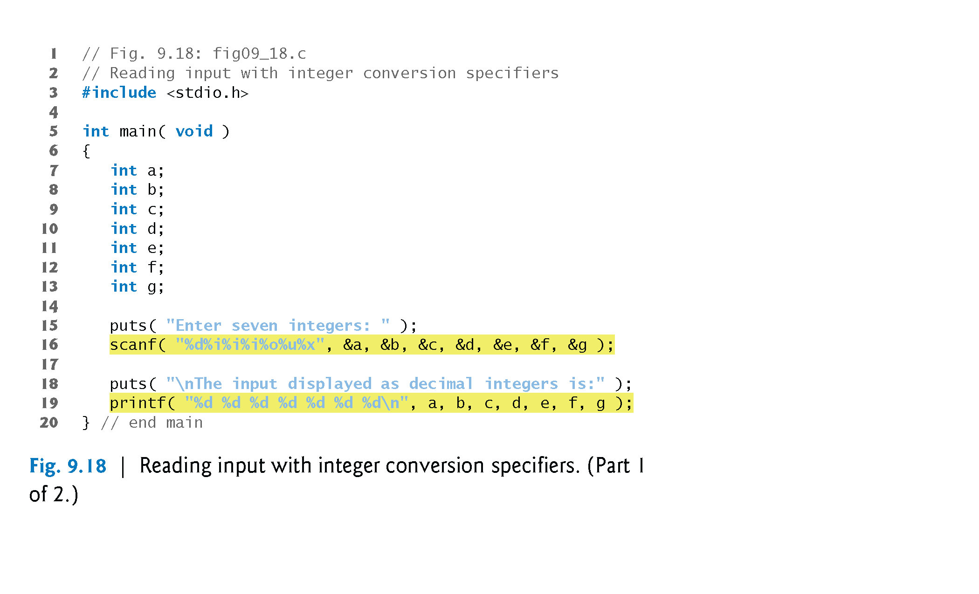
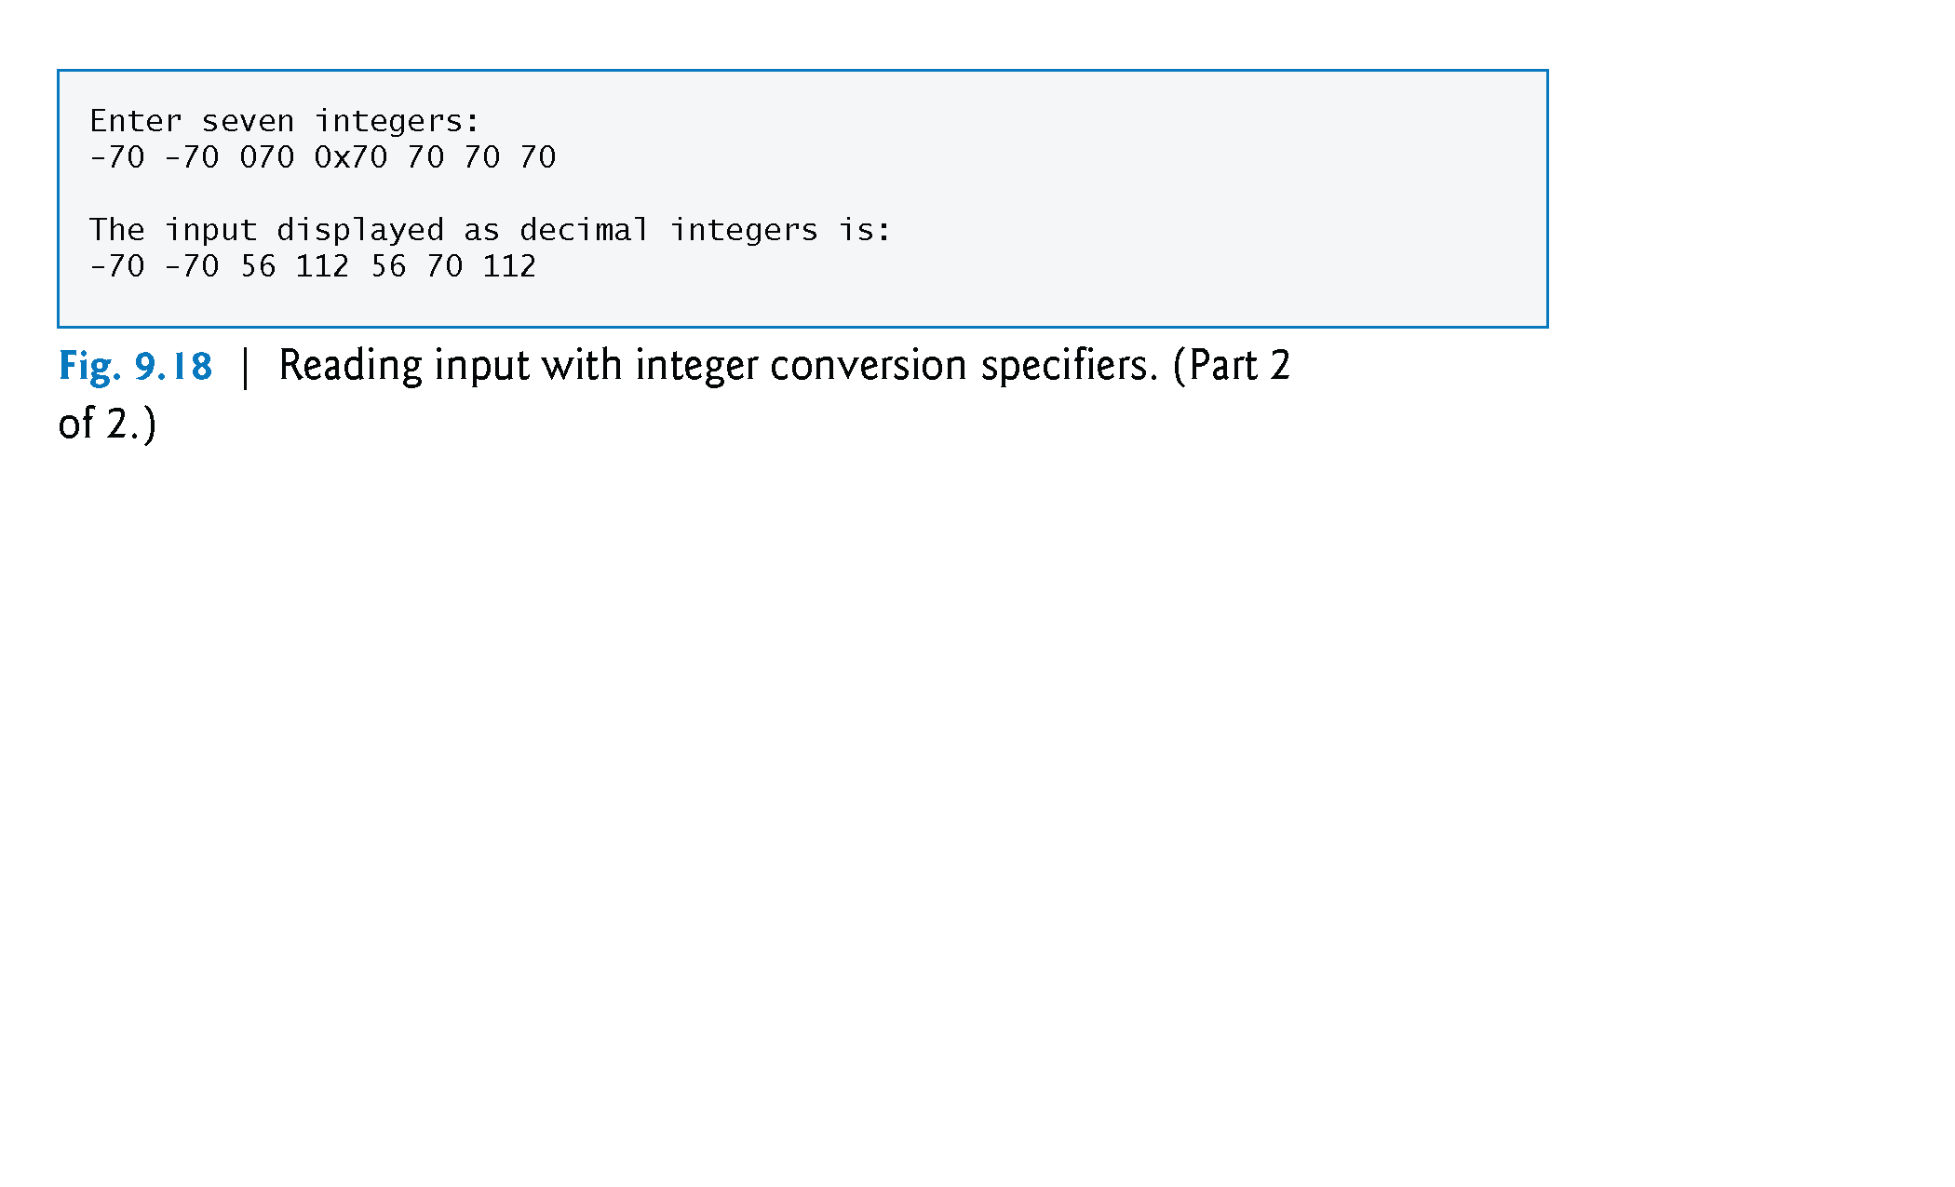

Slide 34
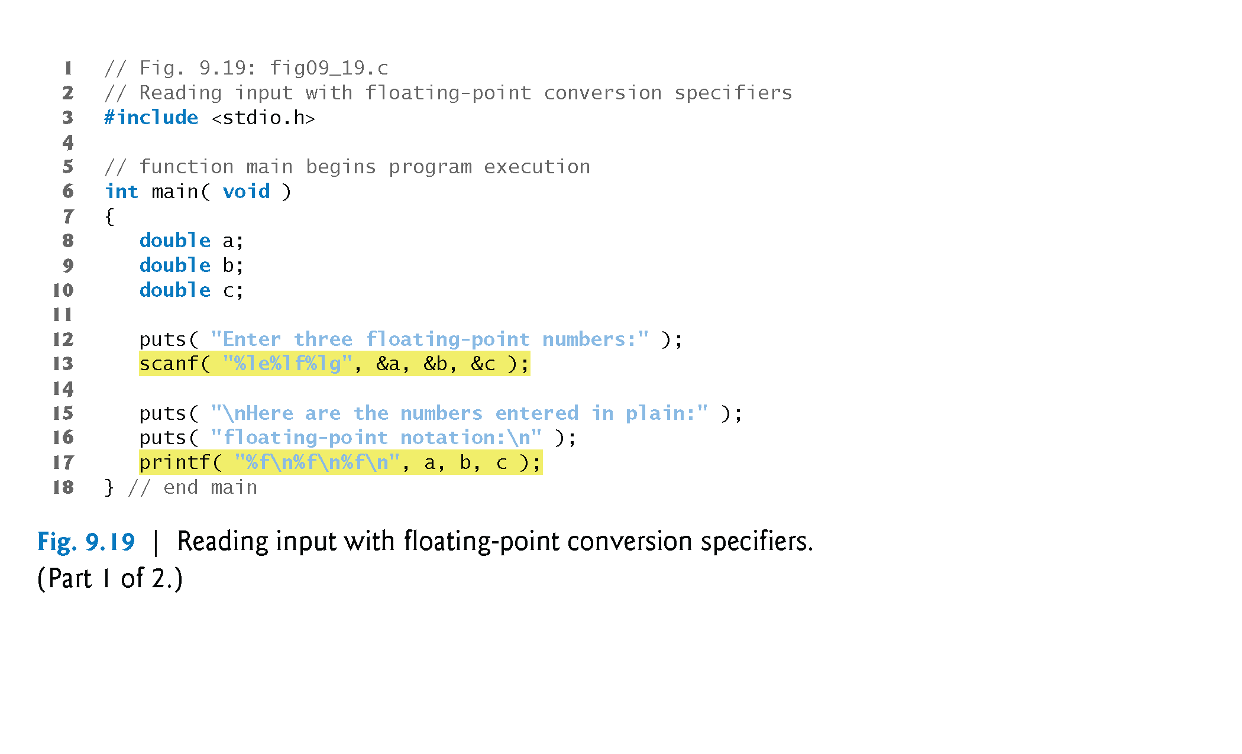
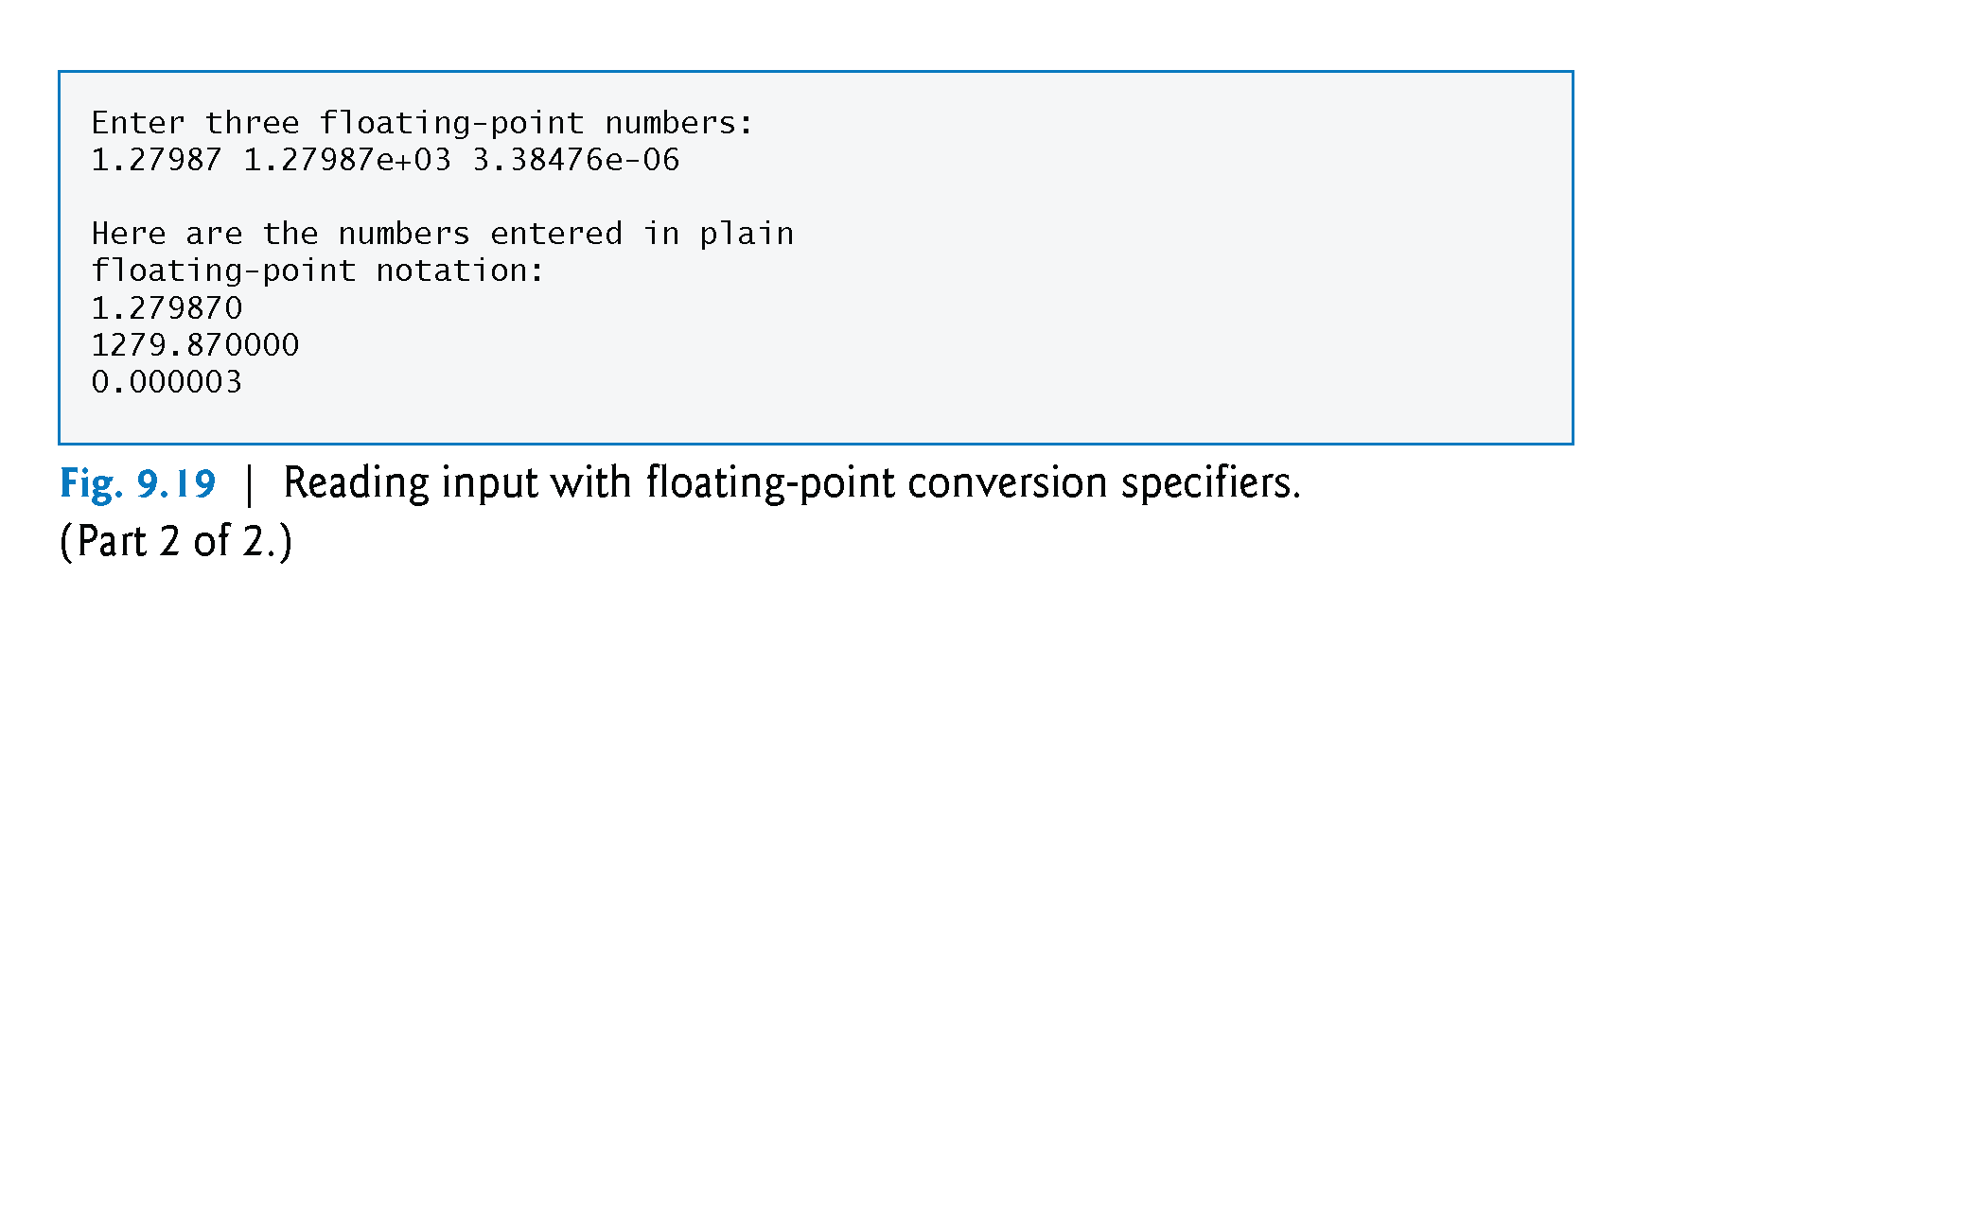

Slide 35
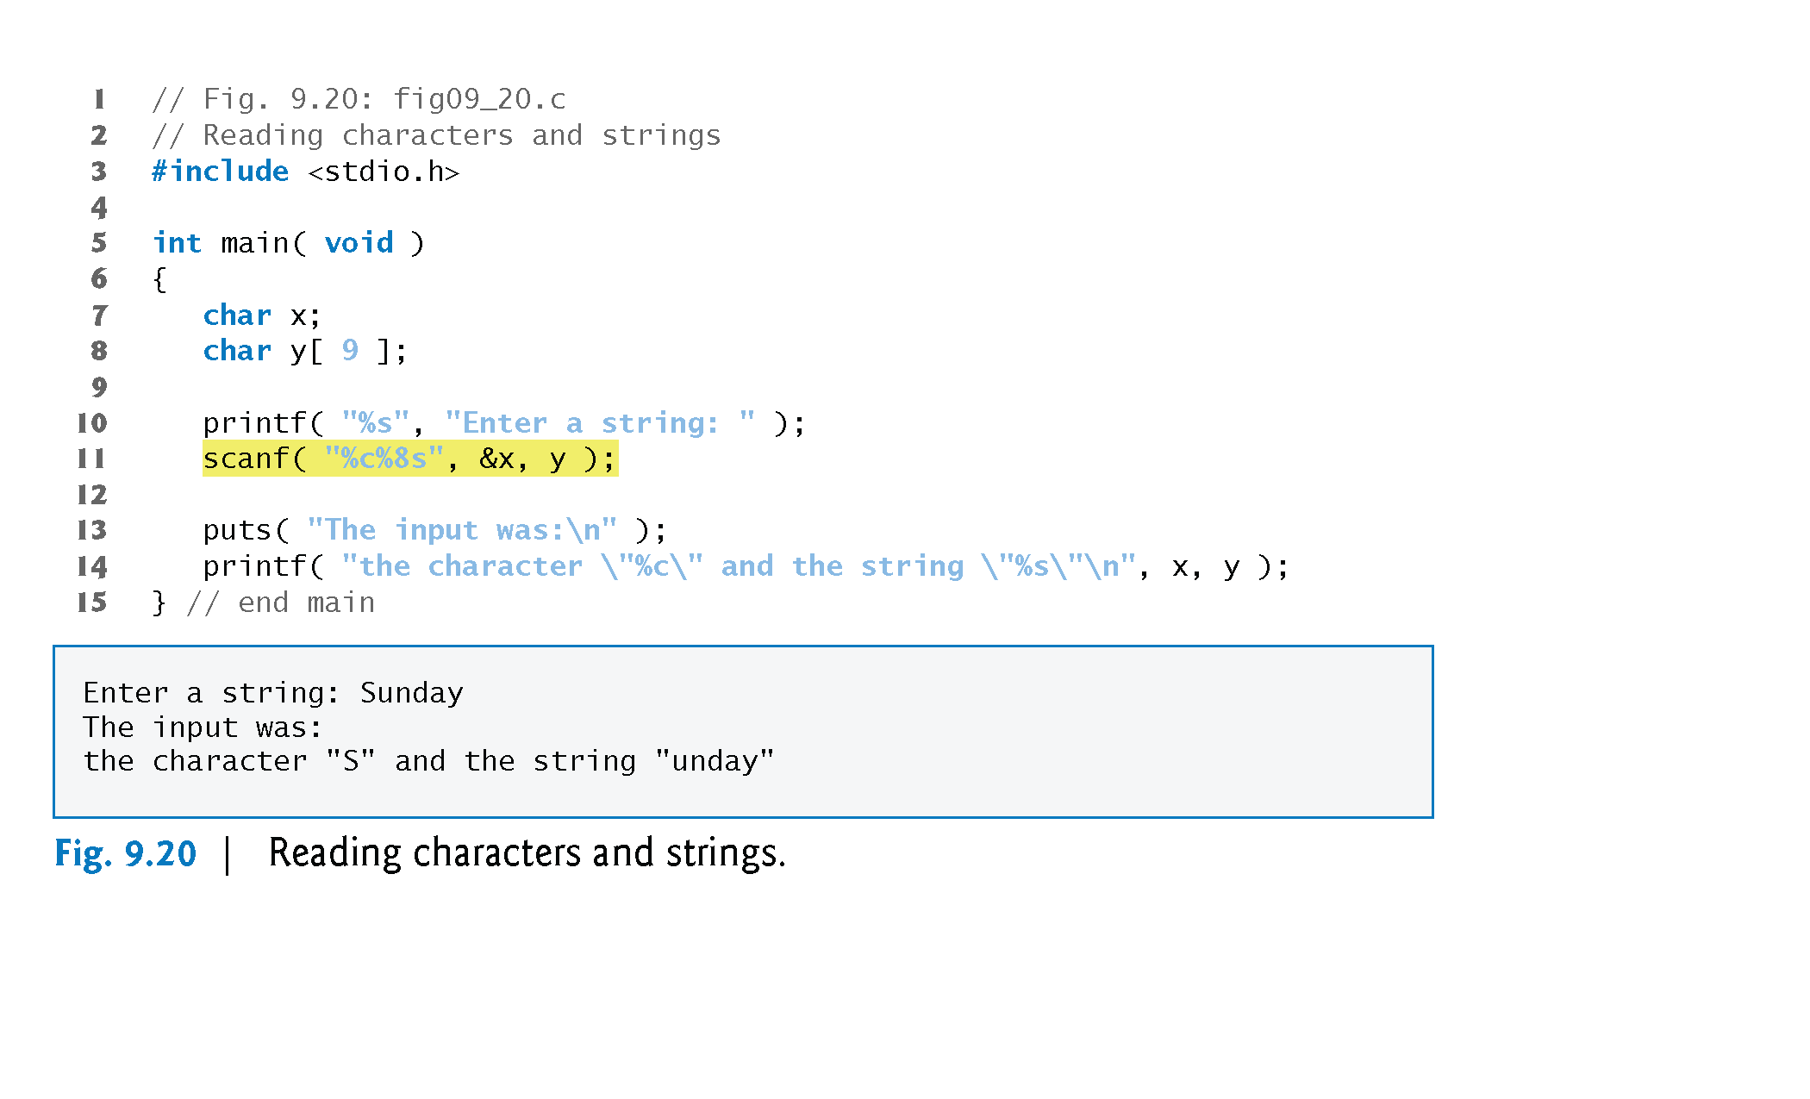

Slide 36
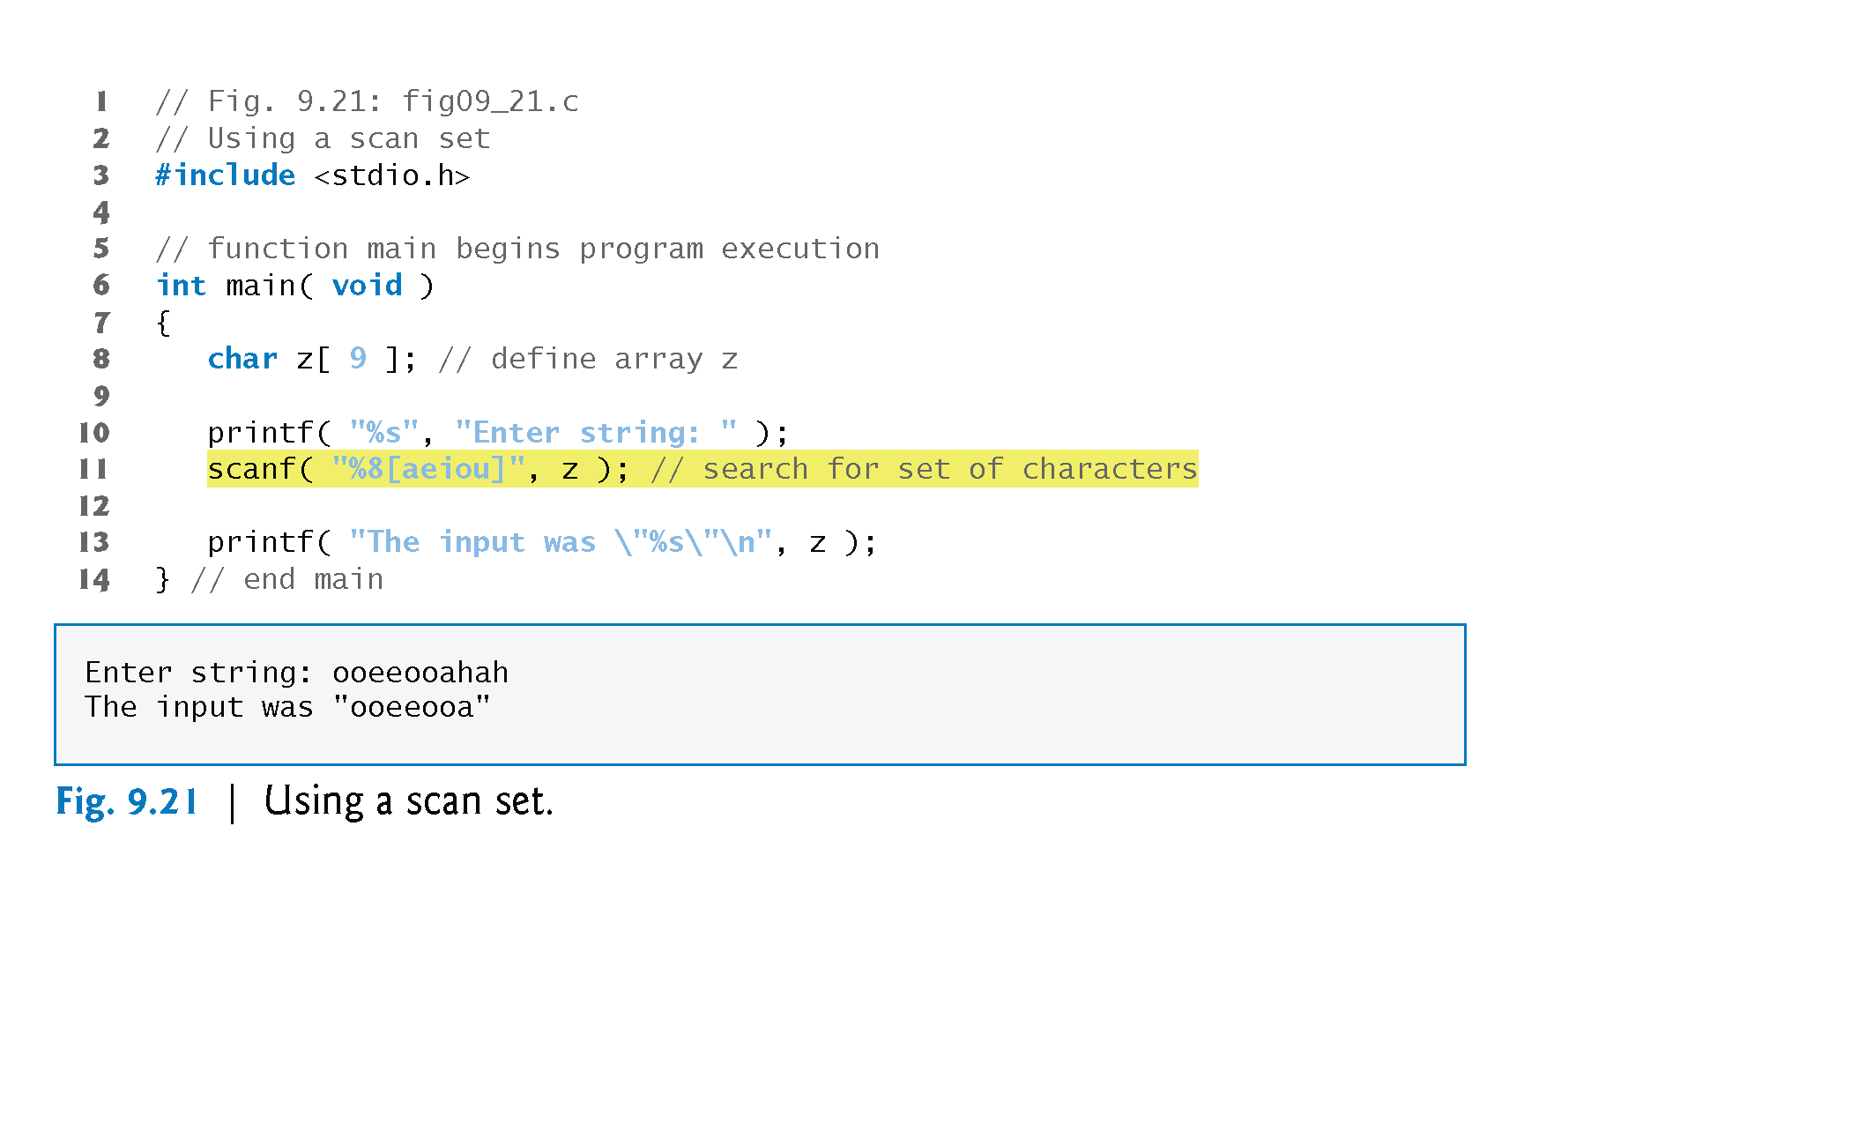

Slide 37
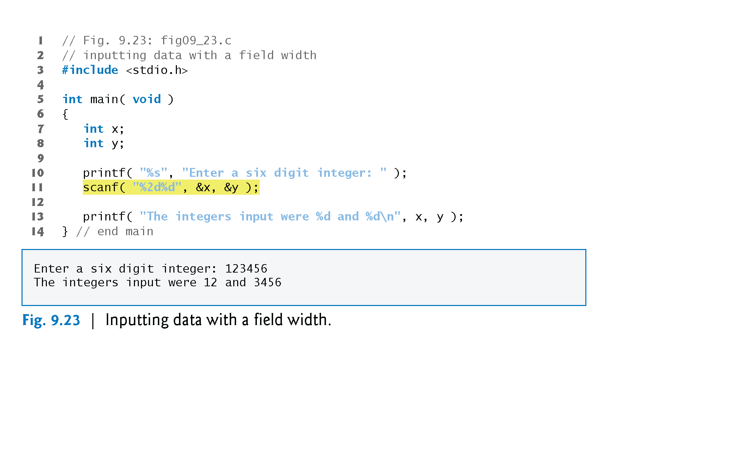

Slide 38
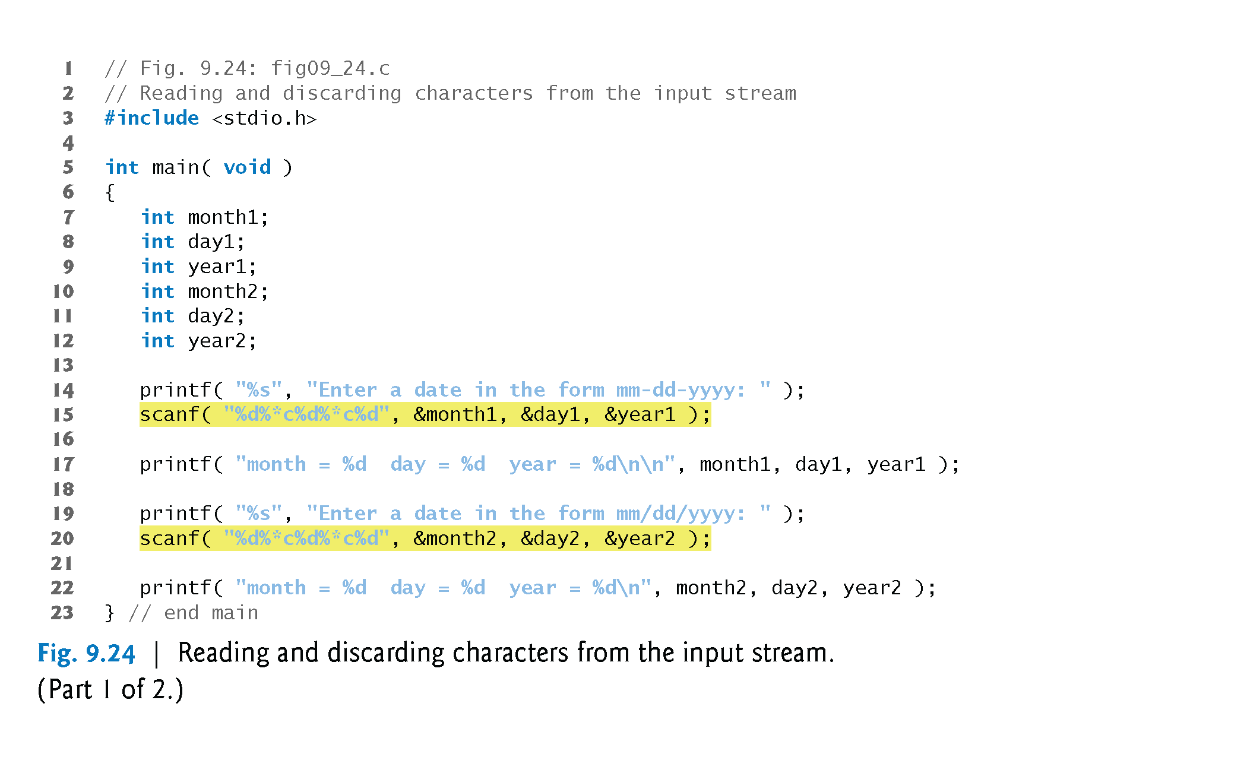
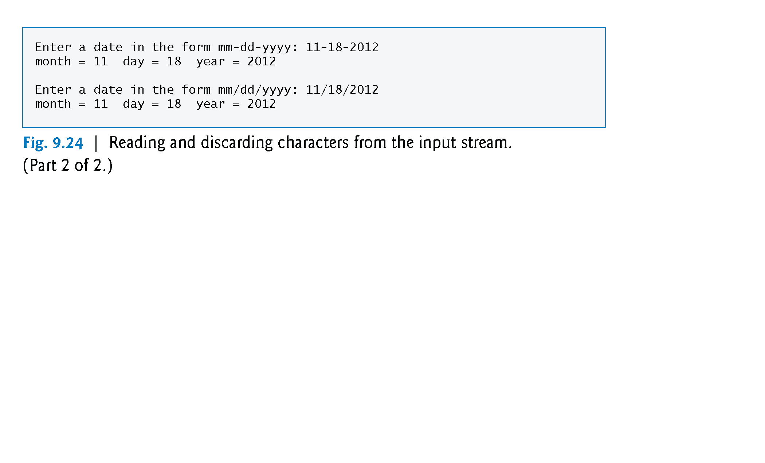

Slide 40
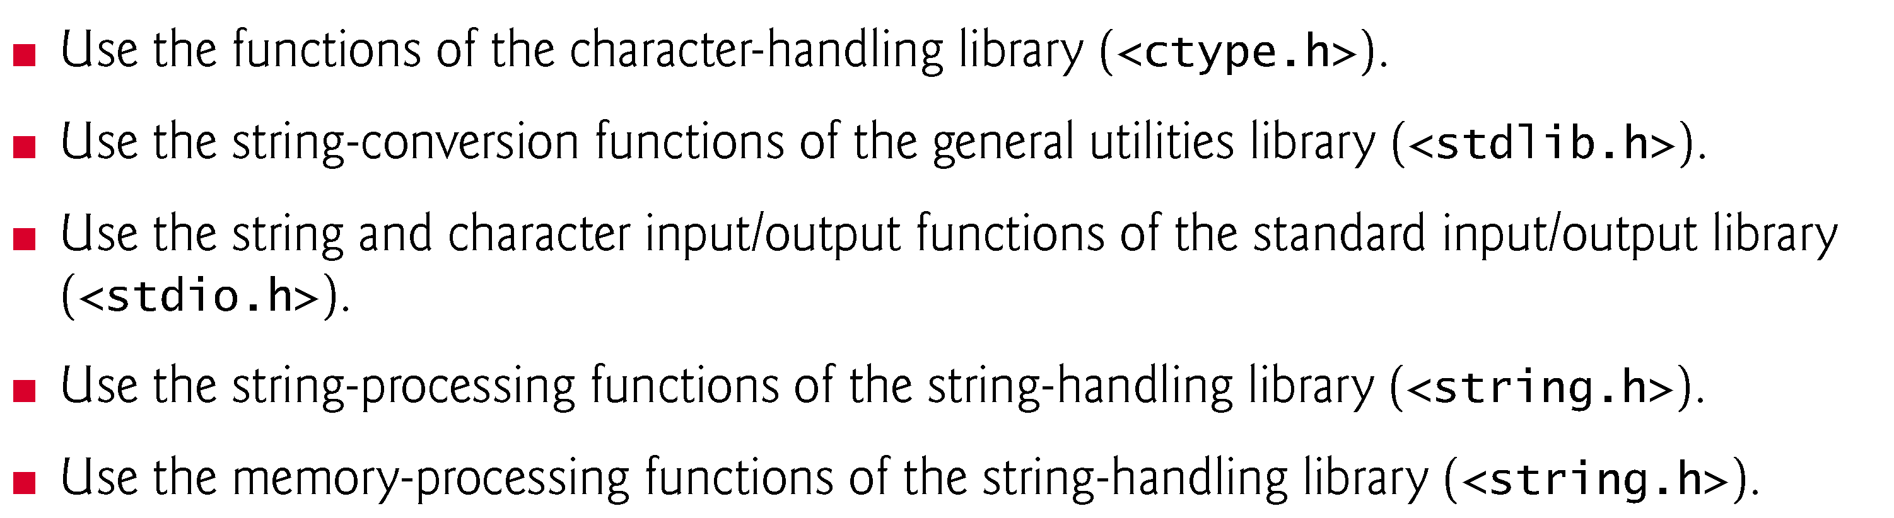
STRING

Slide 41
8.2 Fundamentals of Strings and Characters
Characters are the fundamental building blocks of source programs.
Every program is composed of a sequence of characters that—when grouped together meaningfully—is interpreted by the computer as a series of instructions used to accomplish a task.
A program may contain character constants.
A character constant is an int value represented as a character in single quotes.
The value of a character constant is the integer value of the character in the machine’s character set.

Slide 42
8.2 Fundamentals of Strings and Characters (Cont.)
For example, 'z' represents the integer value of z, and '\n' the integer value of newline (122 and 10 in ASCII, respectively).
A string is a series of characters treated as a single unit.
A string may include letters, digits and various special characters such as +, -, *, / and $.
String literals, or string constants, in C are written in double quotation marks.

Slide 43
Fundamentals of Strings and Characters (Cont.)
A string in C is an array of characters ending in the null character ('\0').
A string is accessed via a pointer to the first character in the string.
The value of a string is the address of its first character.
Thus, in C, it’s appropriate to say that a string is a pointer—in fact, a pointer to the string’s first character.
In this sense, strings are like arrays, because an array is also a pointer to its first element.
A character array or a variable of type char * can be initialized with a string in a definition.

Slide 44
Fundamentals of Strings and Characters (Cont.)
The definitions
char color[] = "blue"; const char *colorPtr = "blue";
each initialize a variable to the string "blue".
The first definition creates a 5-element array color containing the characters 'b', 'l', 'u', 'e' and '\0'.
The second definition creates pointer variable colorPtr that points to the string "blue" somewhere in memory.

Slide 45
Character Handling Library
Character handling library
Includes functions to perform useful tests and manipulations of character data
Each function receives a character (an int) or EOF as an argument
The following slide contains a table of all the functions in <ctype.h>

Slide 47
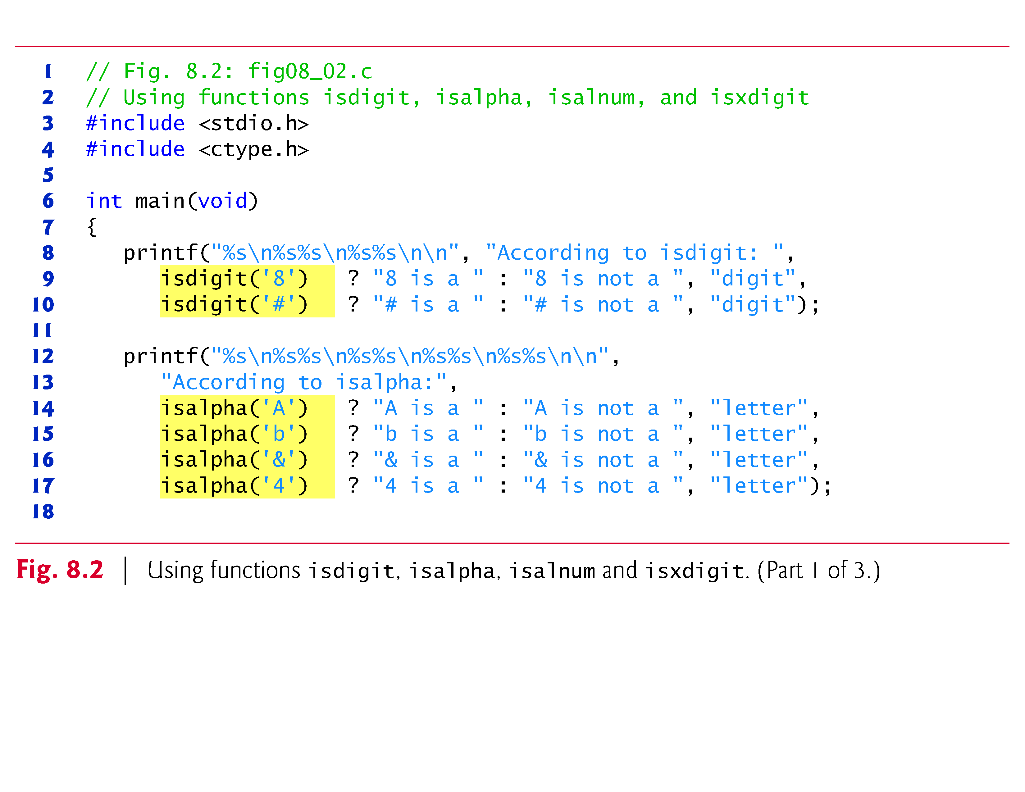

Slide 48
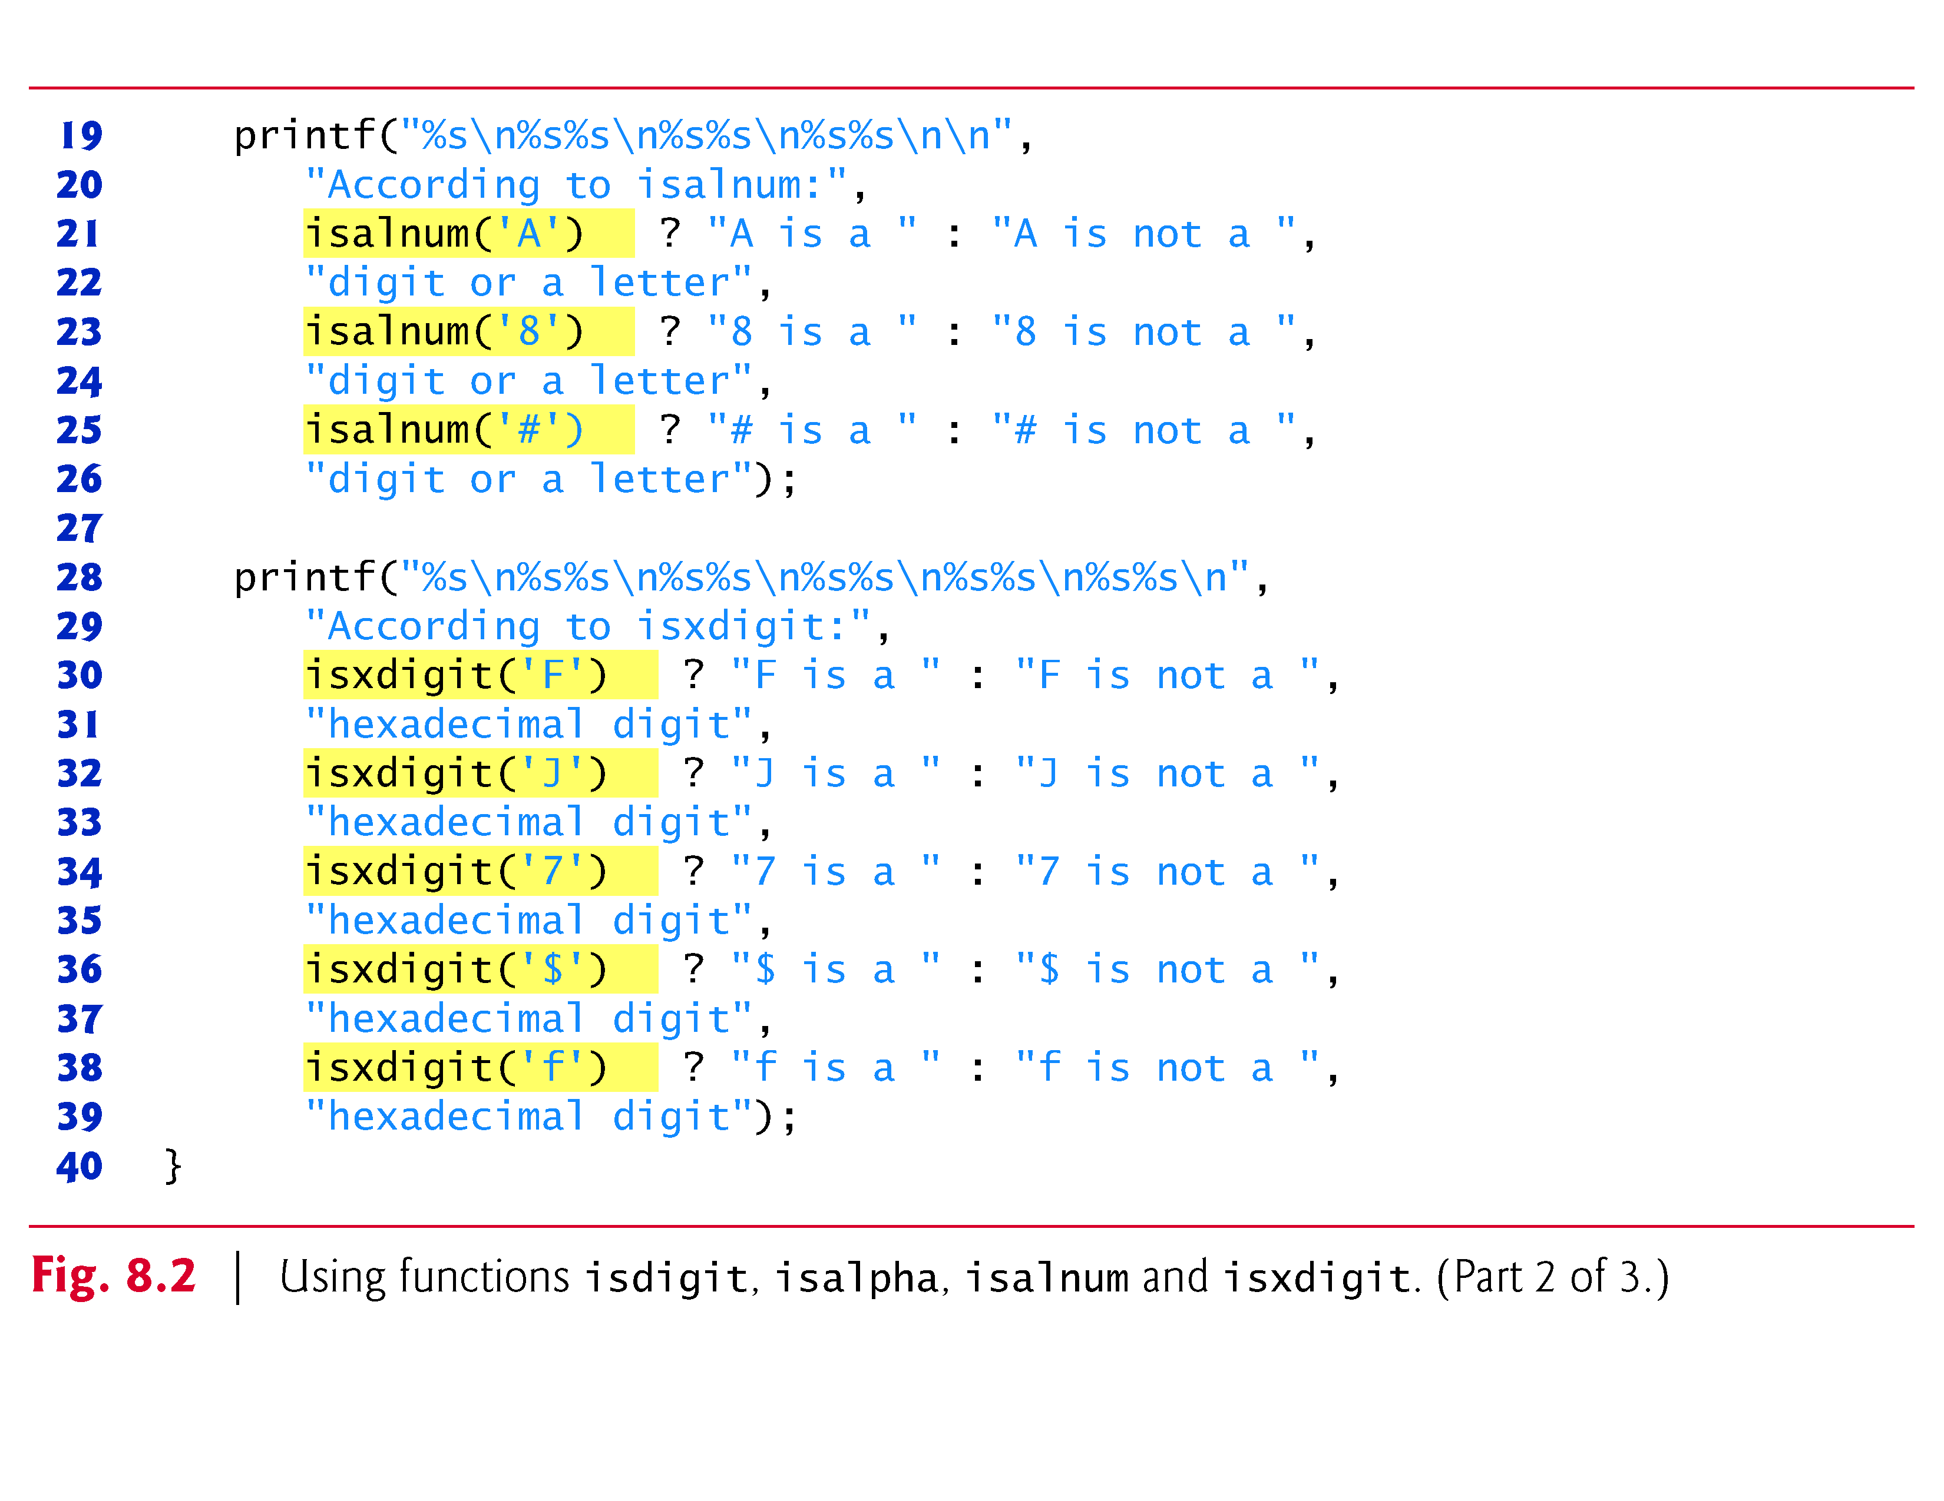

Slide 49
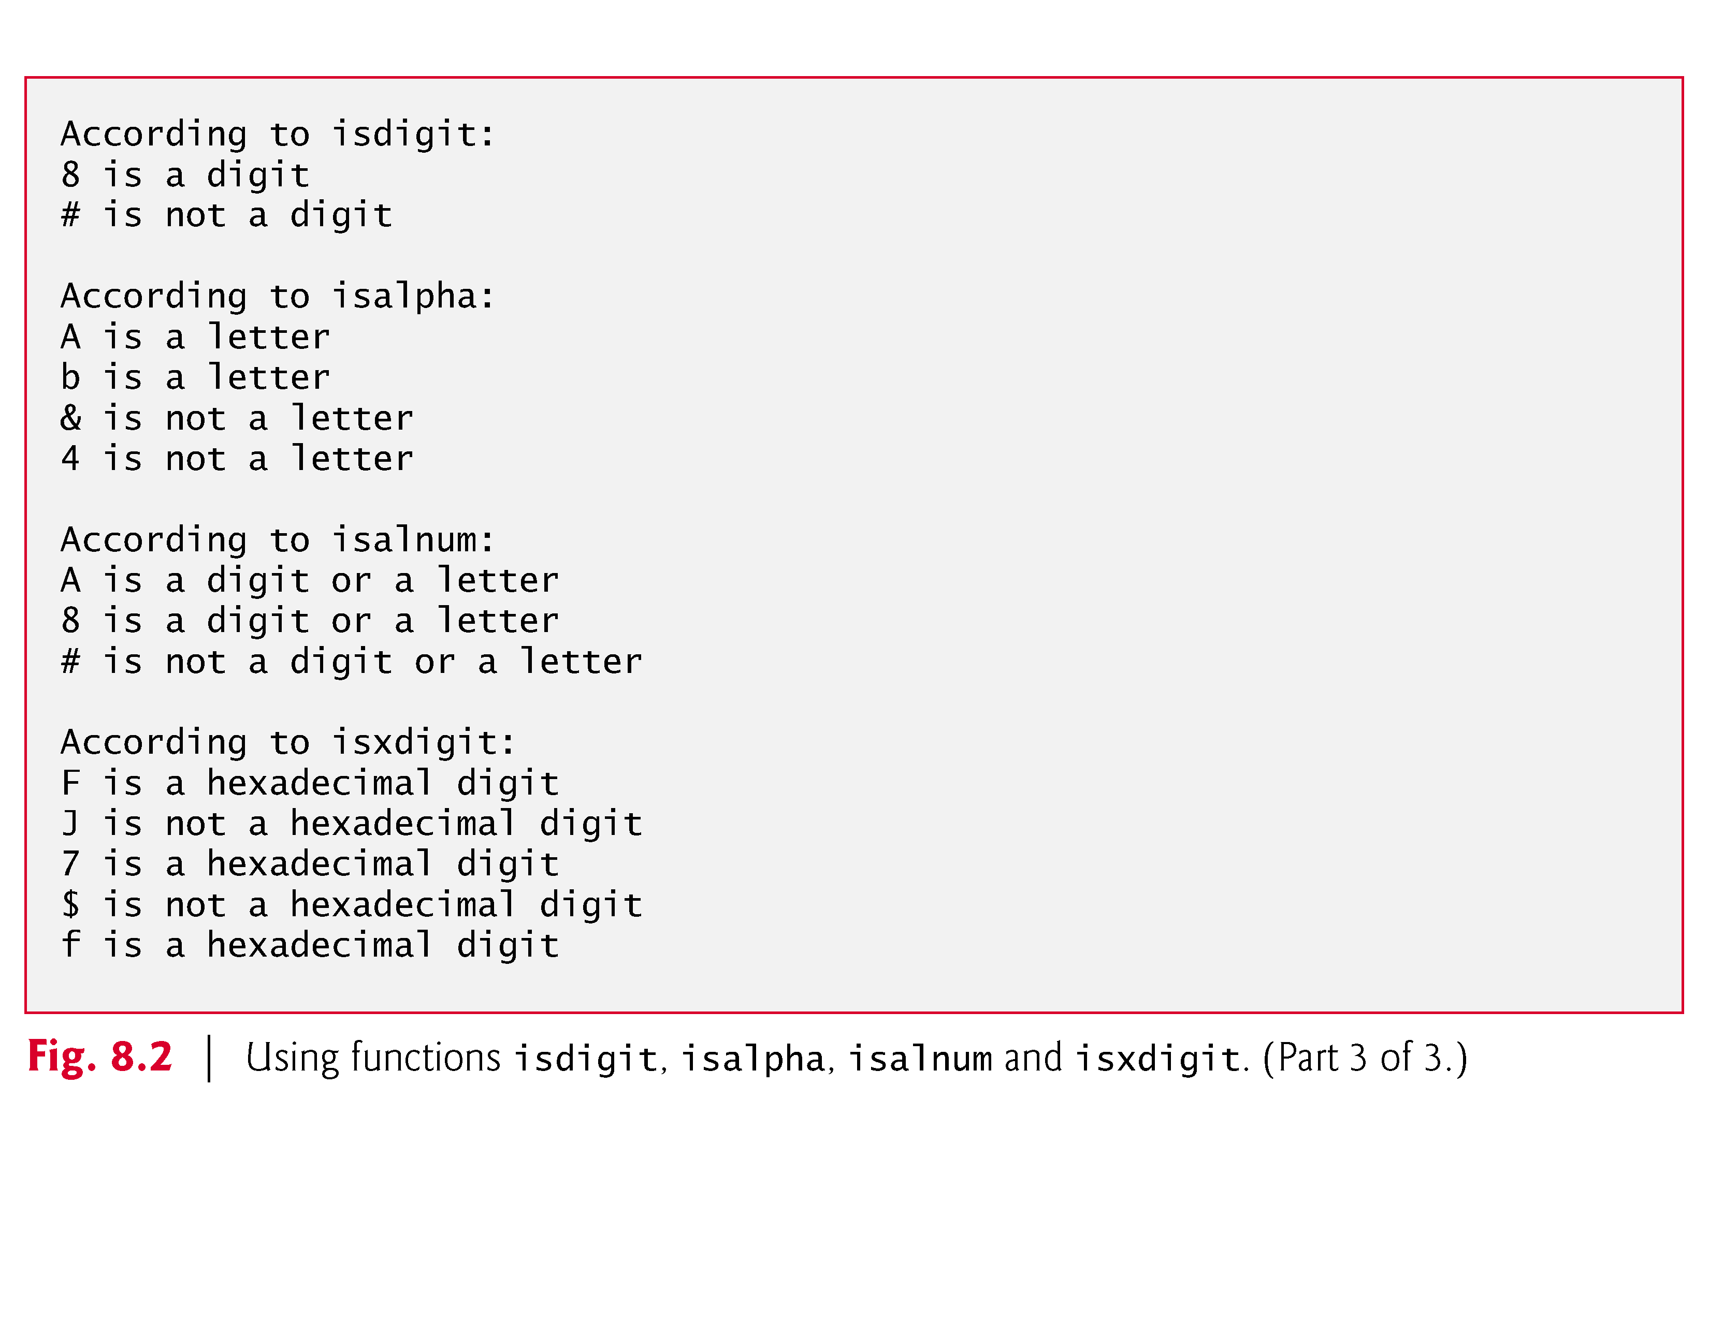

Slide 50
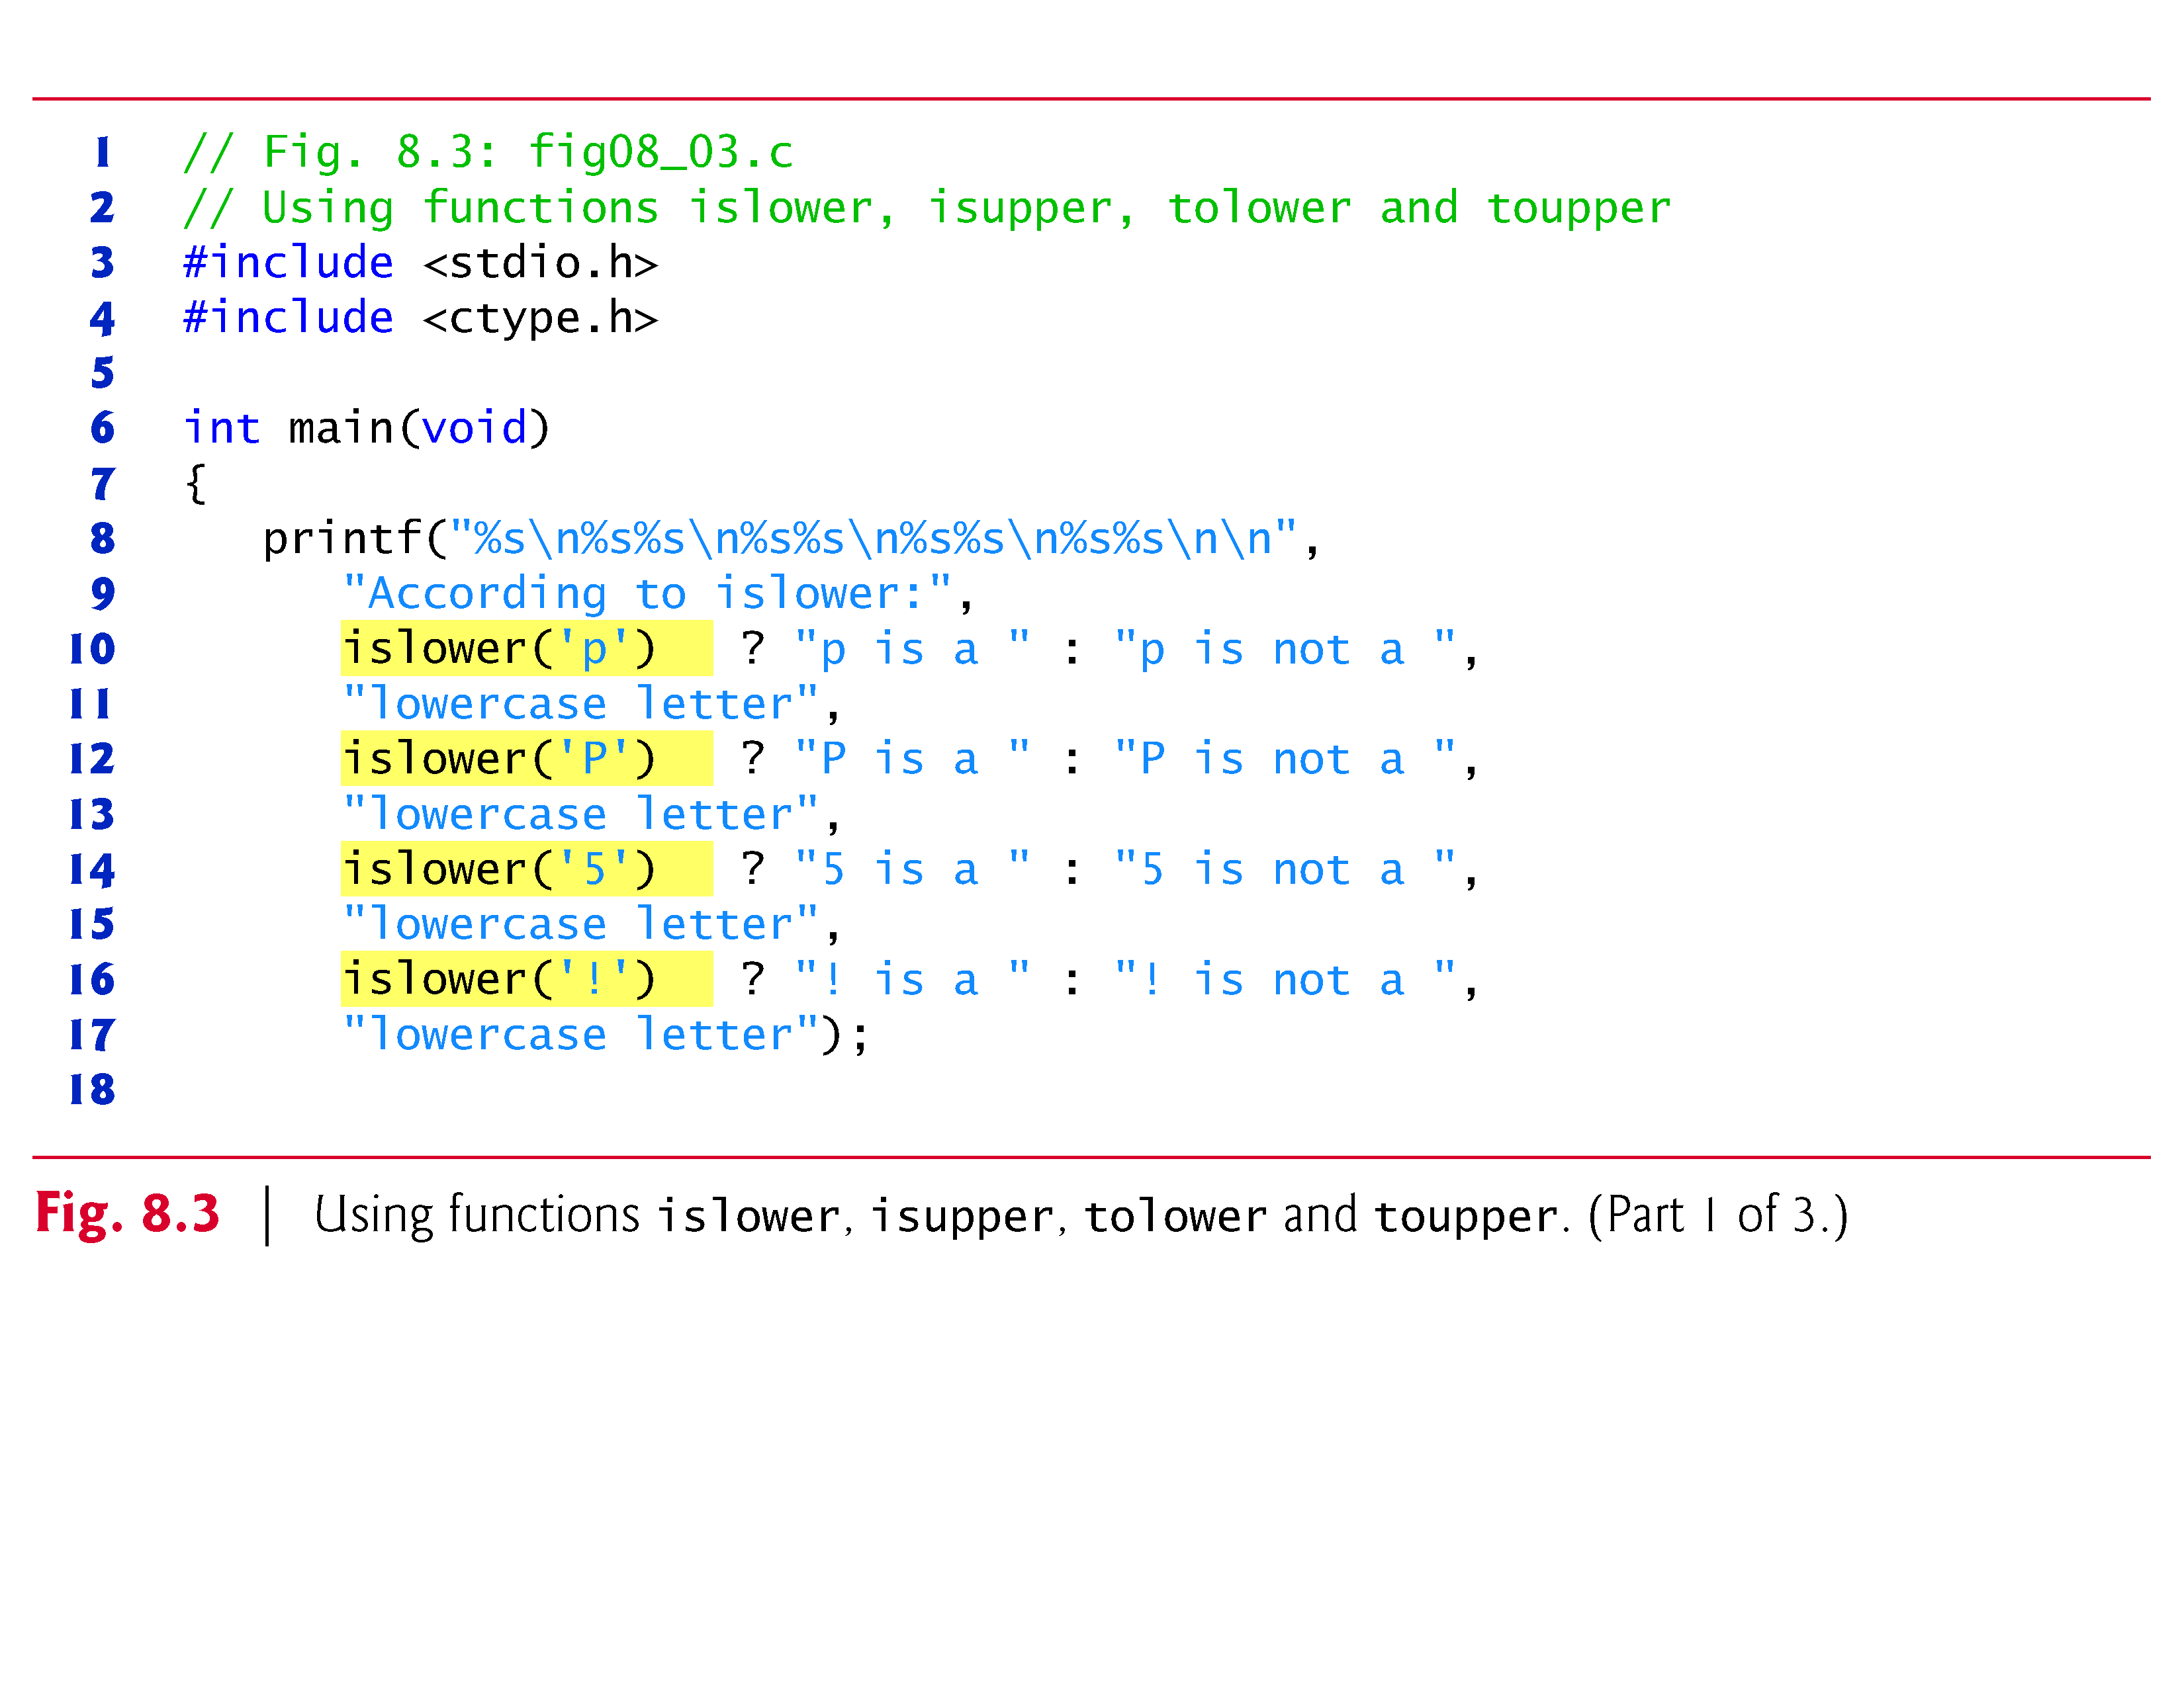

Slide 51
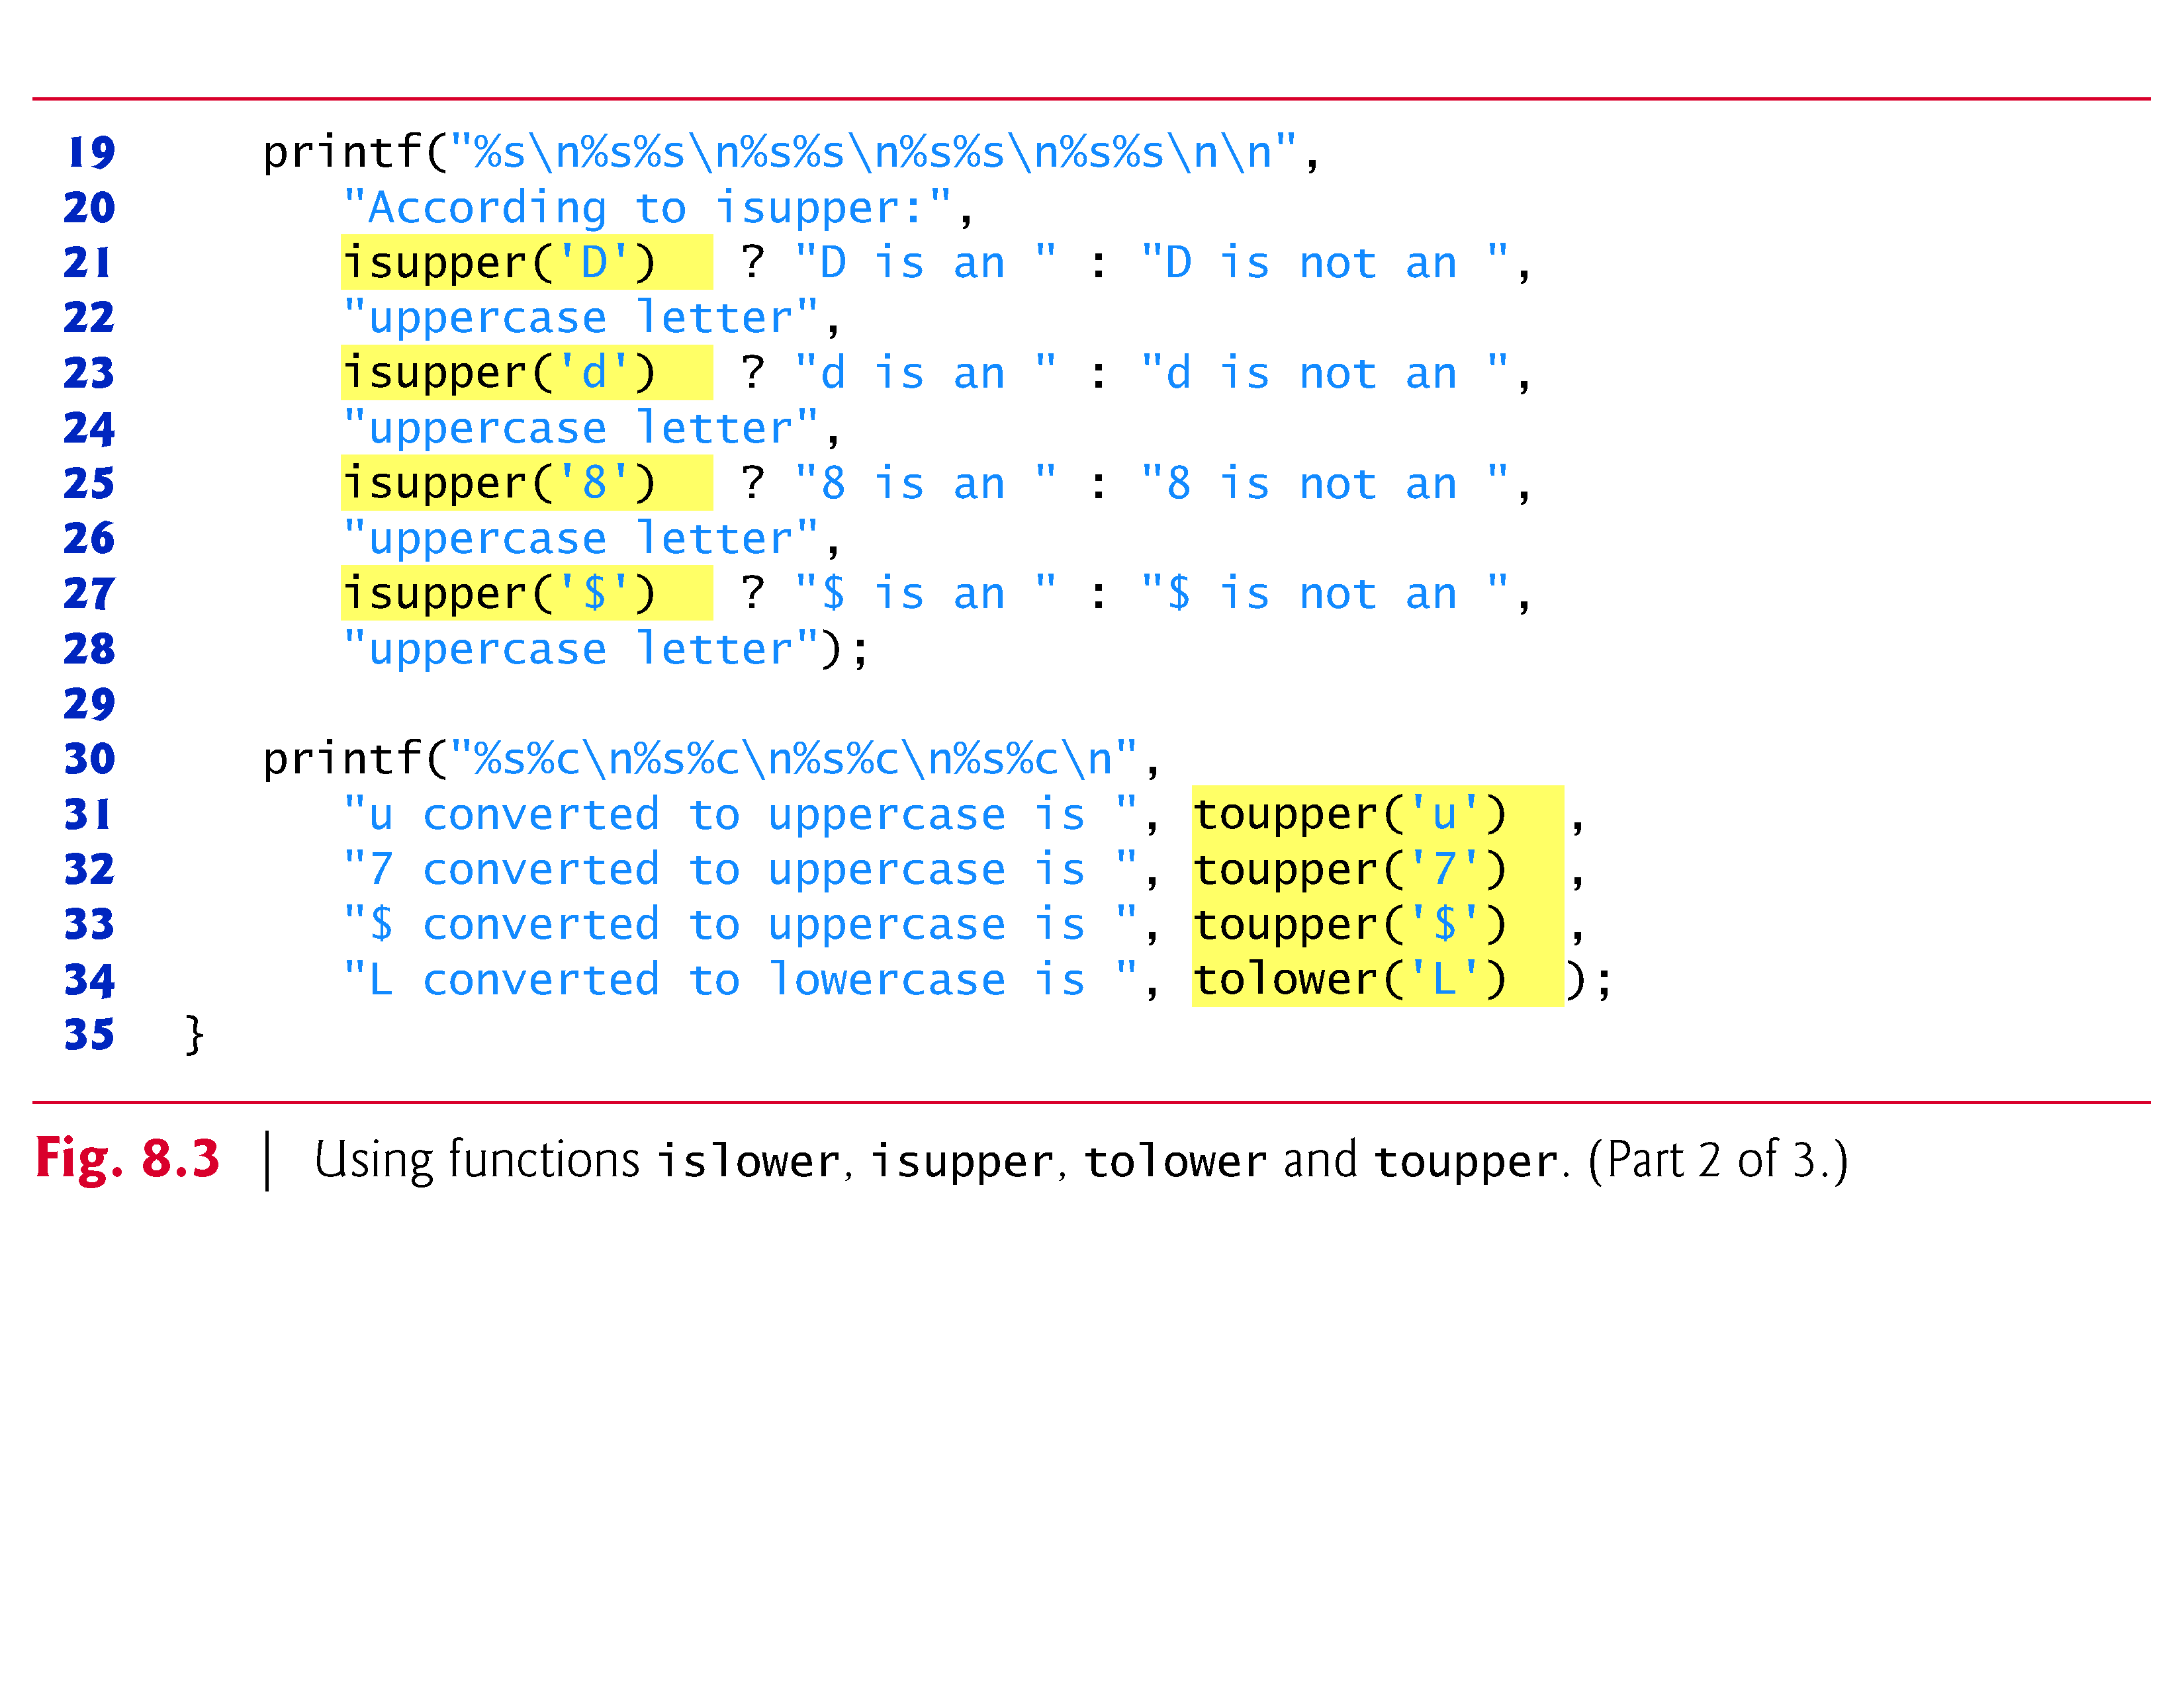

Slide 52
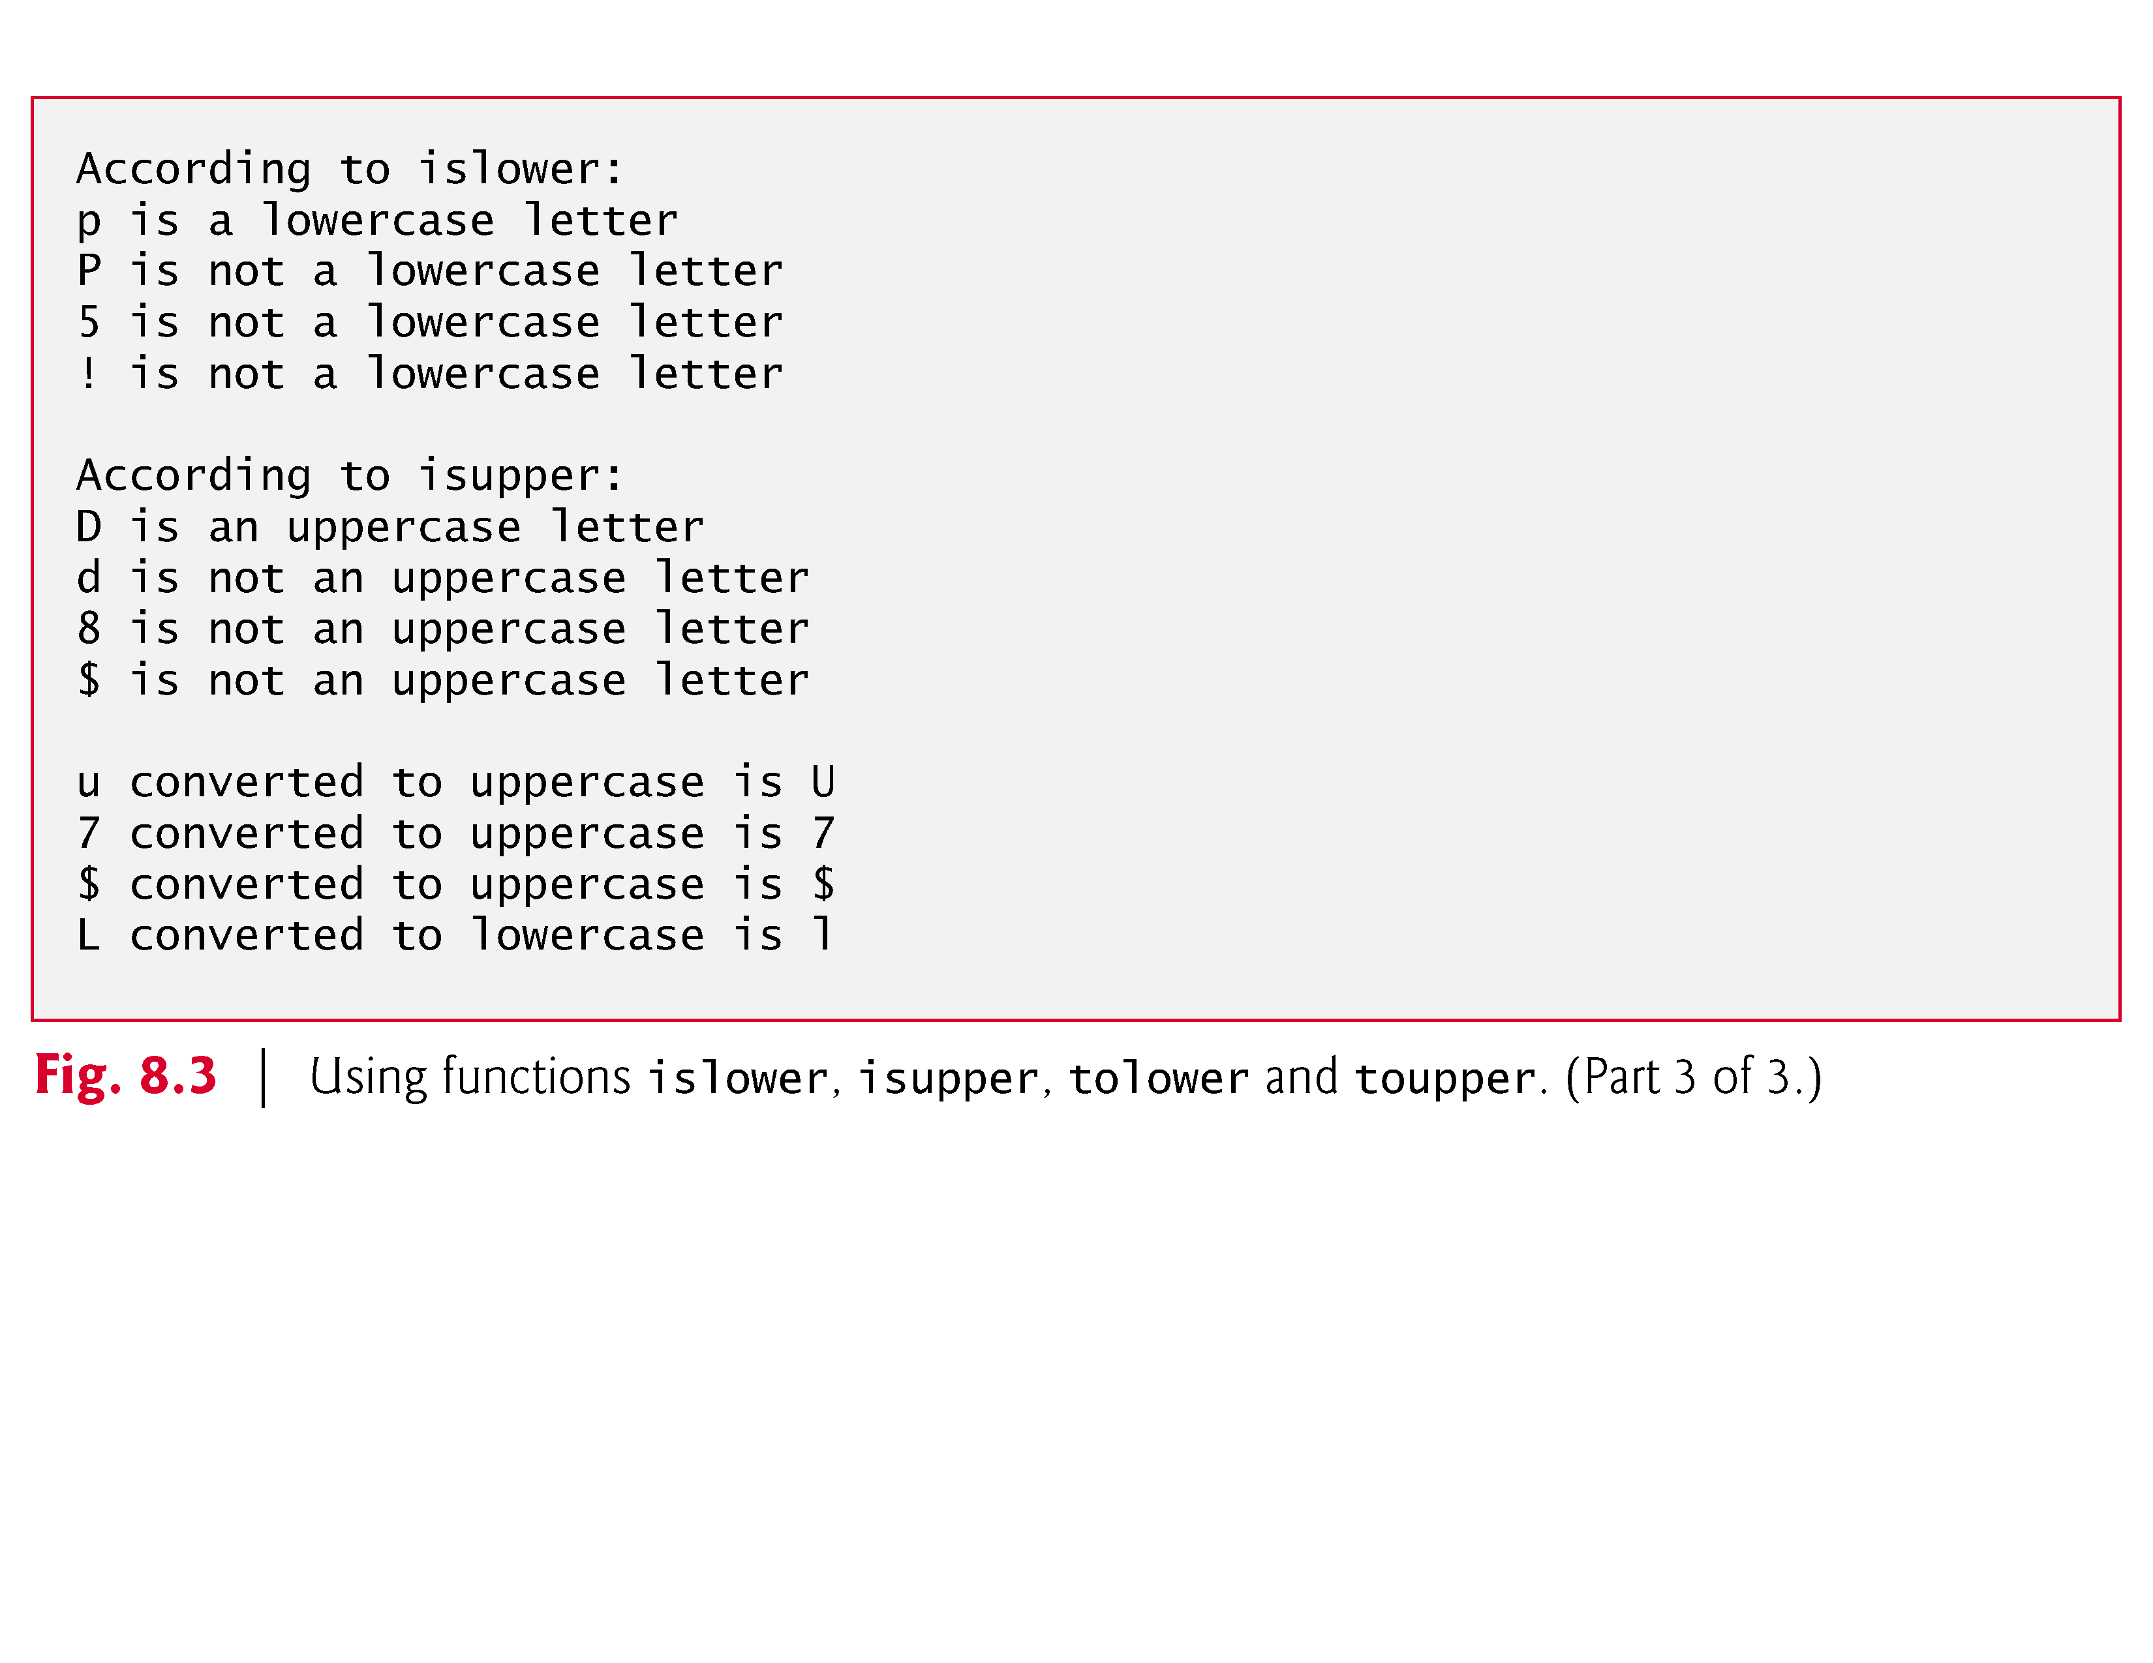

Slide 53
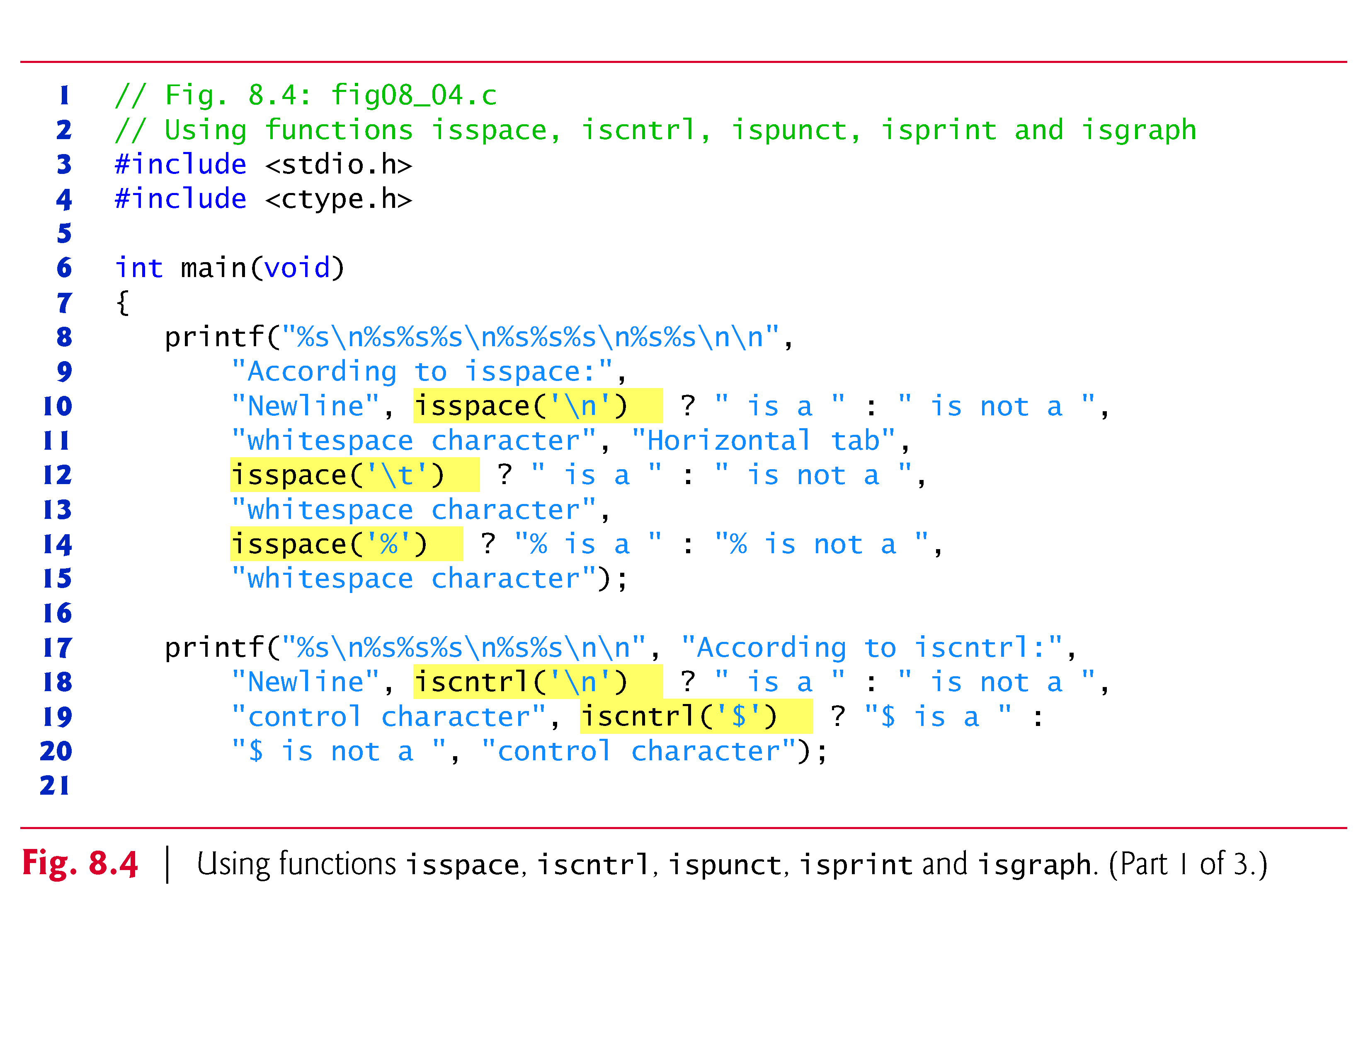

Slide 54
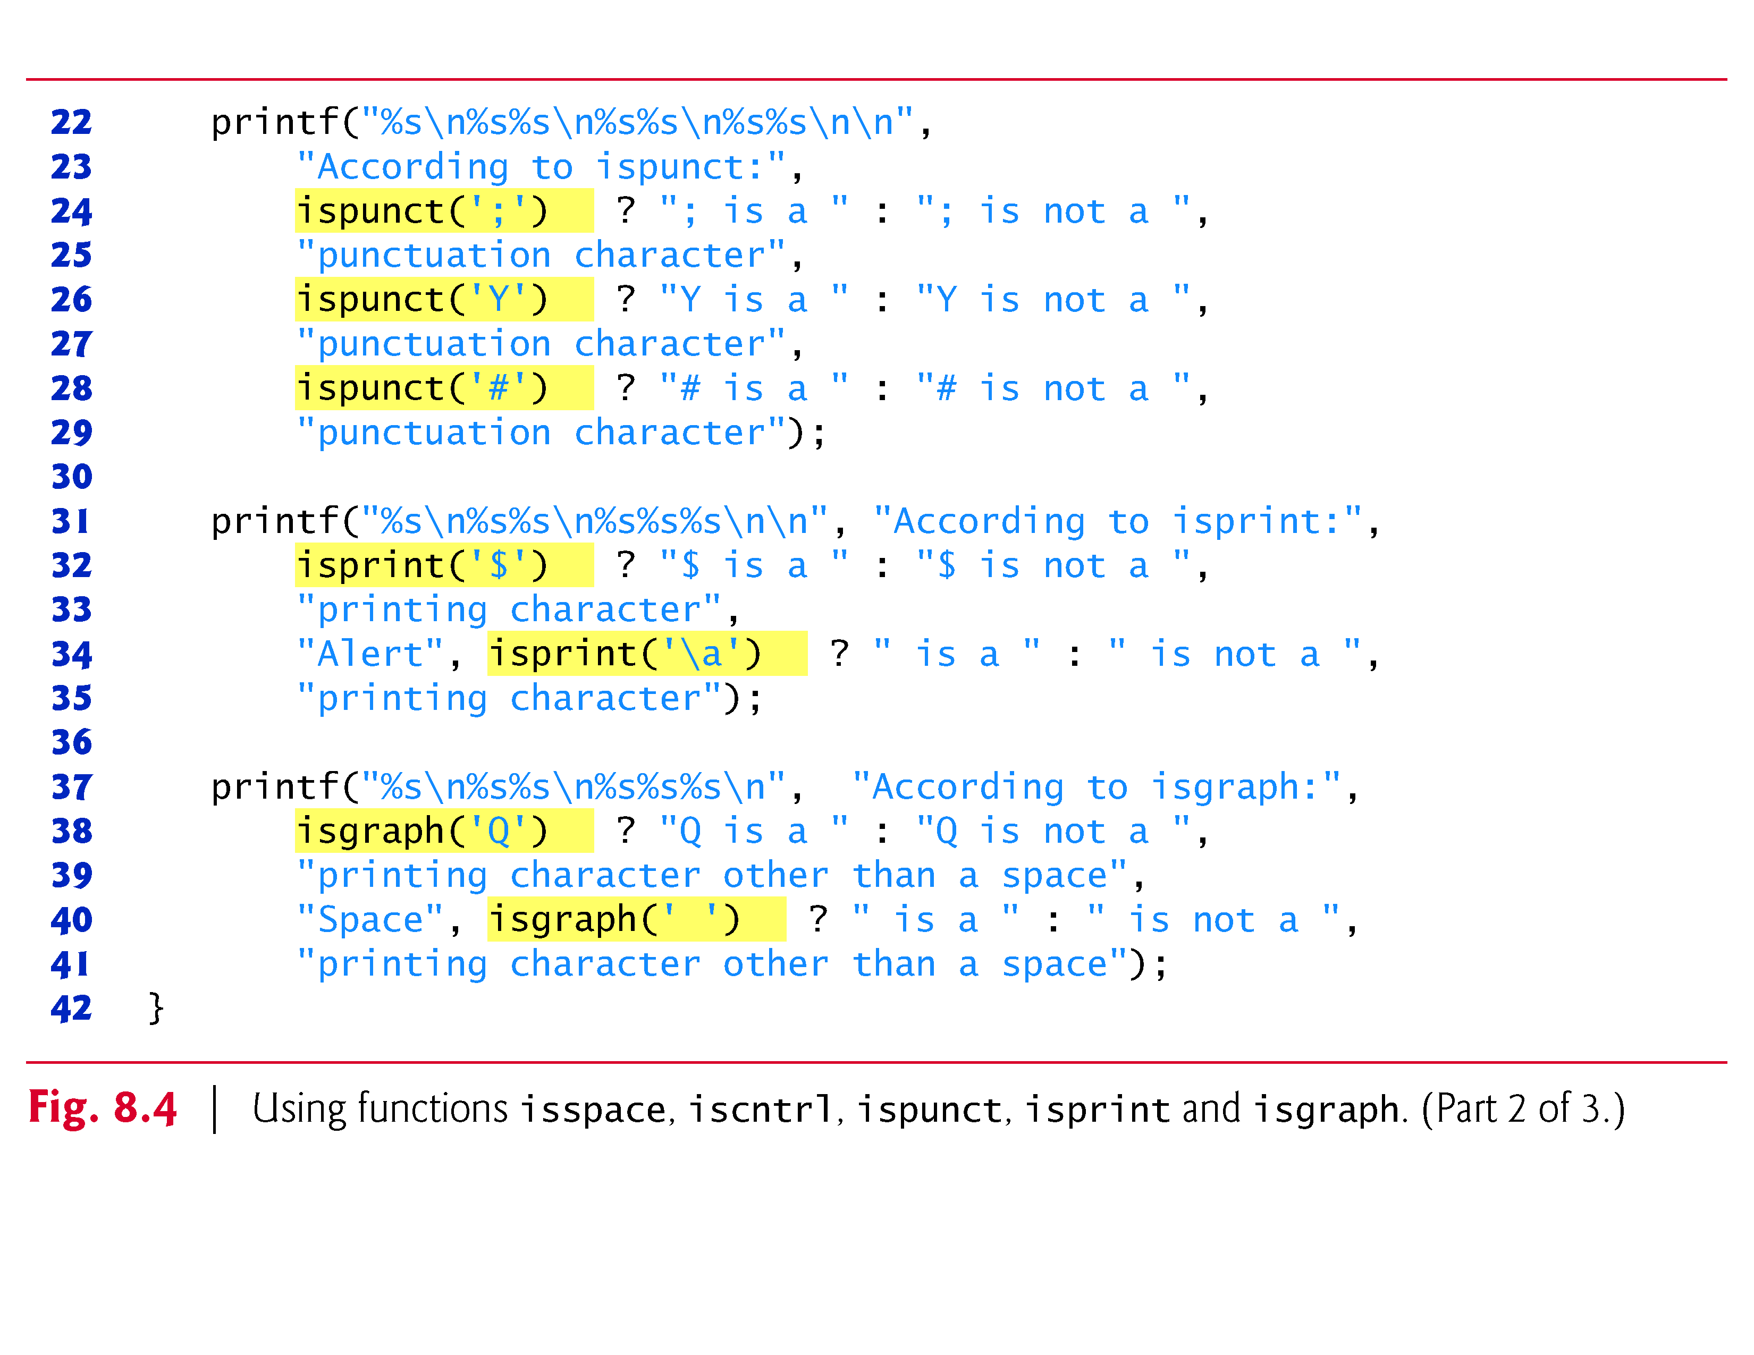

Slide 55
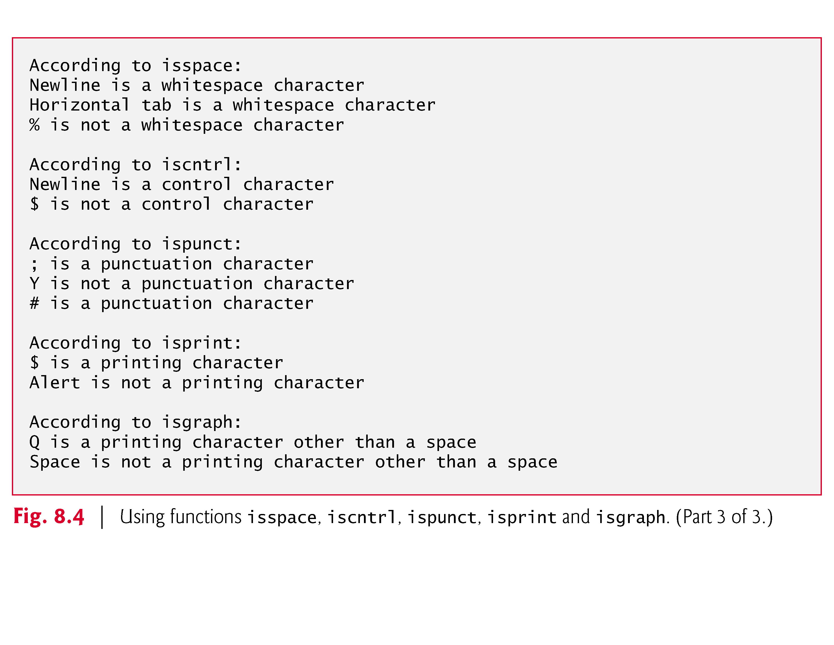

Slide 56
String Conversion Functions
Conversion functions
In <stdlib.h> (general utilities library)
Convert strings of digits to integer and floating-point values

Slide 57
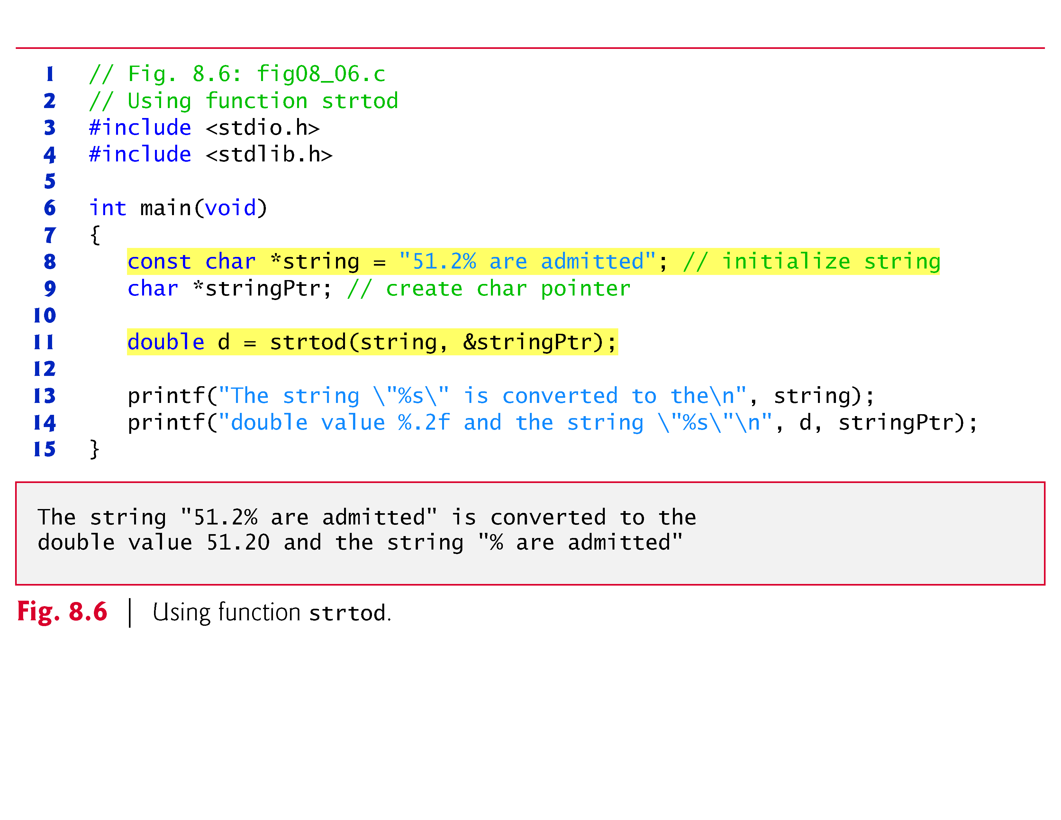

Slide 58
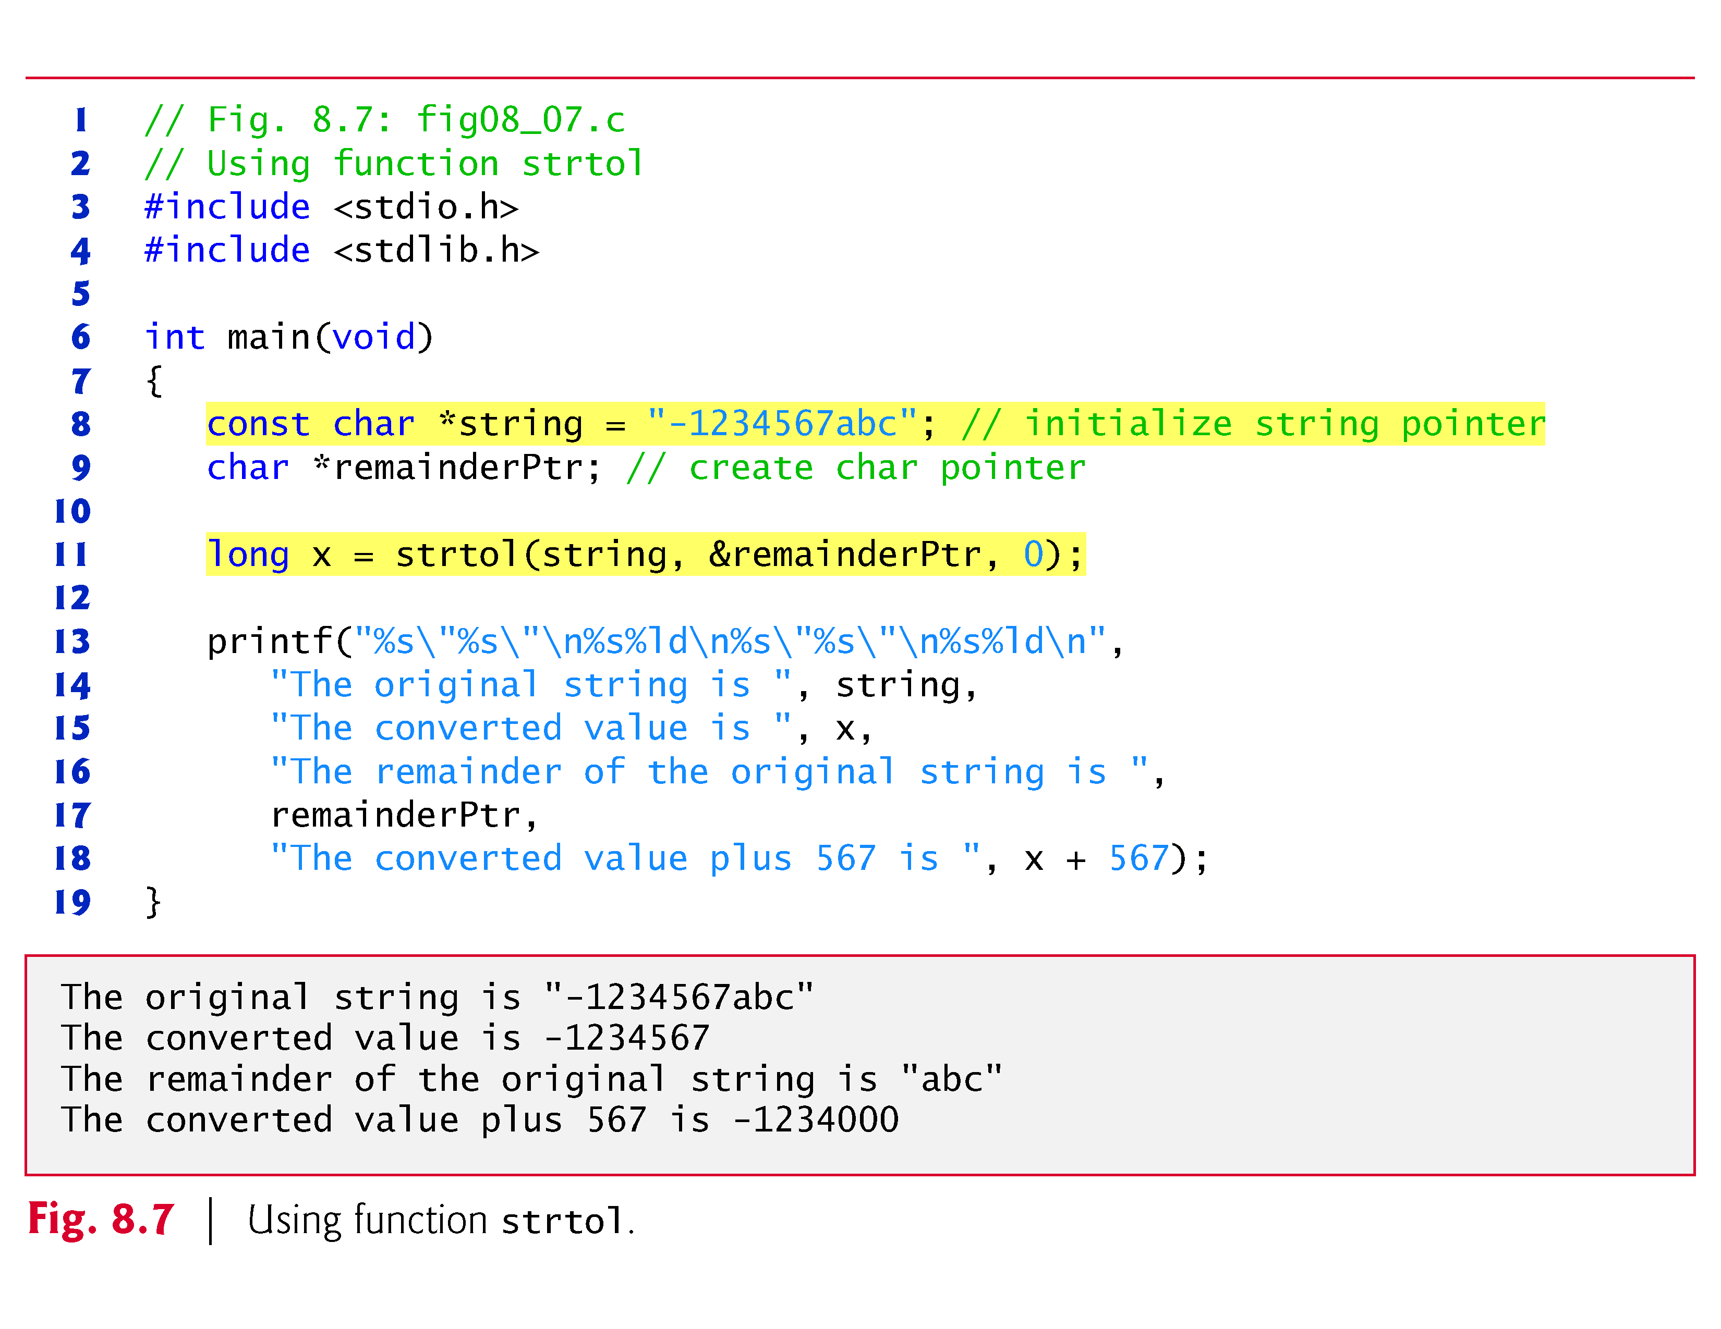

Slide 59
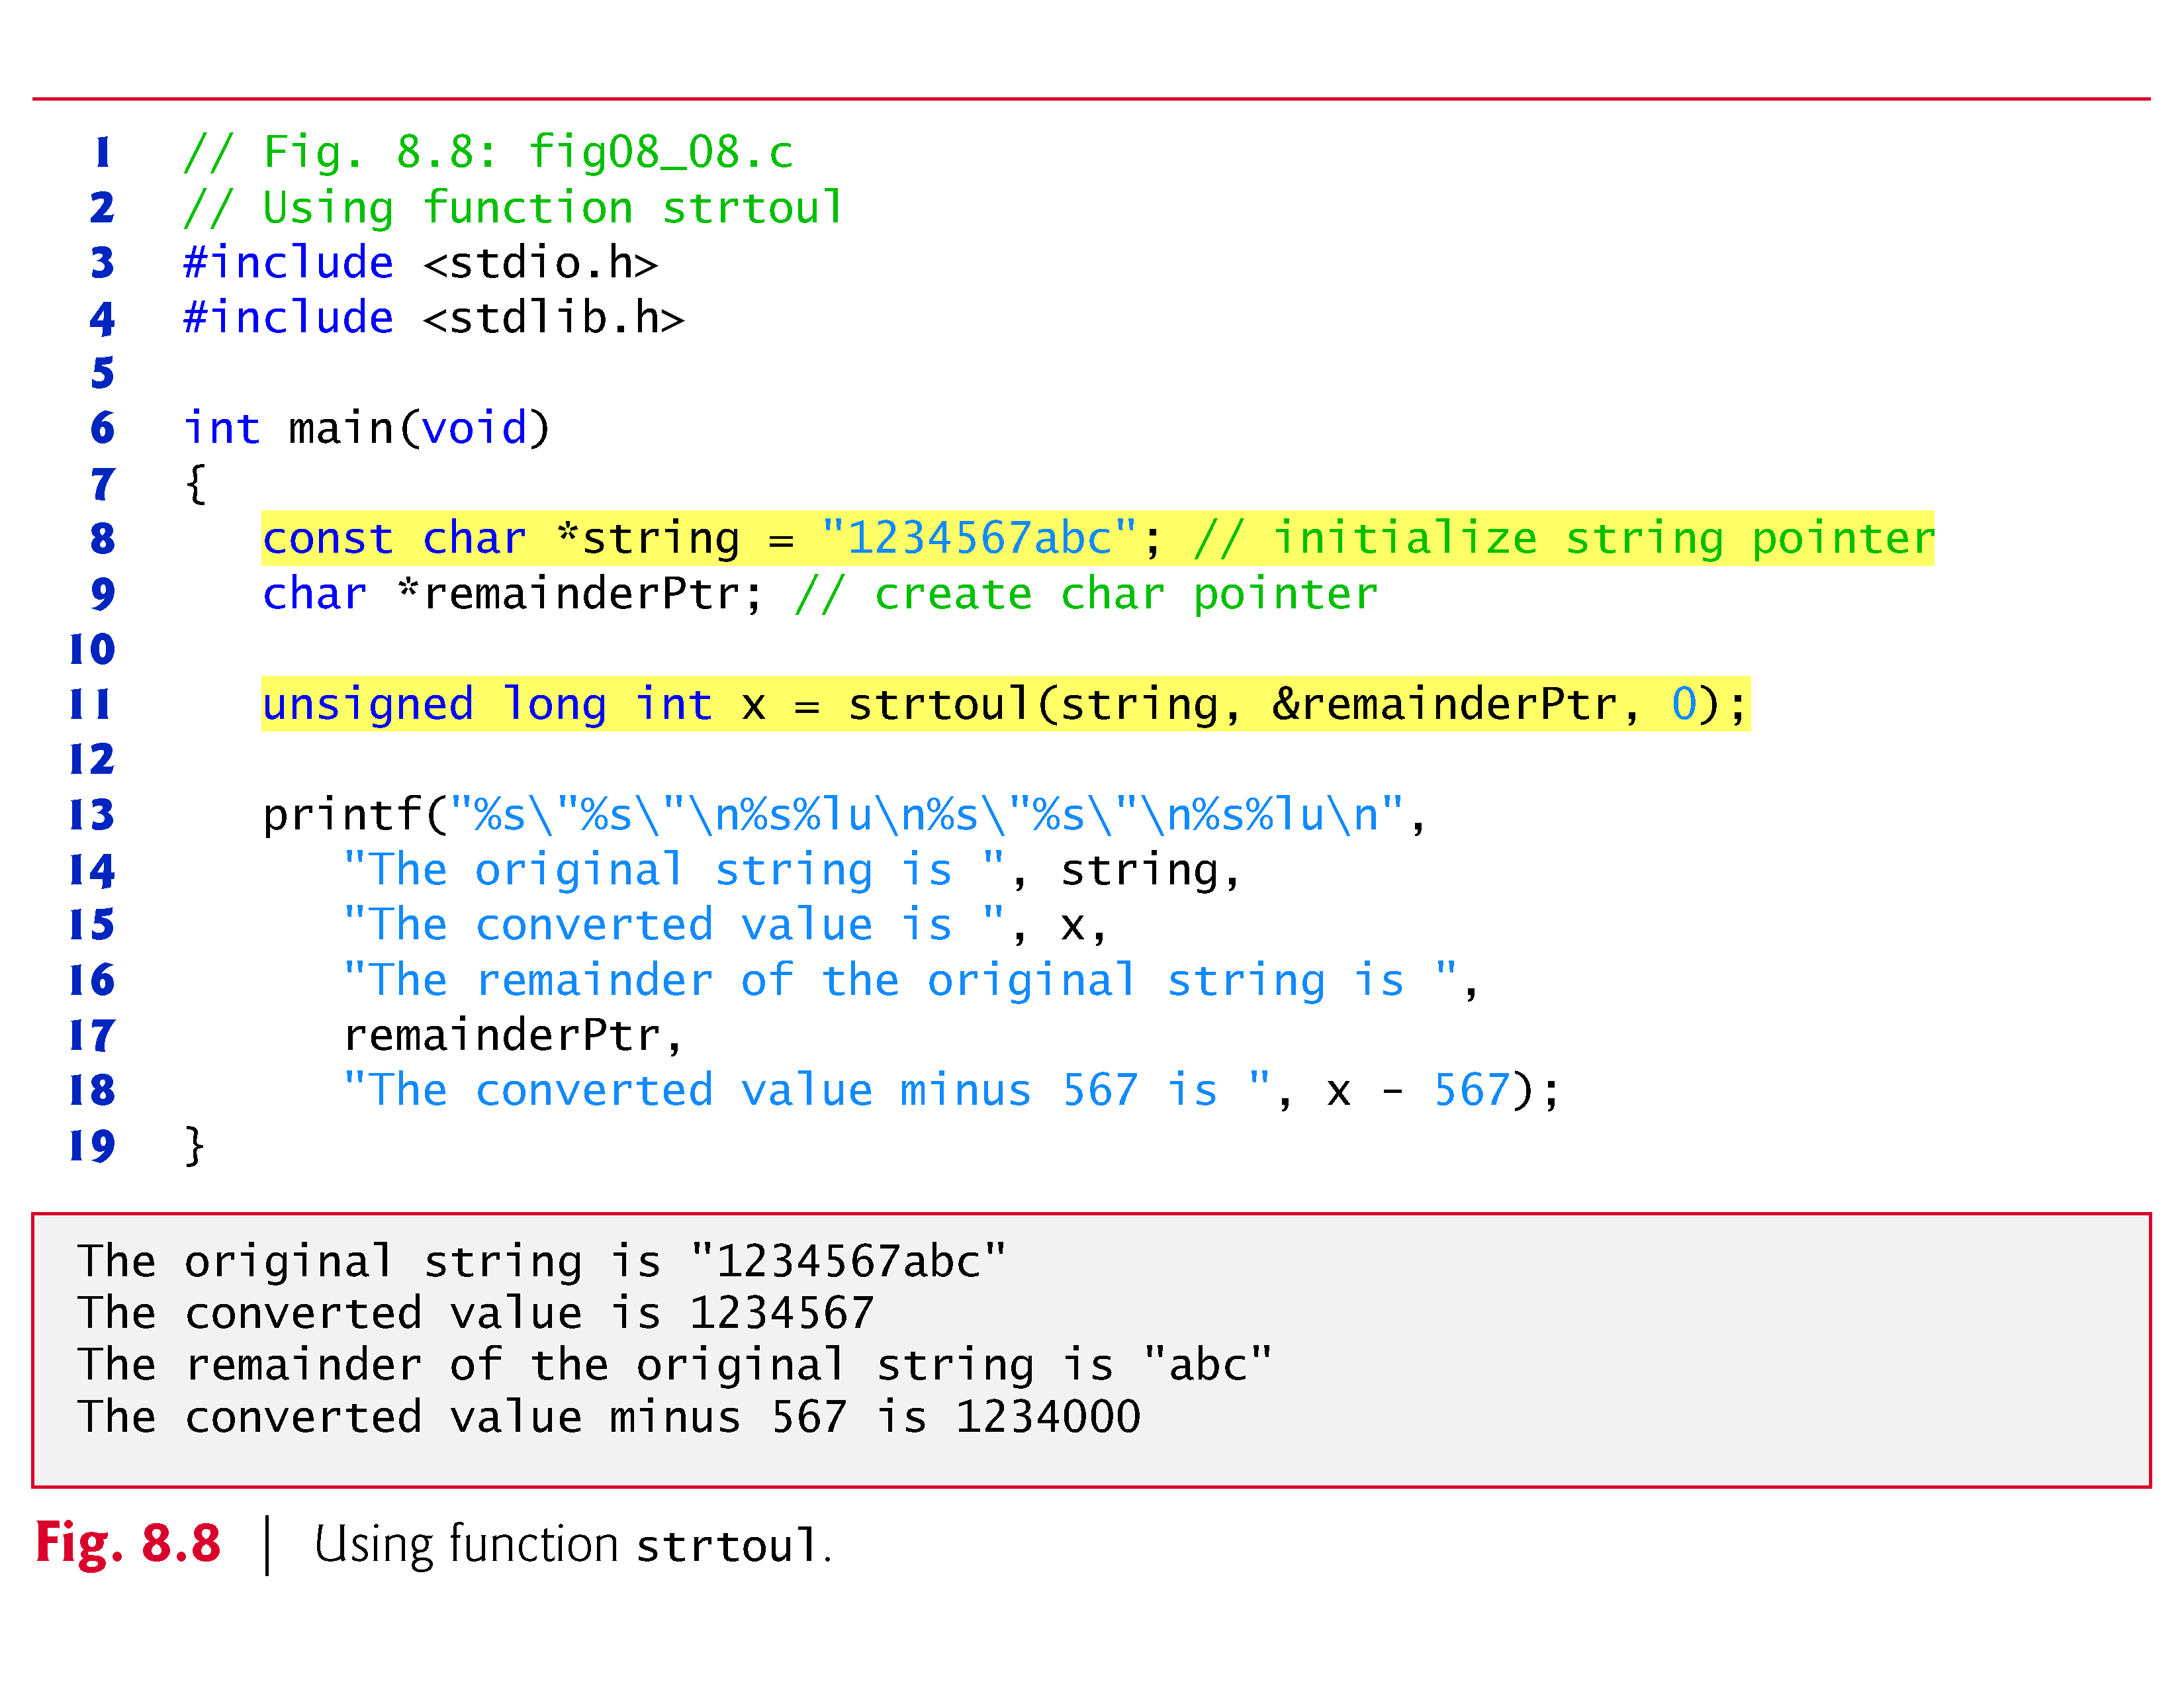

Slide 60
Standard Input/Output Library Functions
Functions in <stdio.h>
Used to manipulate character and string data

Slide 61
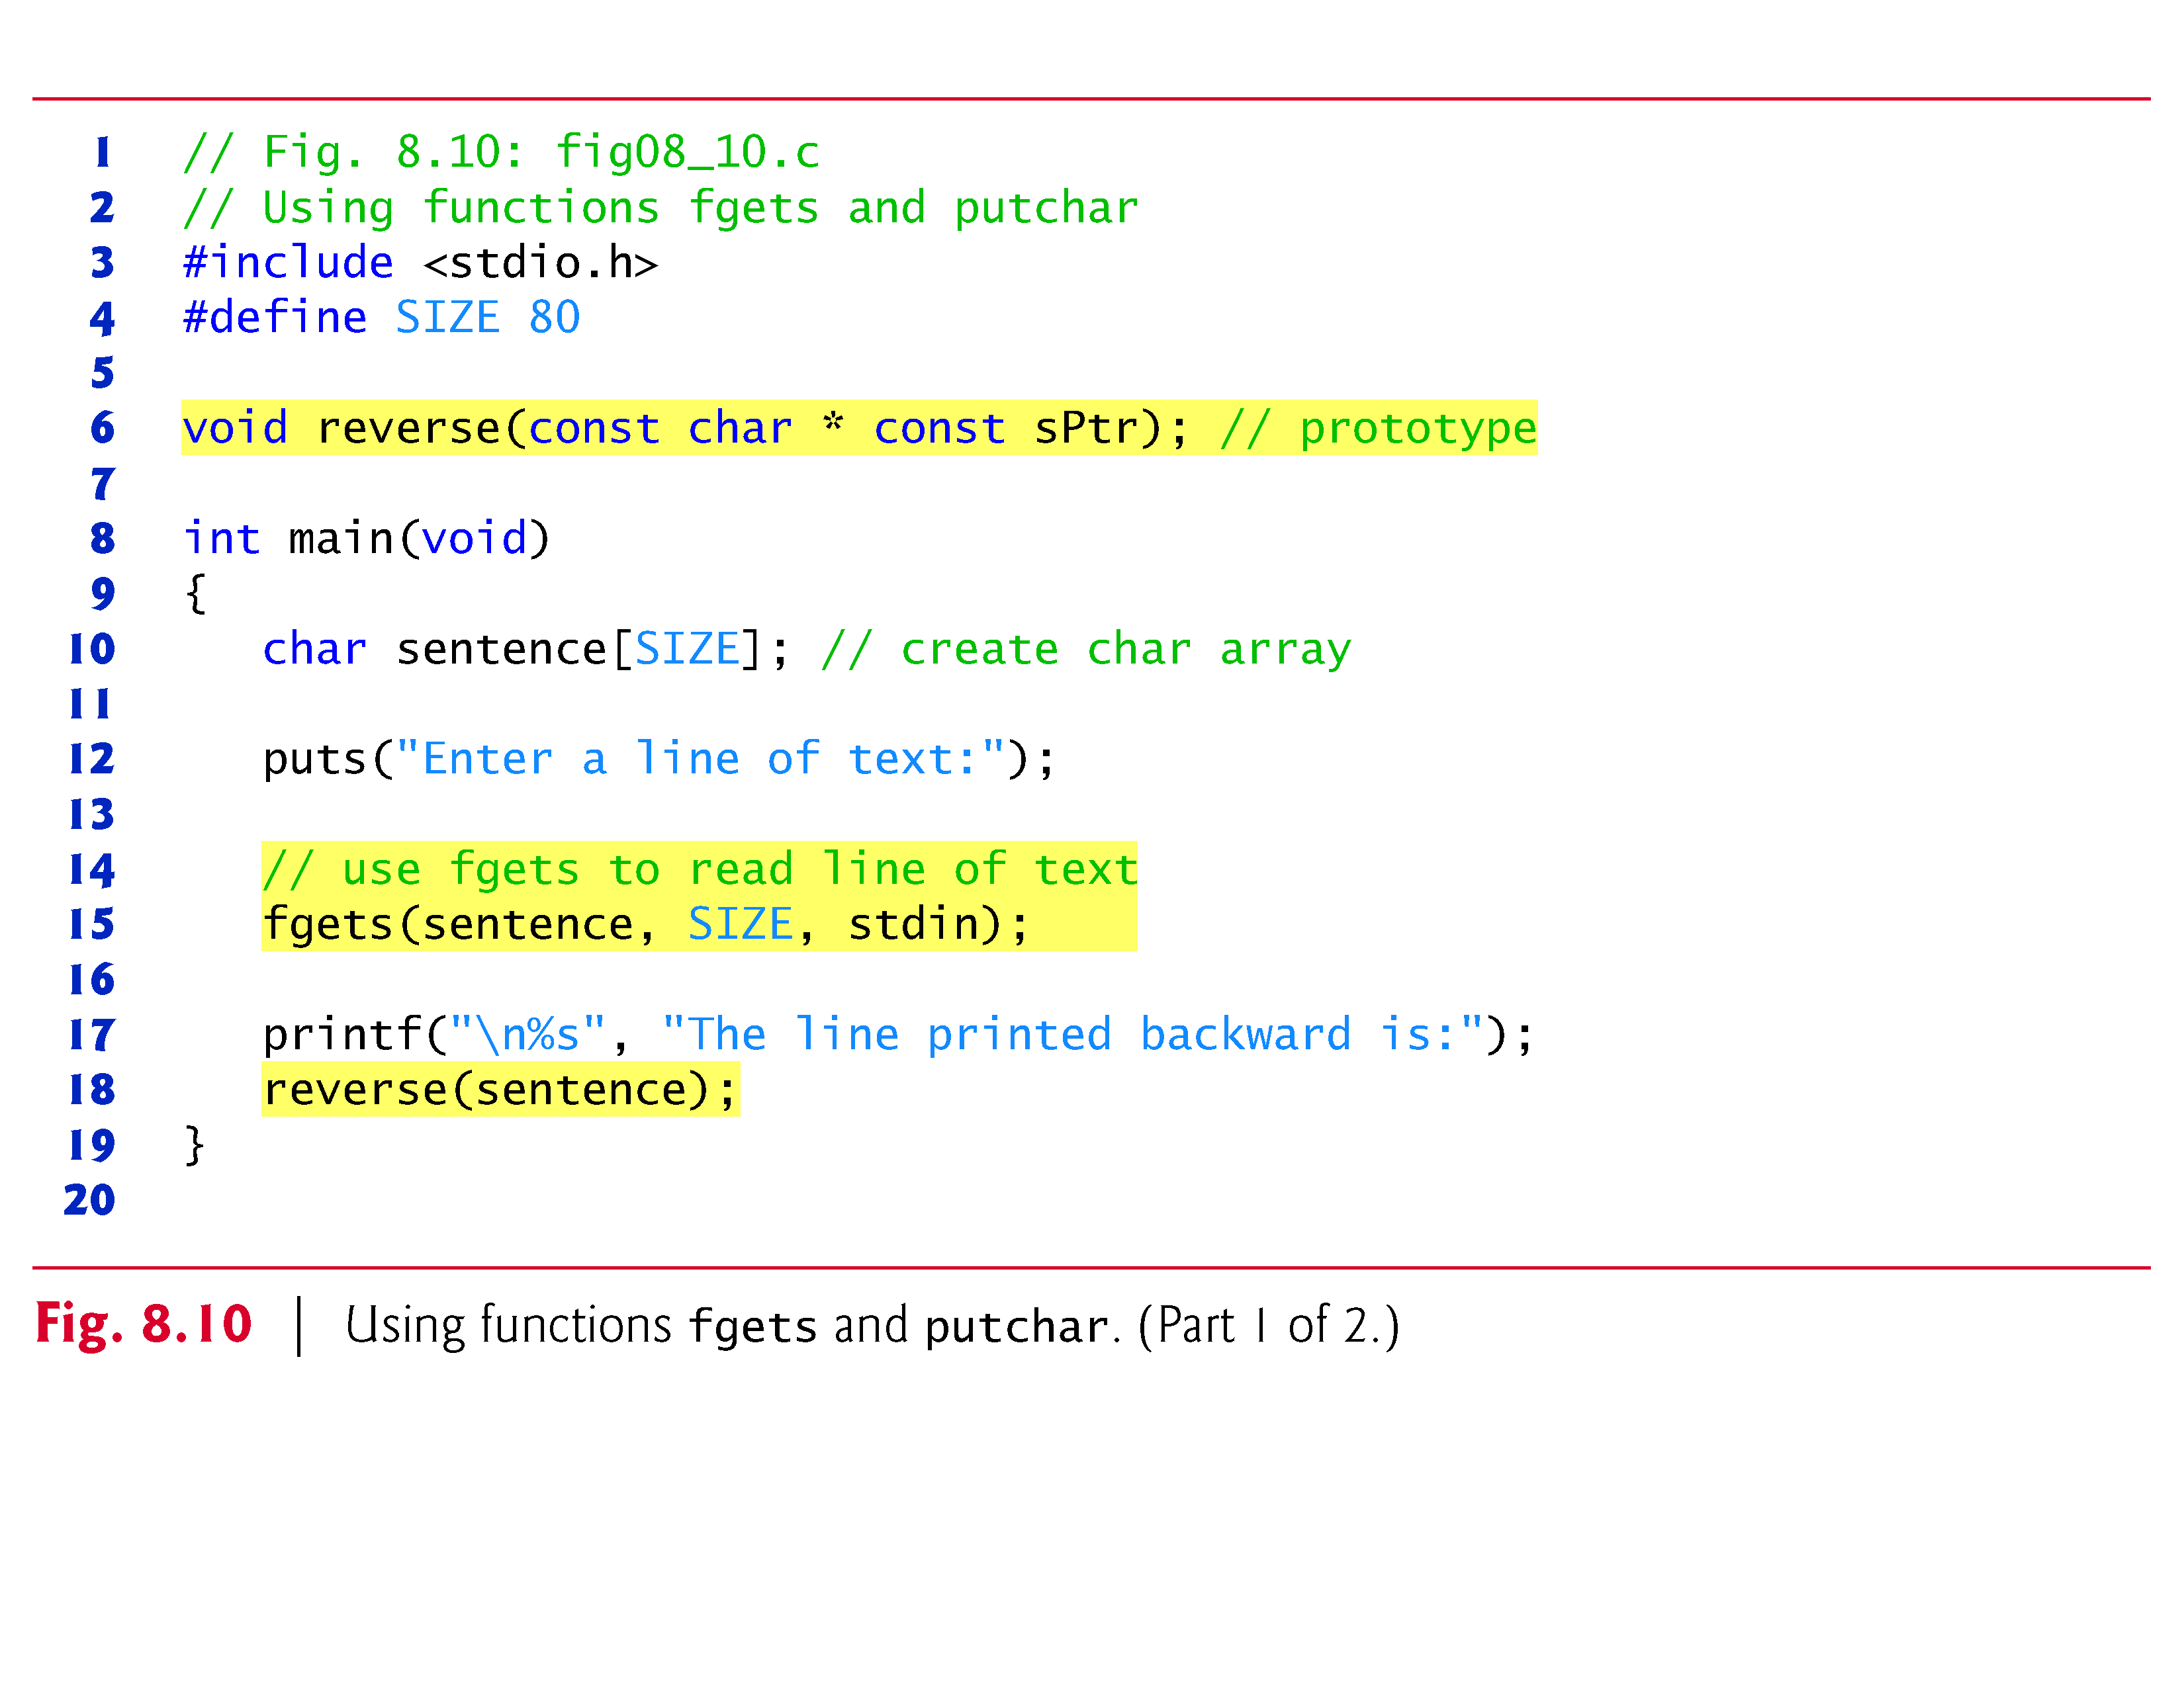

Slide 62
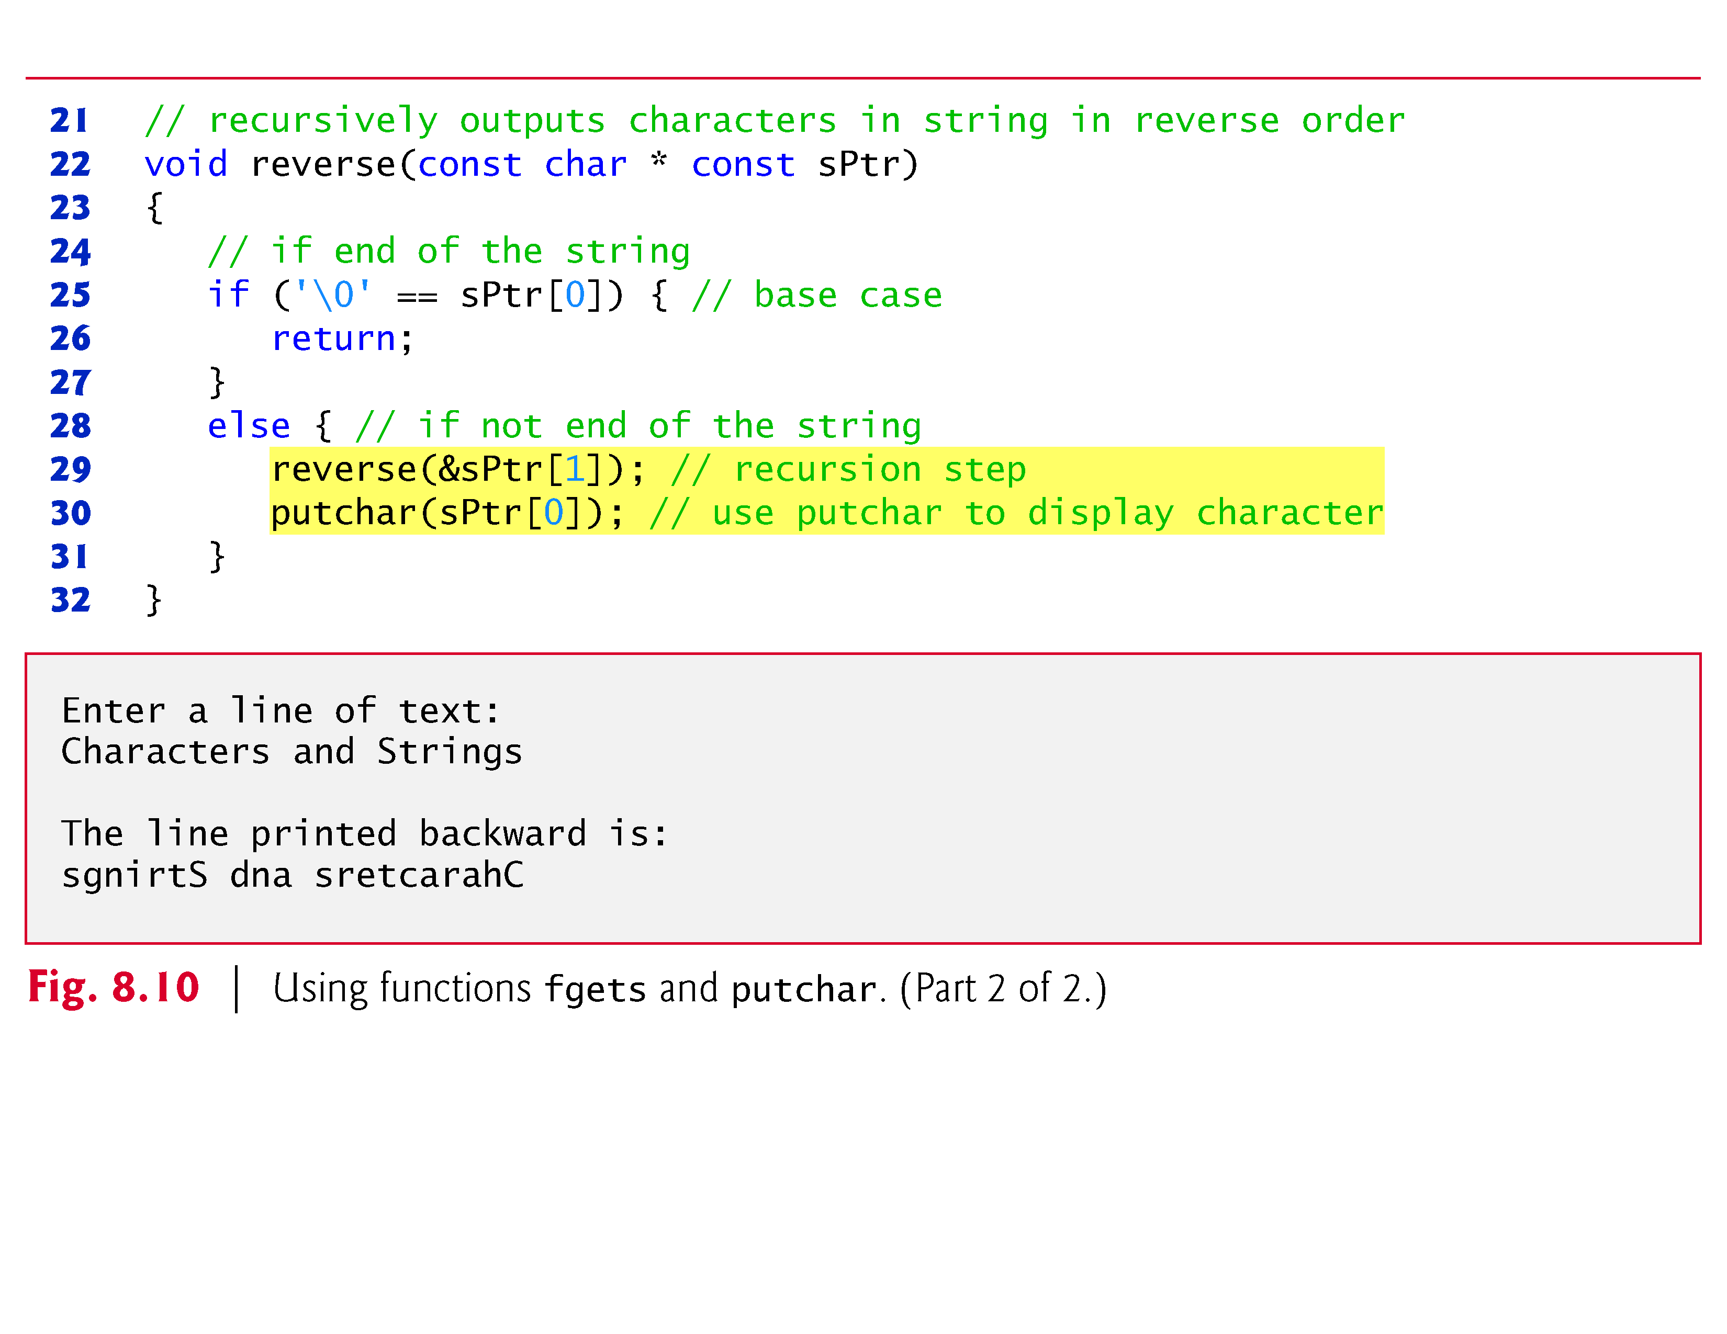

Slide 63
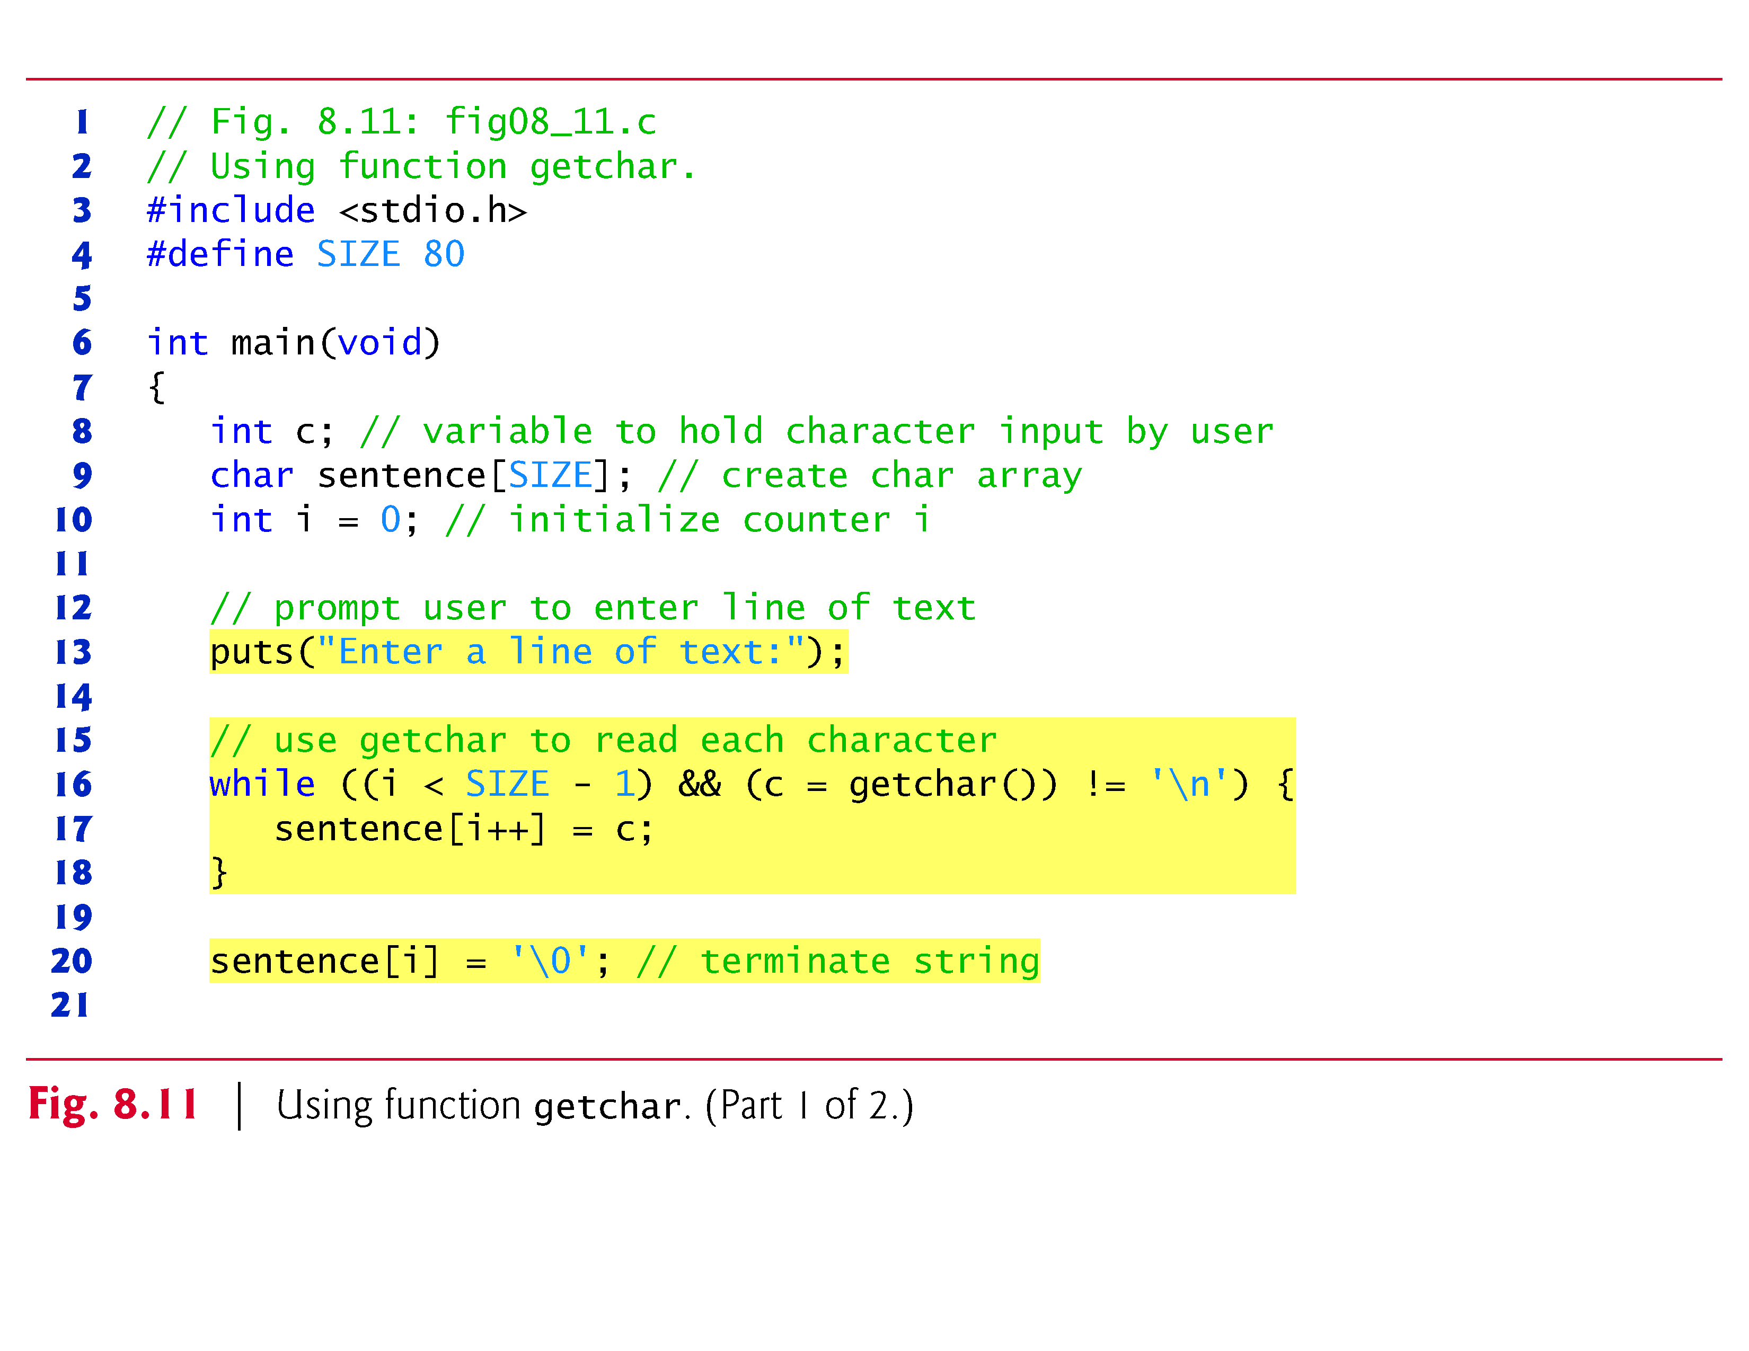

Slide 64
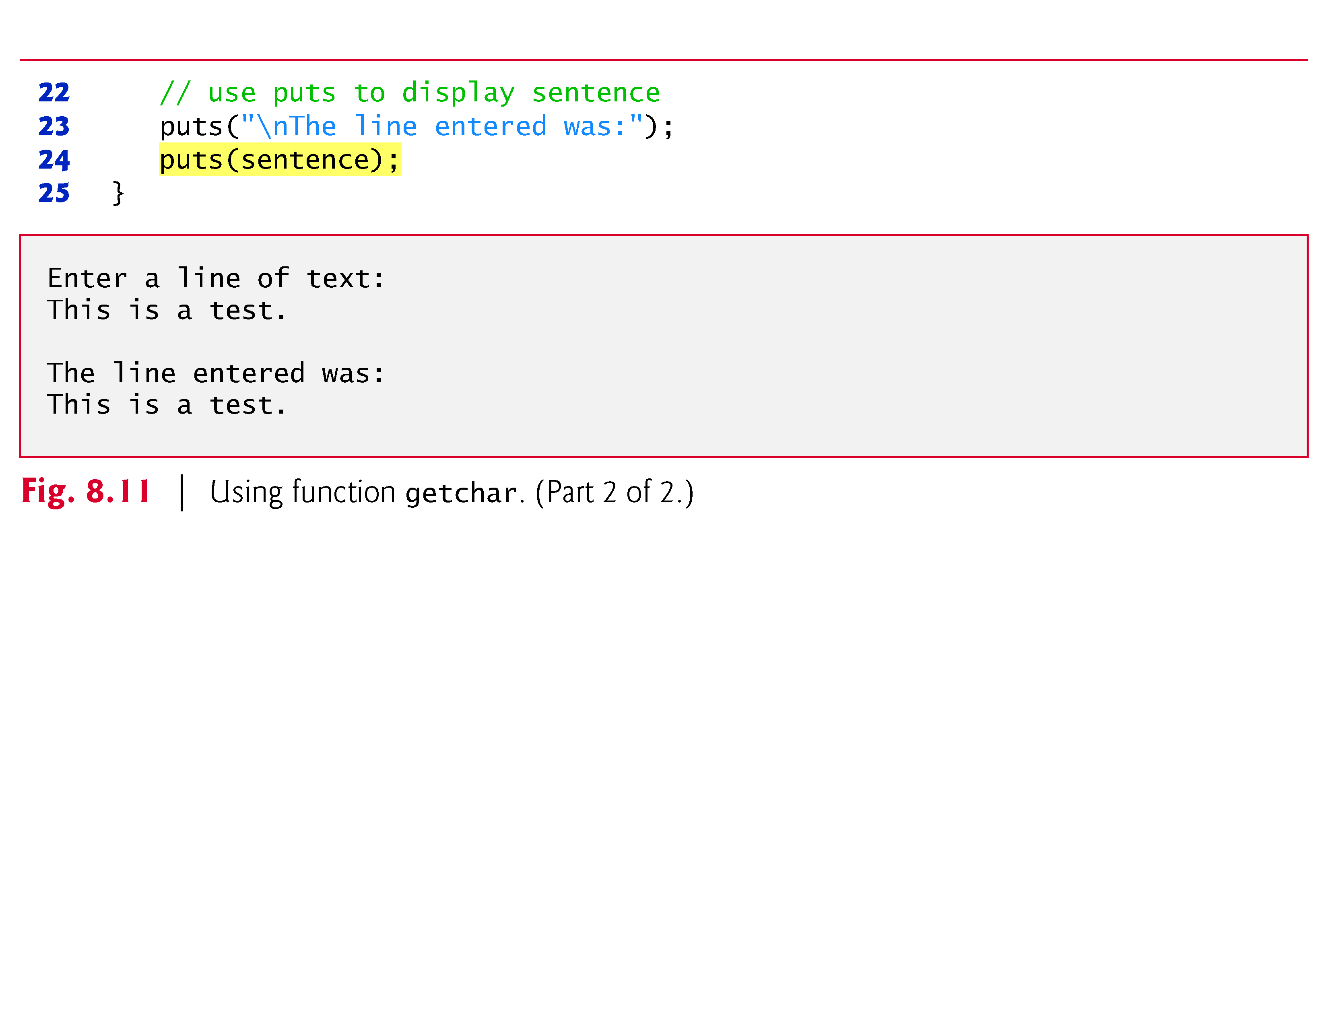

Slide 65
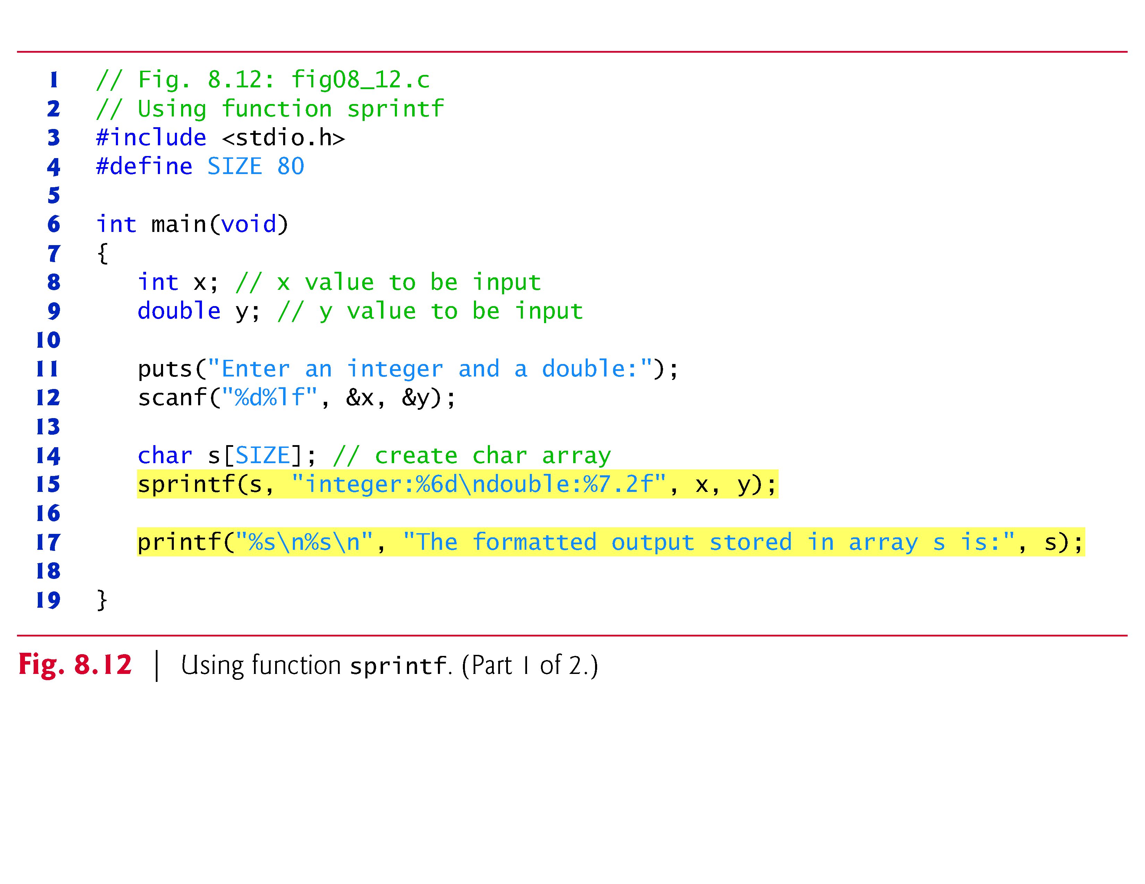

Slide 66
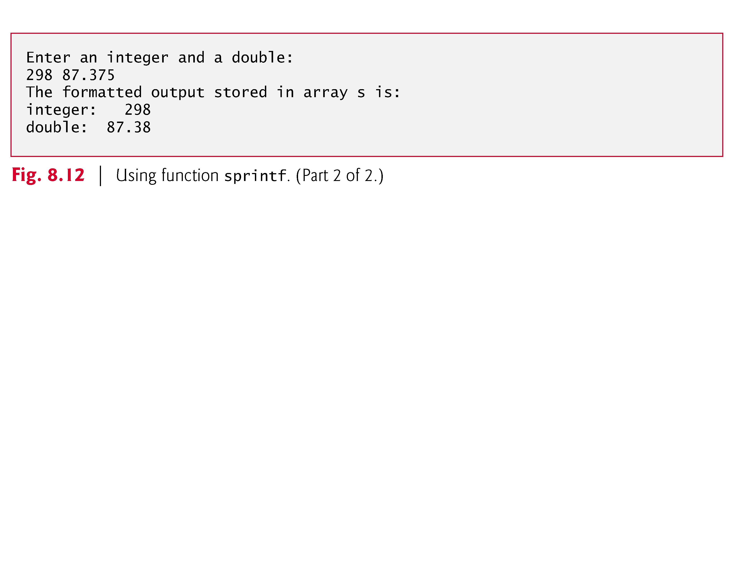

Slide 67
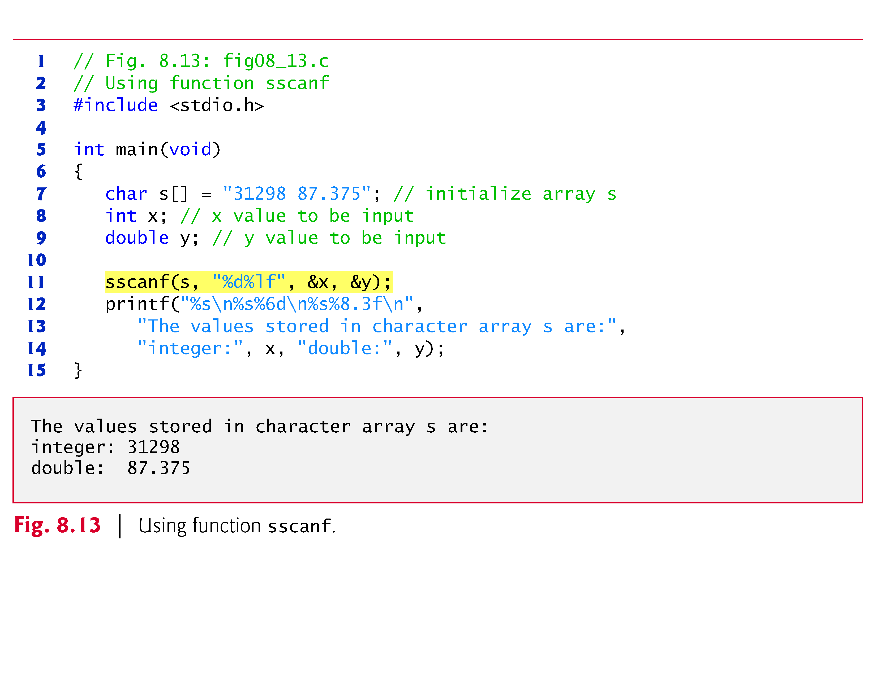

Slide 68
String Manipulation Functions of the String Handling Library
String handling library has functions to
Manipulate string data
Search strings
Tokenize strings
Determine string length

Slide 69
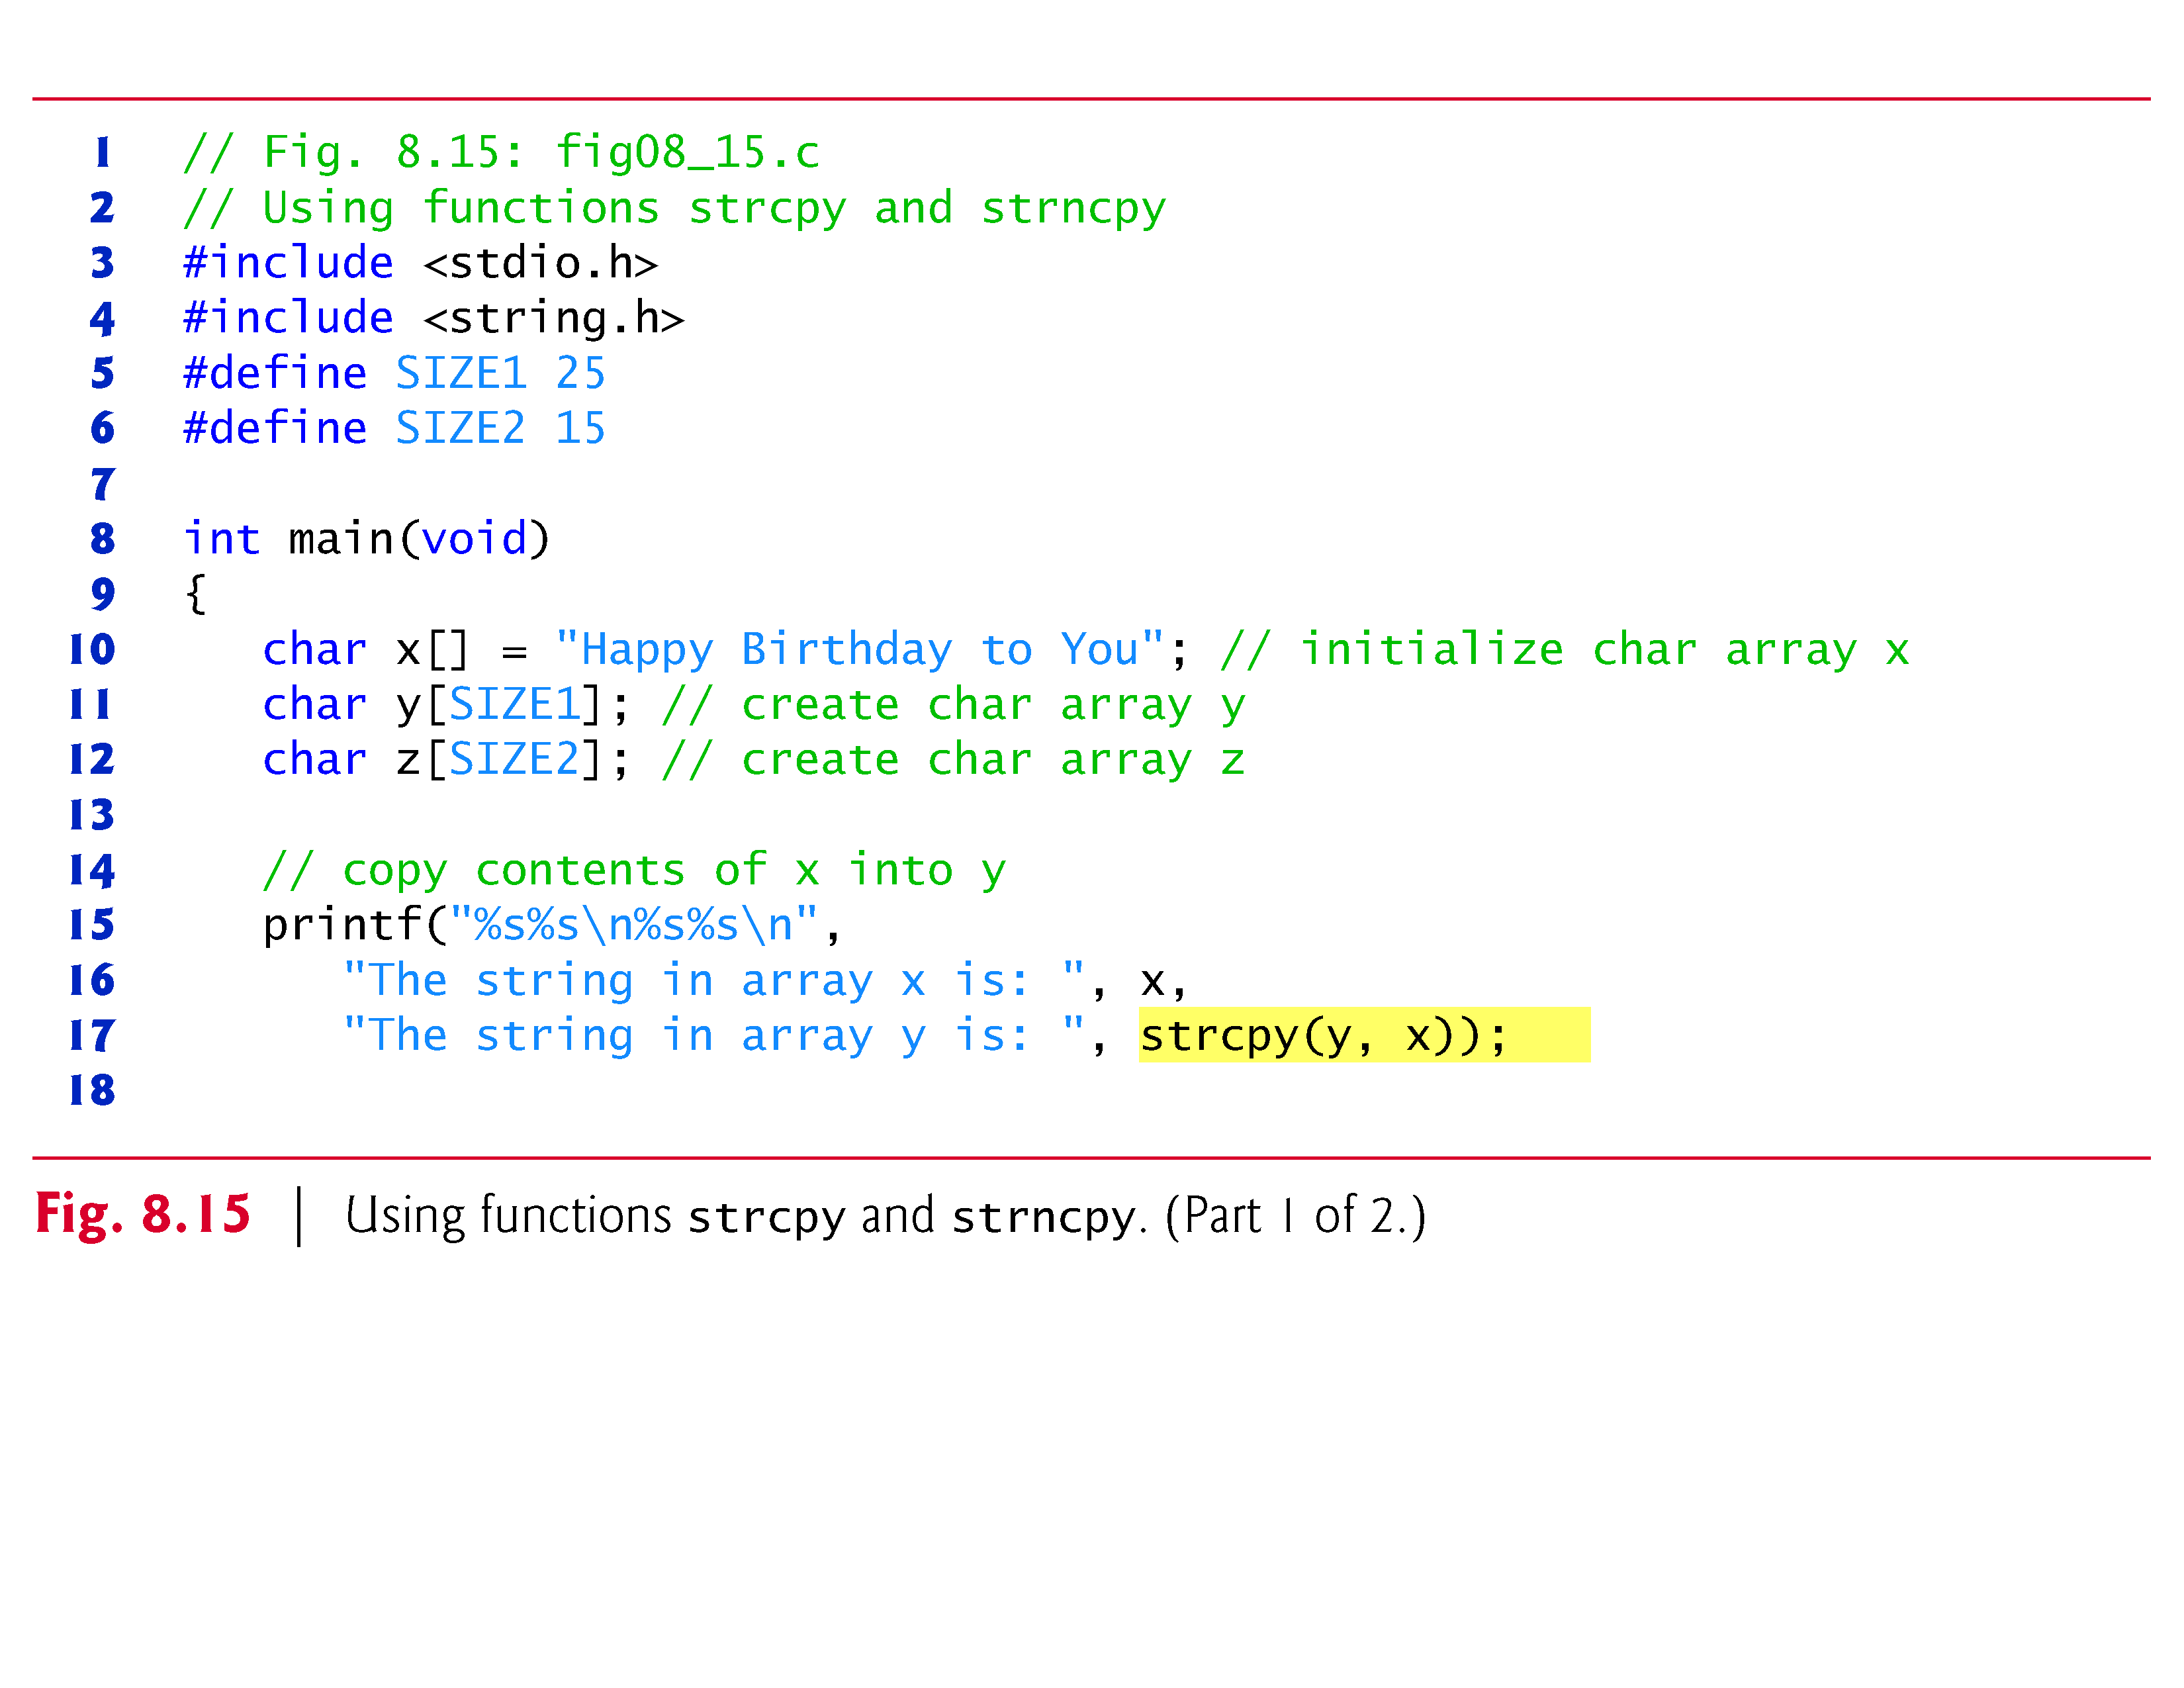

Slide 70
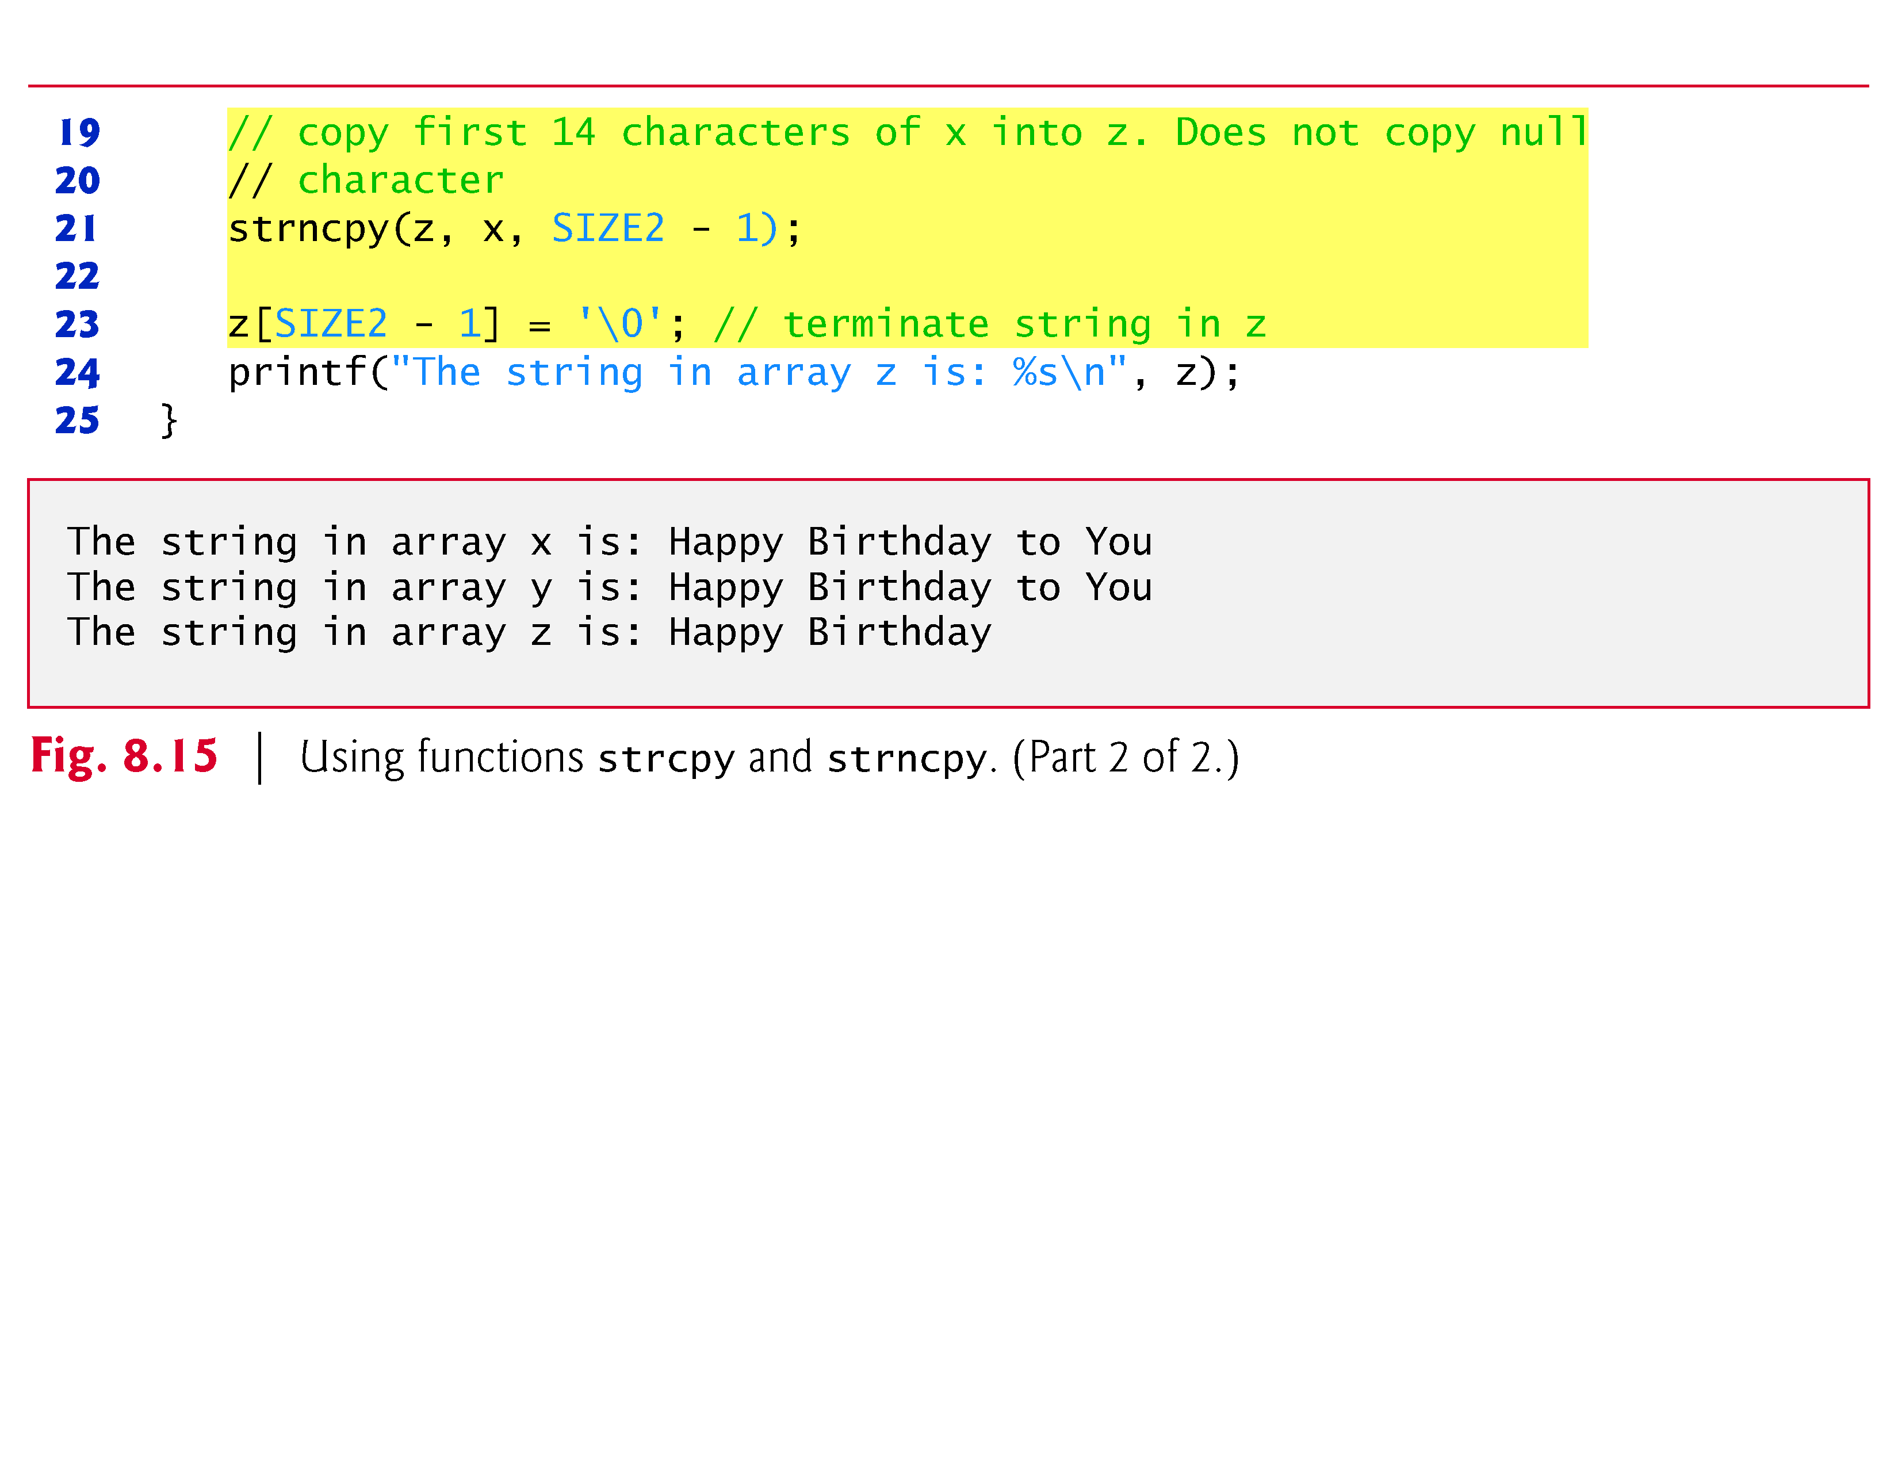

Slide 71
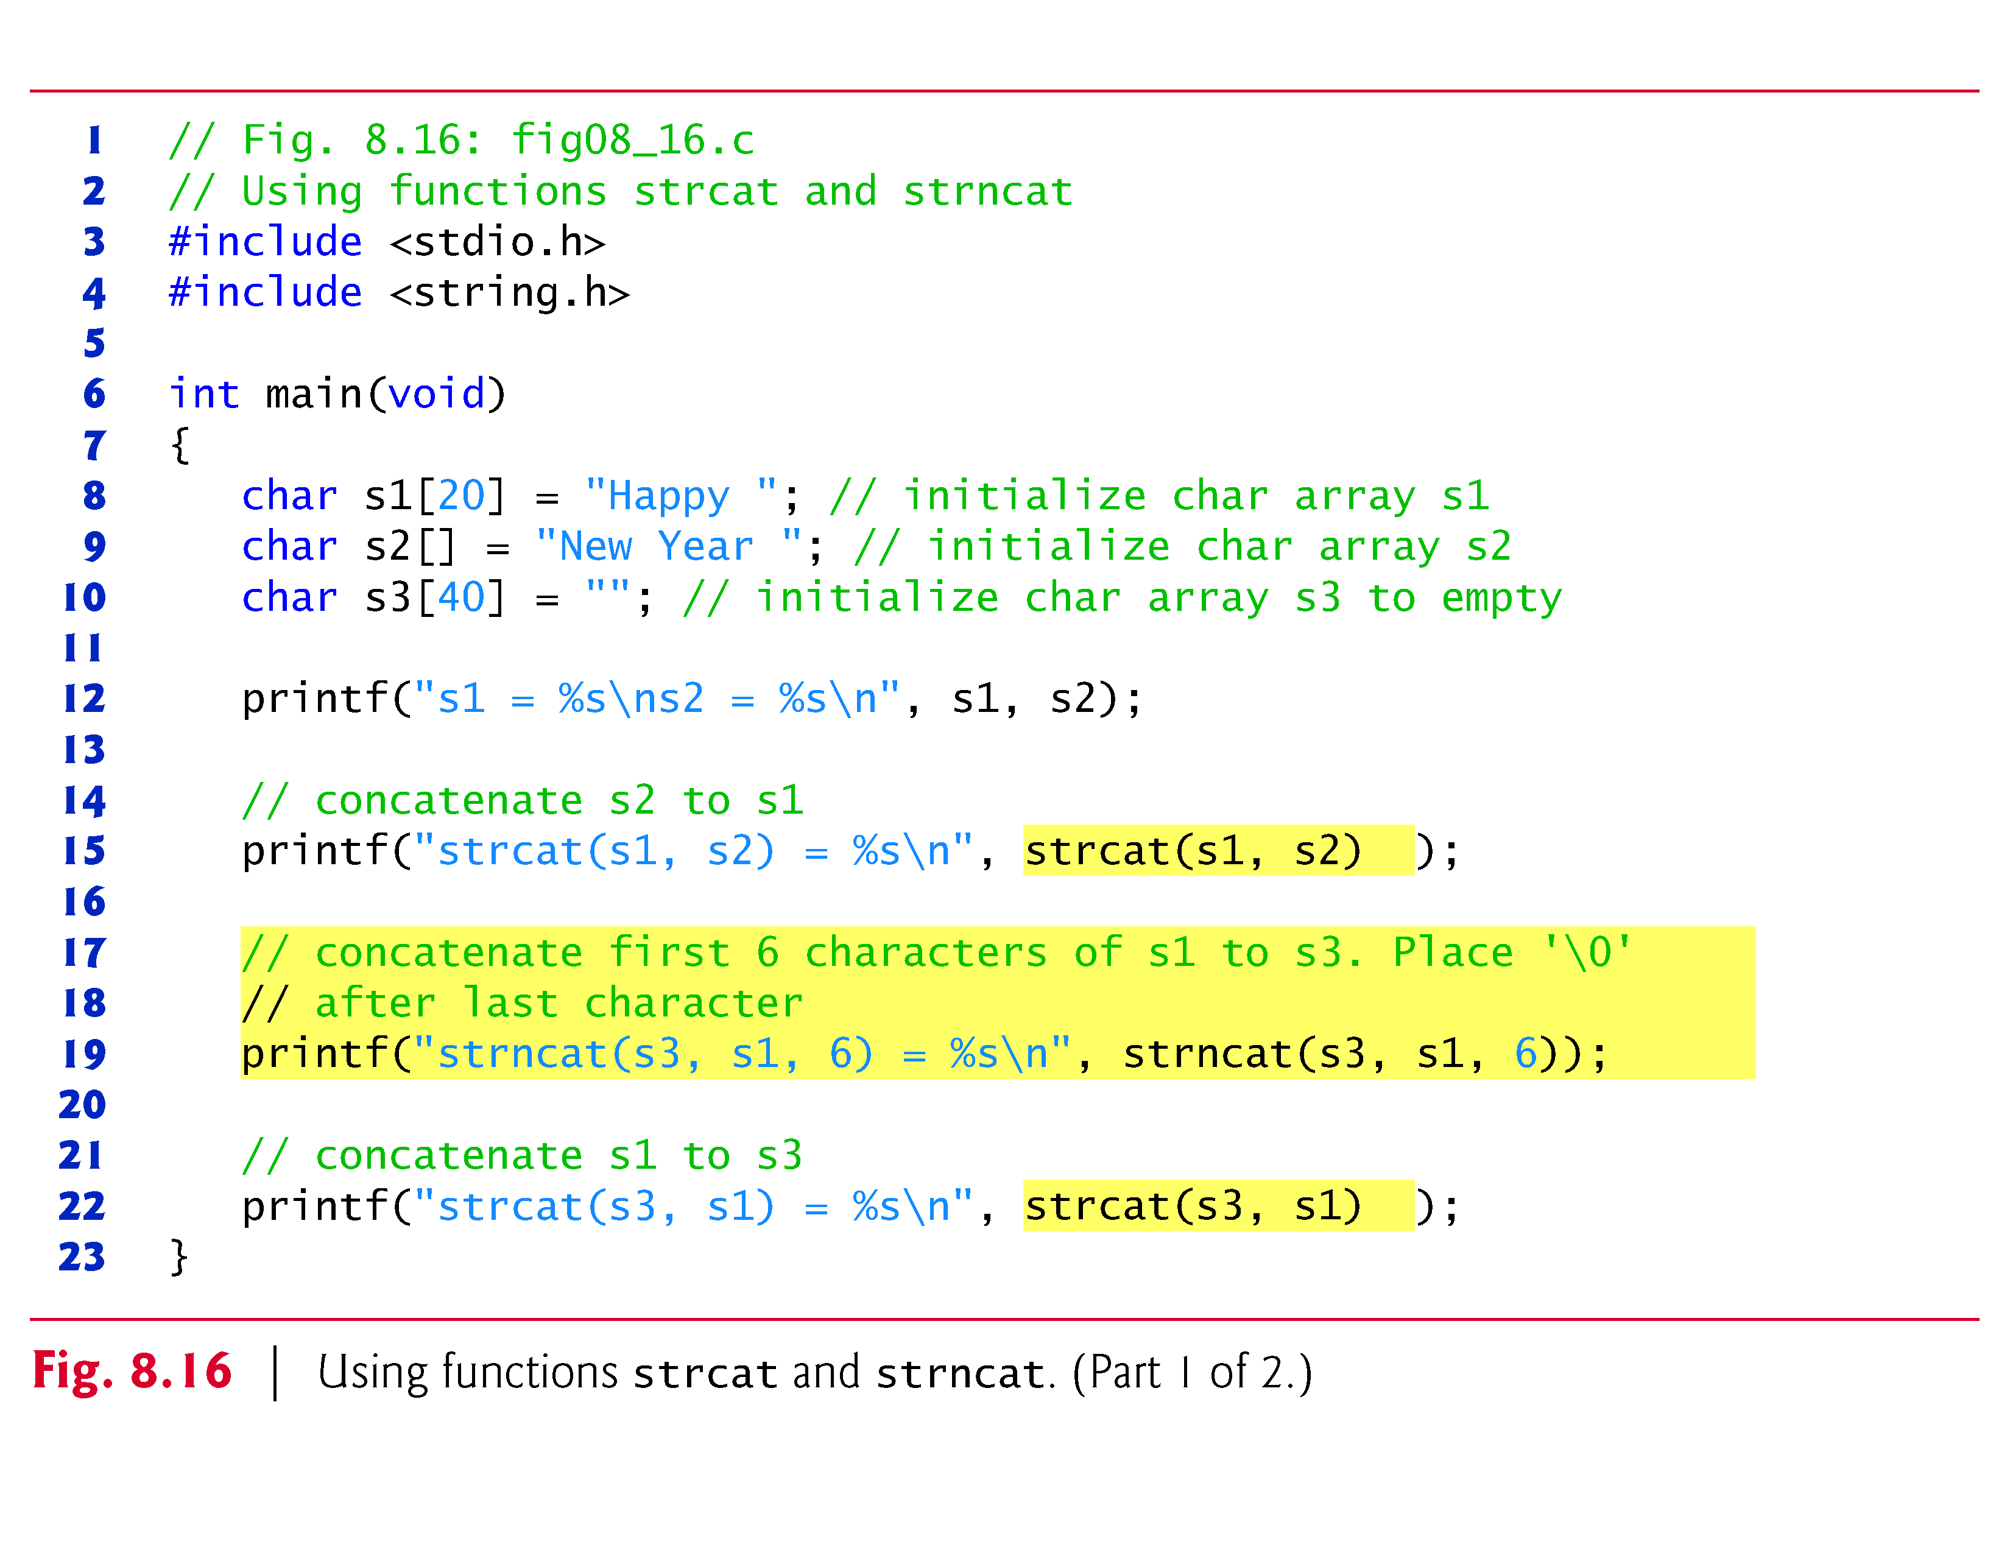
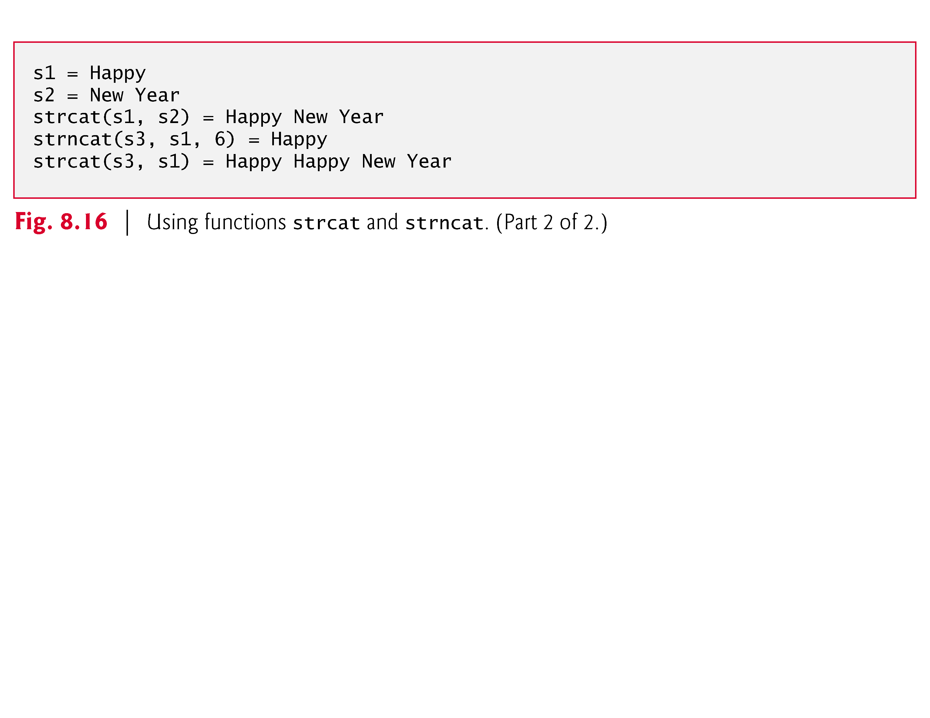

Slide 72
Comparison Functions of the String Handling Library
Comparing strings
Computer compares numeric ASCII codes of characters in string
Appendix D has a list of character codes
int strcmp( const char *s1, const char *s2 );
Compares string s1 to s2
Returns a negative number if s1 < s2, zero if s1 == s2 or a positive number if s1 > s2
int strncmp( const char *s1, const char *s2, size_t n );
Compares up to n characters of string s1 to s2
Returns values as above

Slide 73
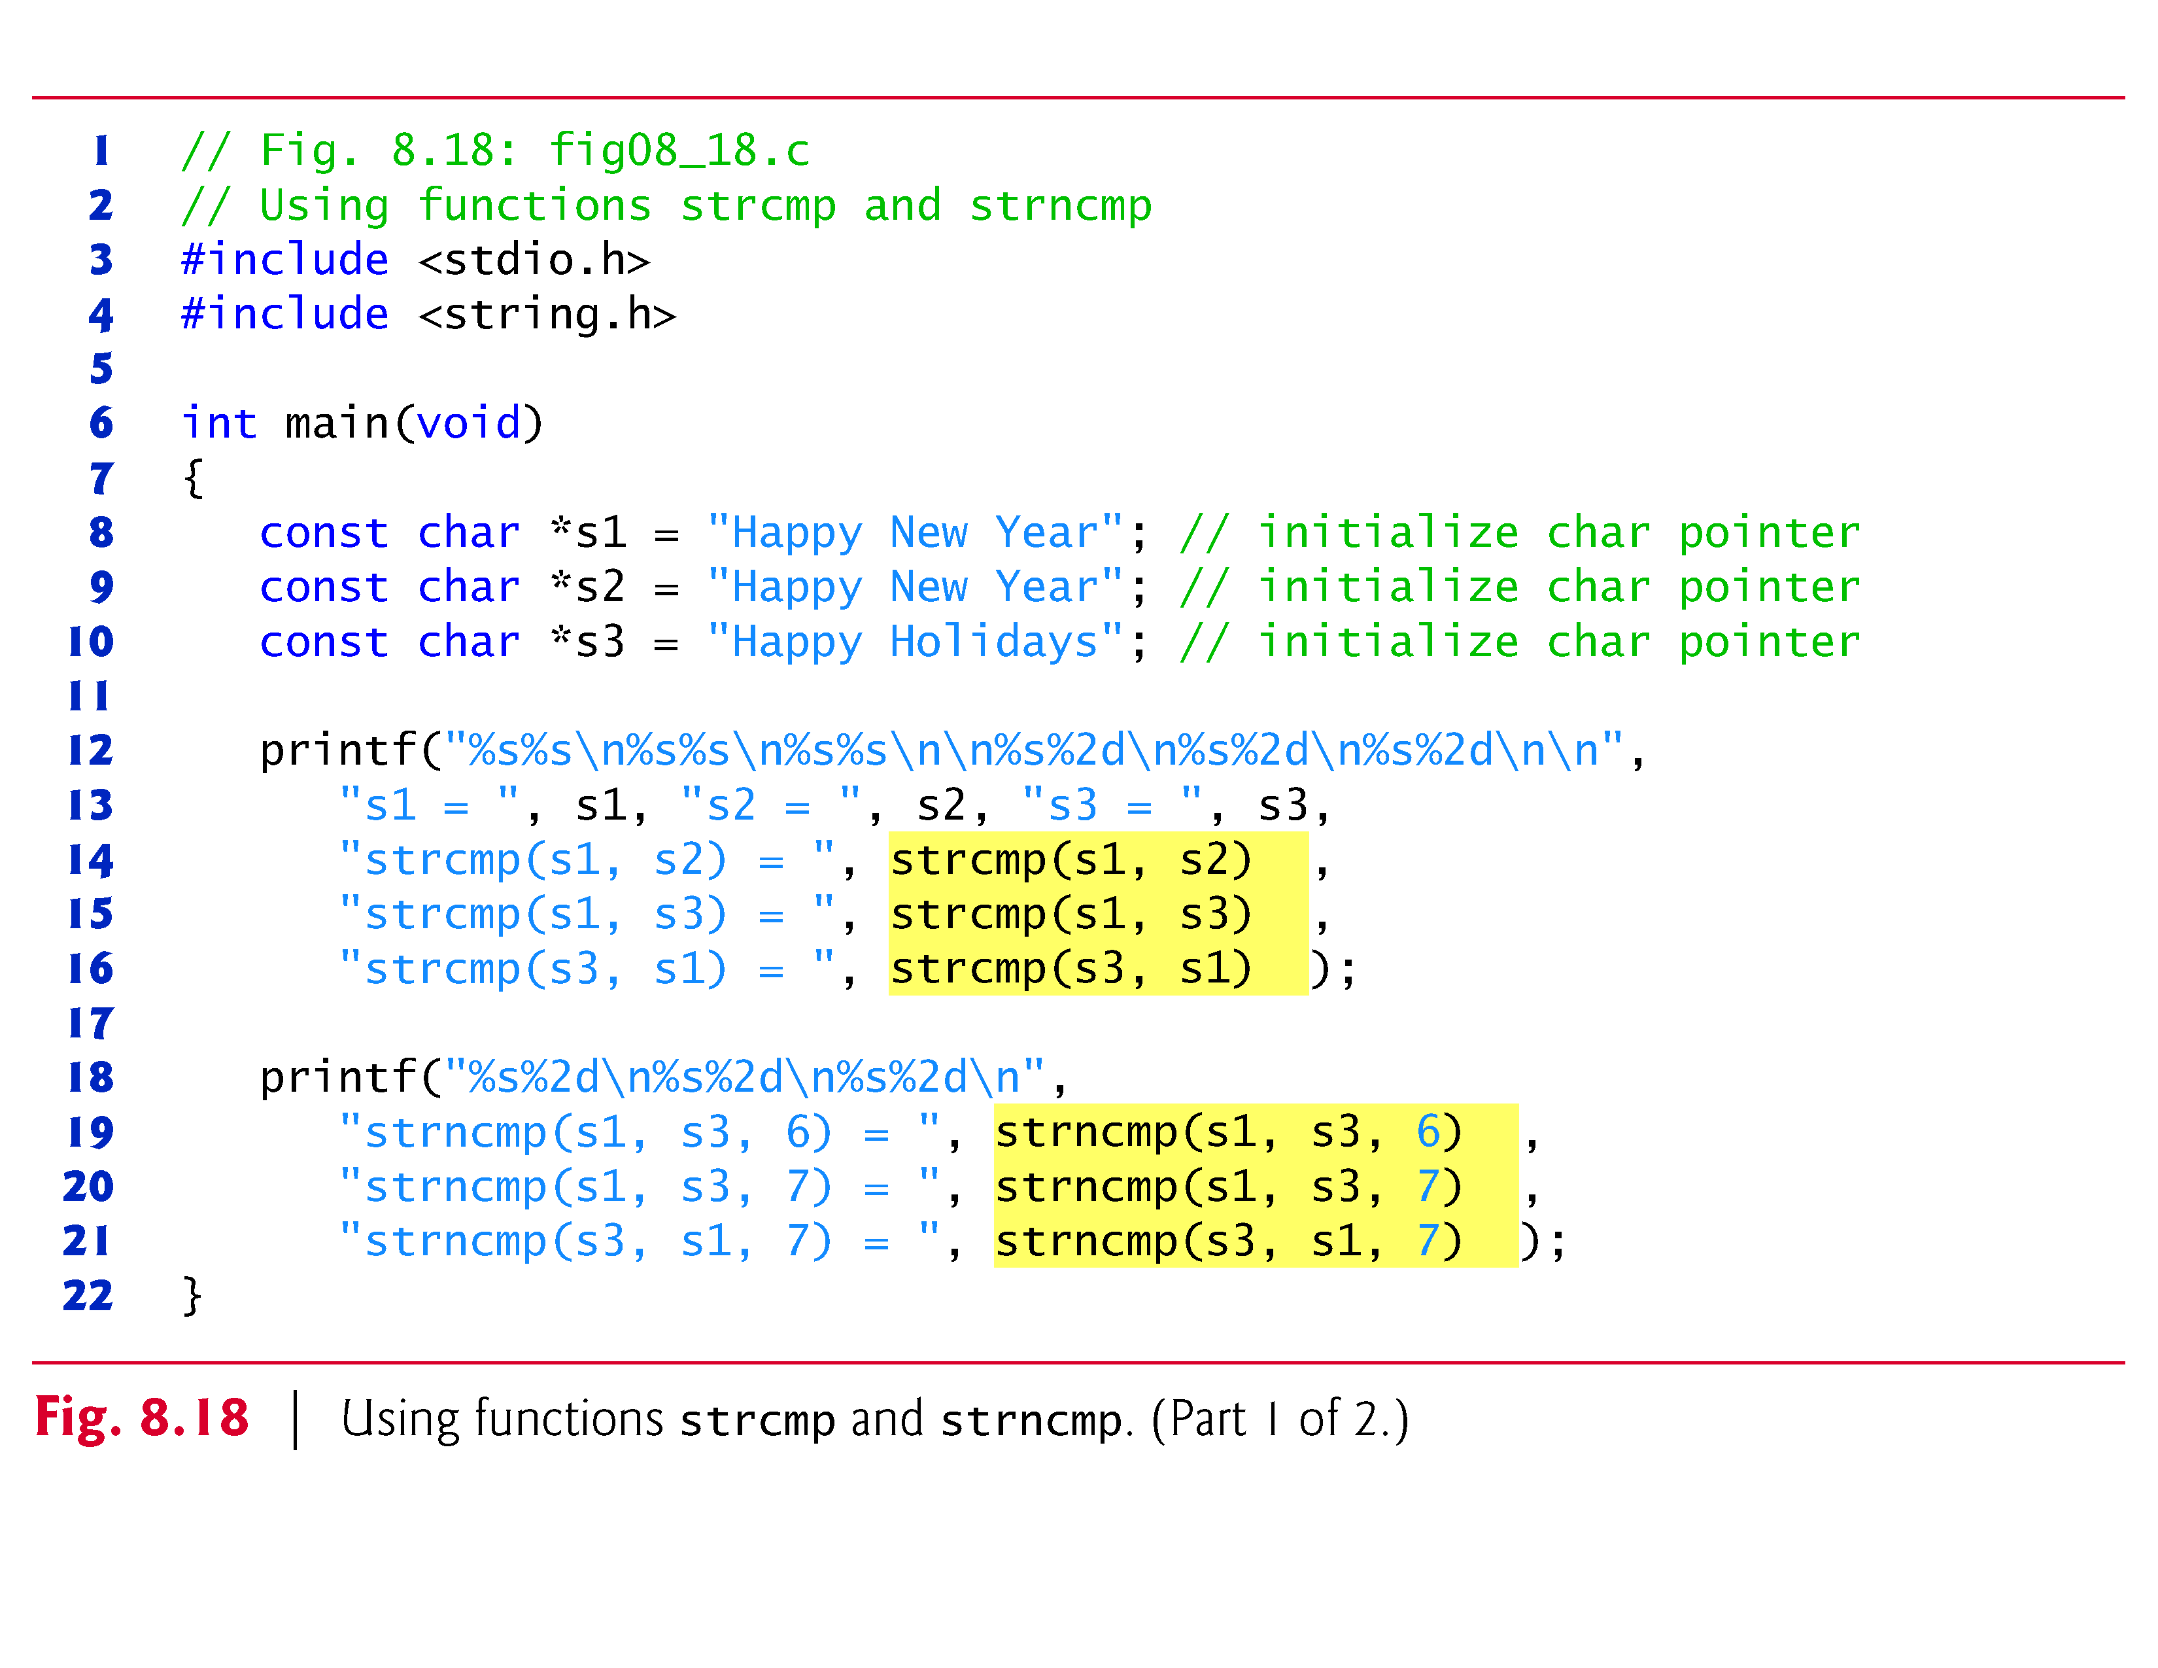
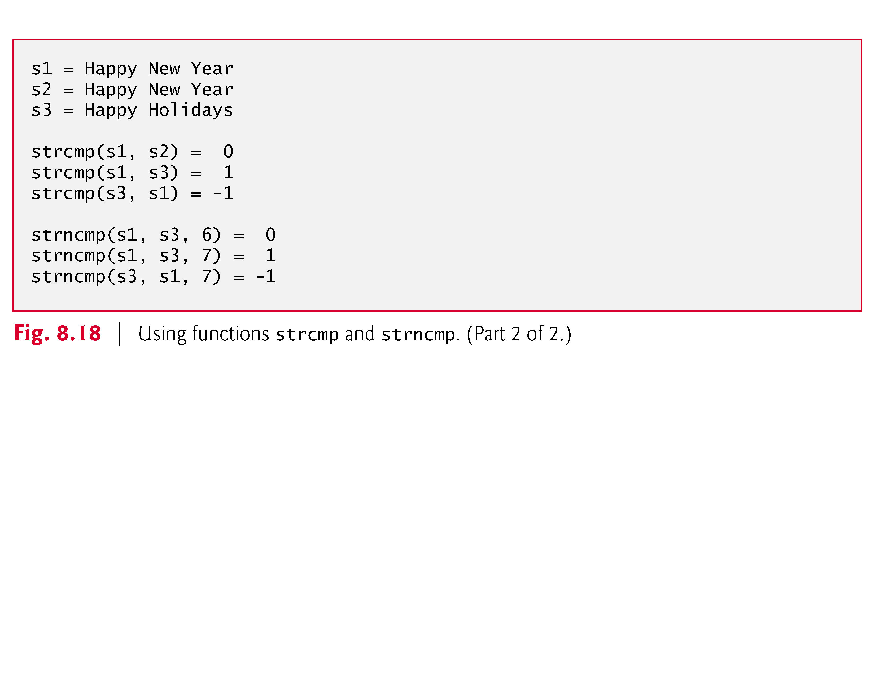

Slide 74
Search Functions of the String Handling Library

Slide 75
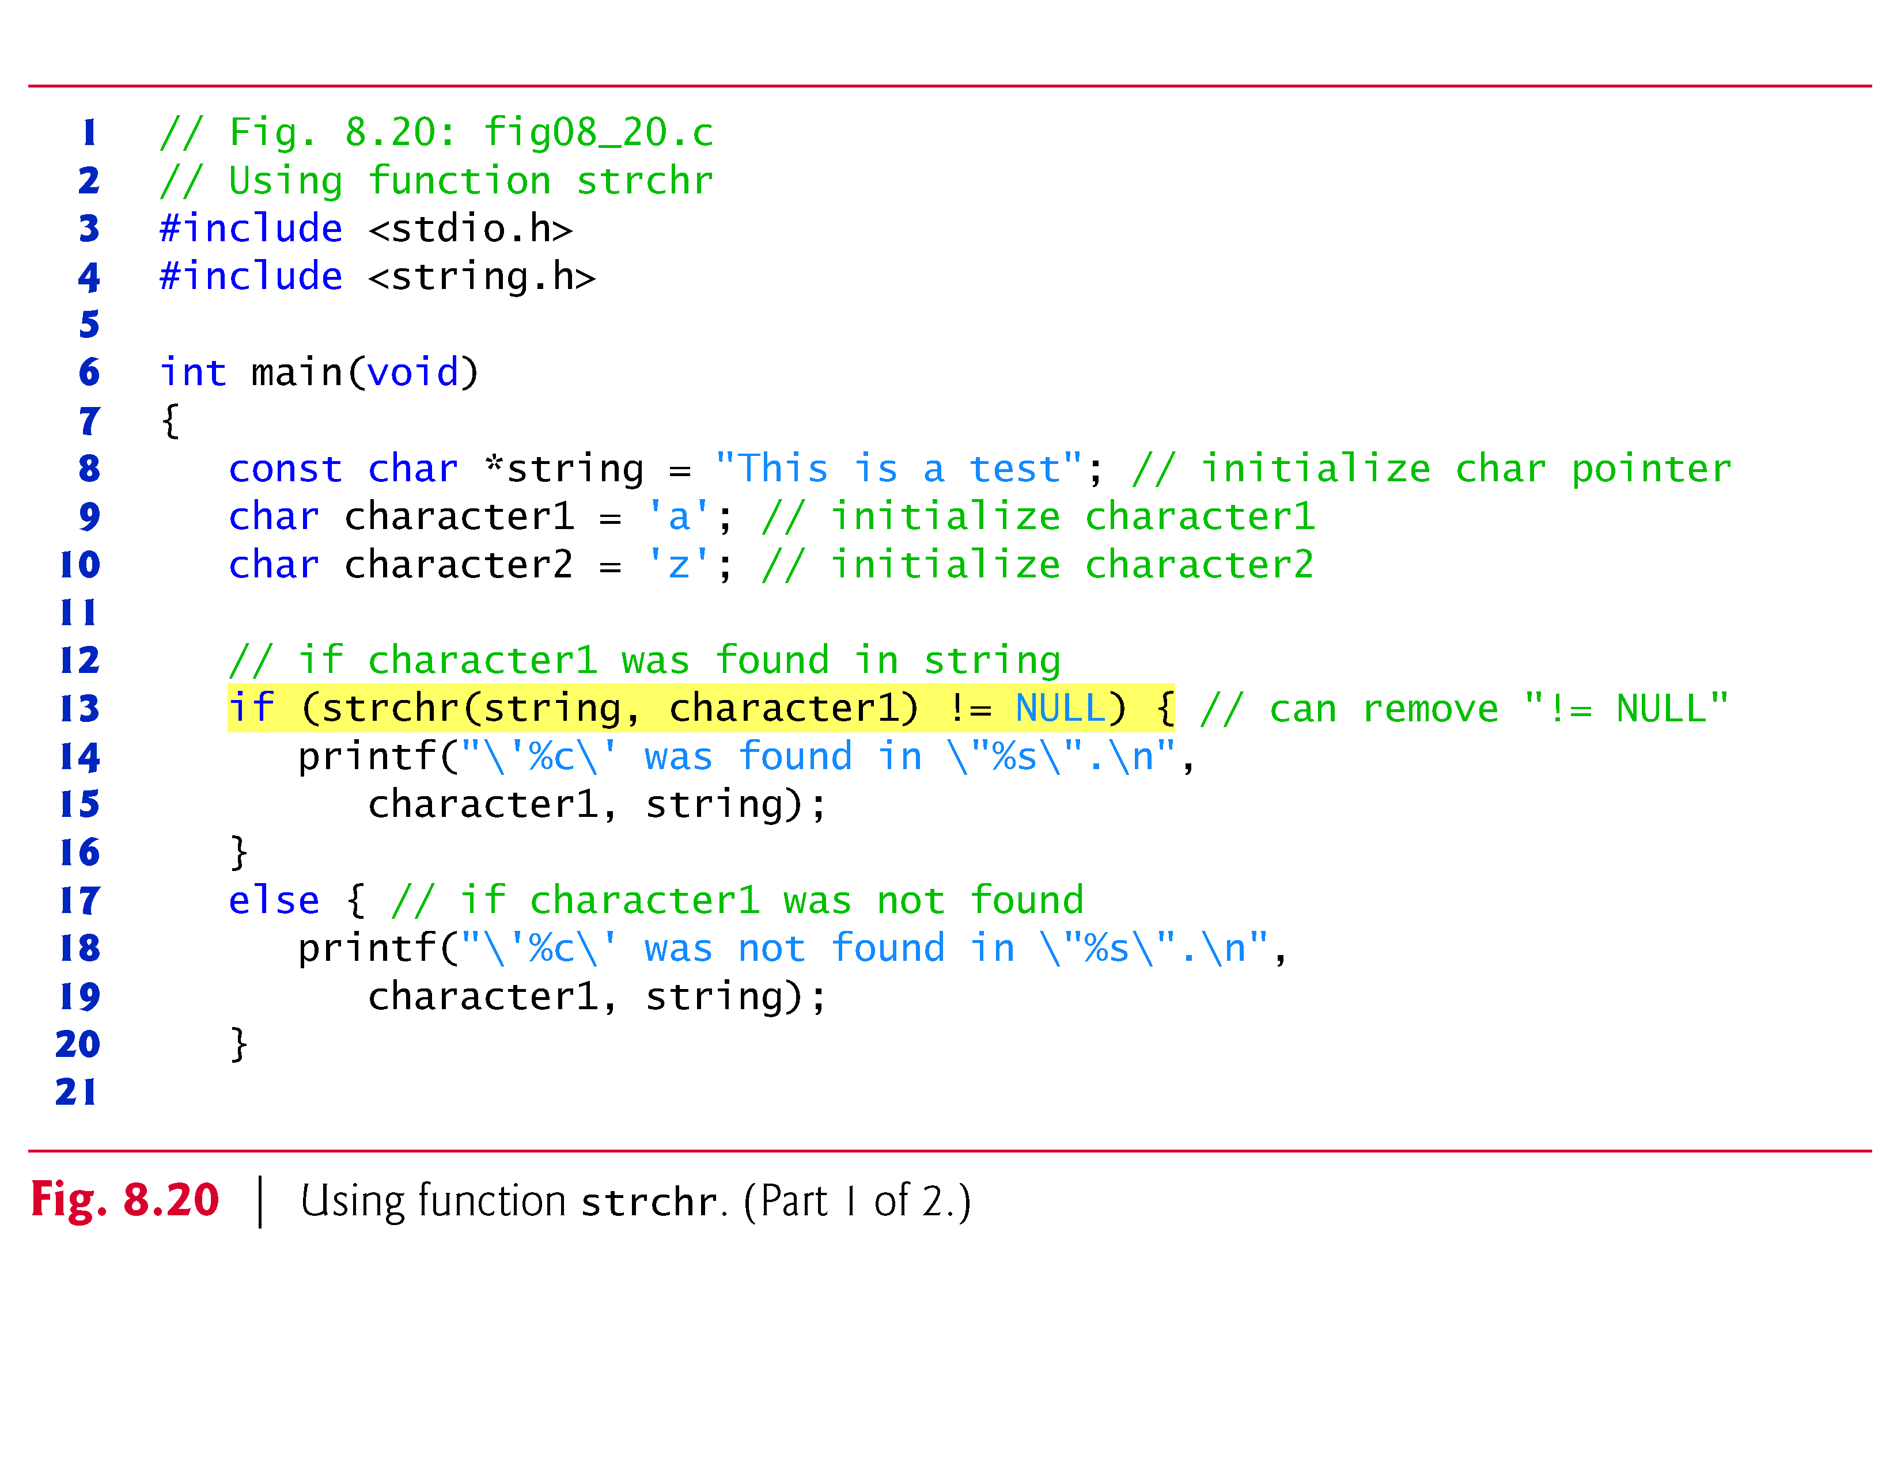

Slide 76


Slide 77


Slide 78


Slide 79


Slide 80


Slide 81


Slide 82



Slide 83
Memory Functions of the String- handling Library
Memory Functions
In <stdlib.h>
Manipulate, compare, and search blocks of memory
Can manipulate any block of data
Pointer parameters are void *
Any pointer can be assigned to void *, and vice versa
void * cannot be dereferenced
Each function receives a size argument specifying the number of bytes (characters) to process

Slide 85


Slide 86


Slide 87


Slide 88


Slide 89


Slide 90
Other Functions of the String Handling Library
char *strerror( int errornum );
Creates a system-dependent error message based on errornum
Returns a pointer to the string
size_t strlen( const char *s );
Returns the number of characters (before NULL) in string s

Slide 91


Slide 92


Slide 93
8.11 Secure C Programming
Secure String-Processing Functions
In this chapter, we presented functions sprintf, strcpy, strncpy, strcat, strncat, strtok, strlen, memcpy, memmove and memset.
More secure versions of these and many other string-processing and input/output functions are described by the C11 standard’s optional Annex K.
If your C compiler supports Annex K, you should use the secure versions of these functions.

Slide 94
8.11 Secure C Programming (Cont.)
Among other things, the more secure versions help prevent buffer overflows by requiring an additional parameter that specifies the number of elements in the target array and by ensuring that pointer arguments are non-NULL.

Slide 95
8.11 Secure C Programming (Cont.)
Reading Numeric Inputs and Input Validation
It’s important to validate the data that you input into a program.
For example, when you ask the user to enter an integer in the range 1–100 then attempt to read that integer using scanf, there are several possible problems.
The user could enter an integer that’s outside the program’s required range, an integer that’s outside the allowed range for integers on that computer, a non-integer numeric value or a non-numeric value.

Slide 96
8.11 Secure C Programming (Cont.)
You can use various functions that you learned in this chapter to fully validate such input. For example, you could
use fgets to read the input as a line of text
convert the string to a number using strtol and ensure that the conversion was successful, then
ensure that the value is in range.
For more information and techniques for converting input to numeric values, see CERT guideline INT05-C at www.securecoding.cert.org.

